Slide 1
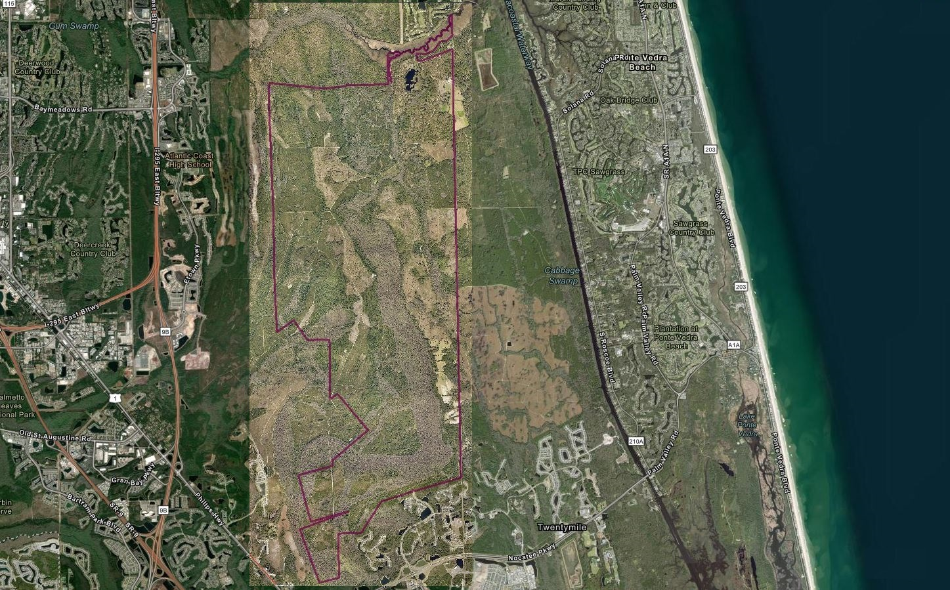
Land Use Amendments
L-5861-23A Ordinance 2023-649
L-5849-23C Ordinance 2023-654
Waterways Commission
October 12, 2023

Slide 2
L-5861-23A Land Use Amendment
Transmittal Ordinance
Ordinance Number 2023-649
Public Hearing Dates
Planning Commission – Thursday, October 19, 2023 City Councils First Hearing – Tuesday, October 24, 2023
City Council LUZ Committee – Tuesday, November 7 2023
Final City Council Hearing – Tuesday, November 14, 2023

Slide 3


L-5861-23A (2023-649)
Location
0 JTB Blvd., 0 San Pablo Rd., 6586 San Pablo Rd. S., 0 Coconut Palm Pky., 4950 20 Mile Rd. N., 0 Rosewater Rd., 0 and 14931 Philips Hwy, and 0 Kiwi Palm Court
Size
Subject Site:
11,047.38 Acres
Wetlands: (GIS)
7,160.45 Acres
Current Land Use
Agriculture (AGR)
Sub-Drainage Basins
Pablo Creek *
Big Davis Creek
Powers Bay
Durbin Creek
Box Branch *
Drainage Basins
Intracoastal Waterway *
Julington Creek
* Direct Impacts
Proposed Land Use
Multi-Use(MU) with Site Specific Policy (SSP) 4.3.23

Slide 4
L-5861-23A Development Standards (2023-649)
Current Development Standard: LDR
Proposed Development
Standard: CGC
AGR – Single family dwelling unit / 2.5 Acres
MU with Site Specific Policy (SSP) 4.3.23

Slide 5
L-5861-23A Development Potentials (2023-649)
Current Development Potential: AGR
Proposed Development
Potential: MU with Site Specific Policy (SSP) 4.3.23
4,418 Single family dwelling units
1,707,500 Sq. Ft. CGC Uses,
8,636 Single Family Dwelling Units
4,884 To Multi-Family Dwelling Units (Total Dwelling Units 13,520)

Slide 6

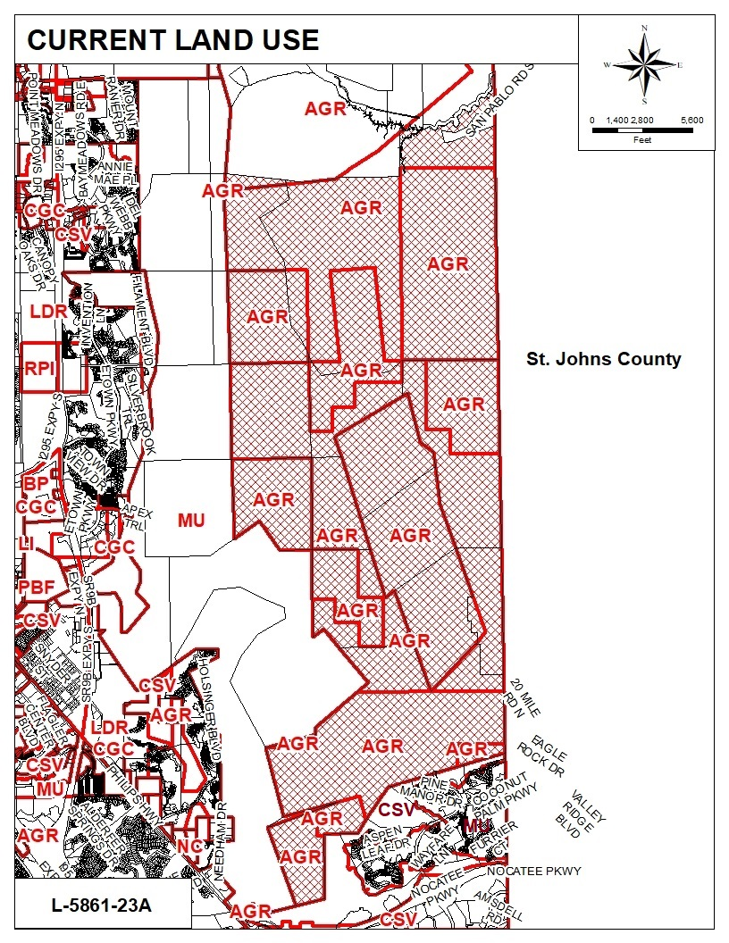
THE TEAM
Land Use Amendment L-5861-23A
Ordinance 2023-649
Current Land Use Map
Site Land Use
Agriculture (AGR)
Surrounding Land Uses
Agriculture (AGR), Mixed Use (MU), and Conservation (CSV)
Land Use Amendment L-5861-23A is proposing a Land Use Change from AGR to MU with SSP 4.3.23
L-5644-21C

Slide 7
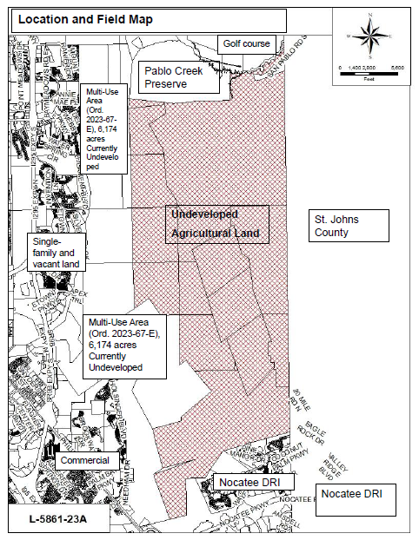
Land Use Amendment L-5861-23A
Ordinance 2023-649
Land Utilization Map

Slide 8
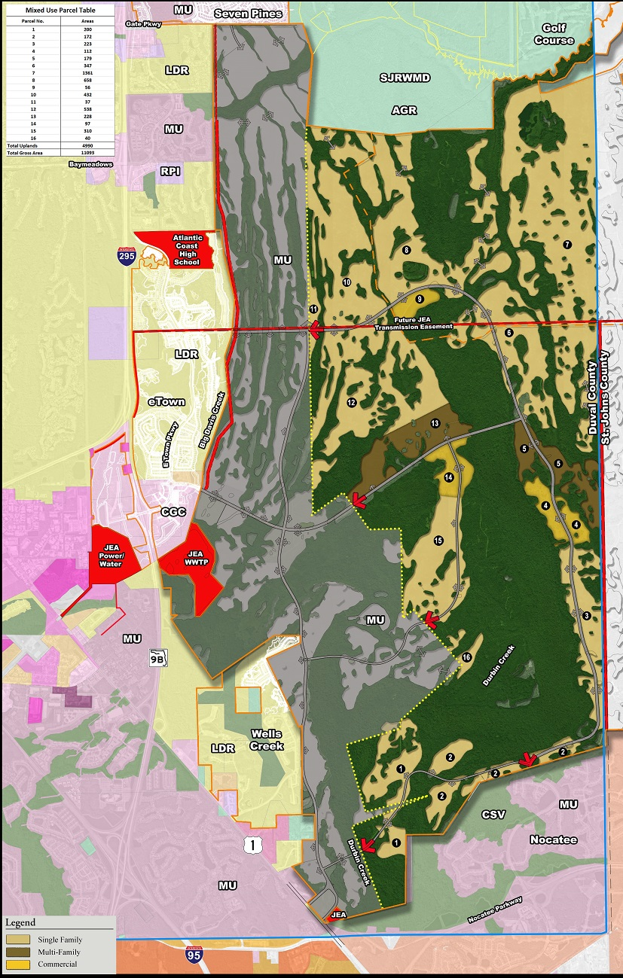

Land Use Amendment L-5861-23A
Ordinance 2023-649
Non-Binding Preliminary Development Plan

Slide 9
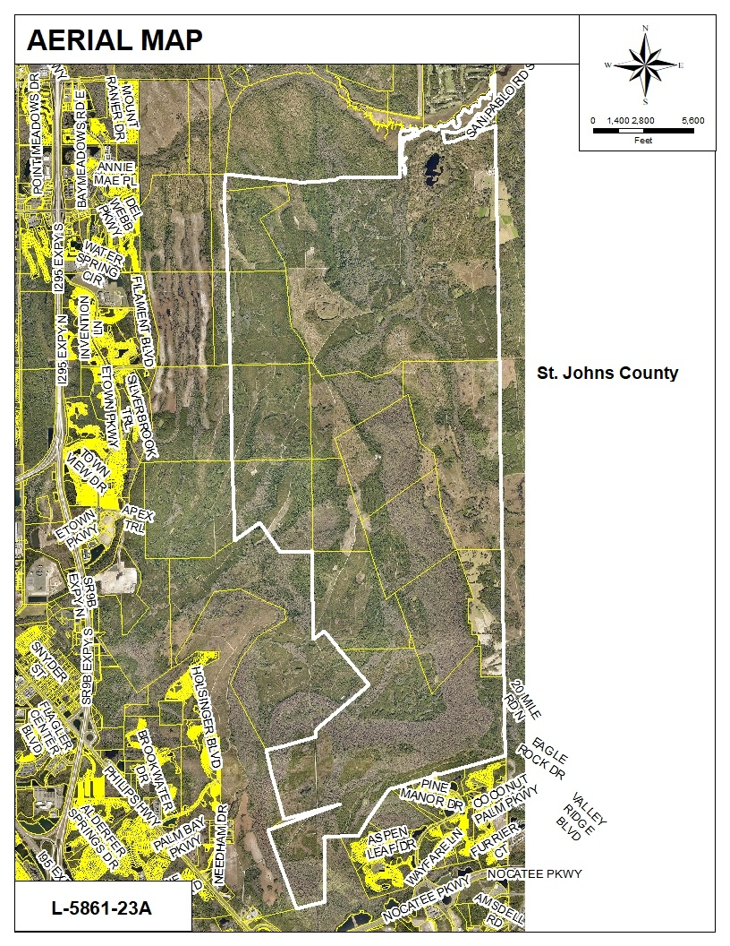
Land Use Amendment
L-5861-23A
Ordinance 2023-649
Aerial Map

Slide 10
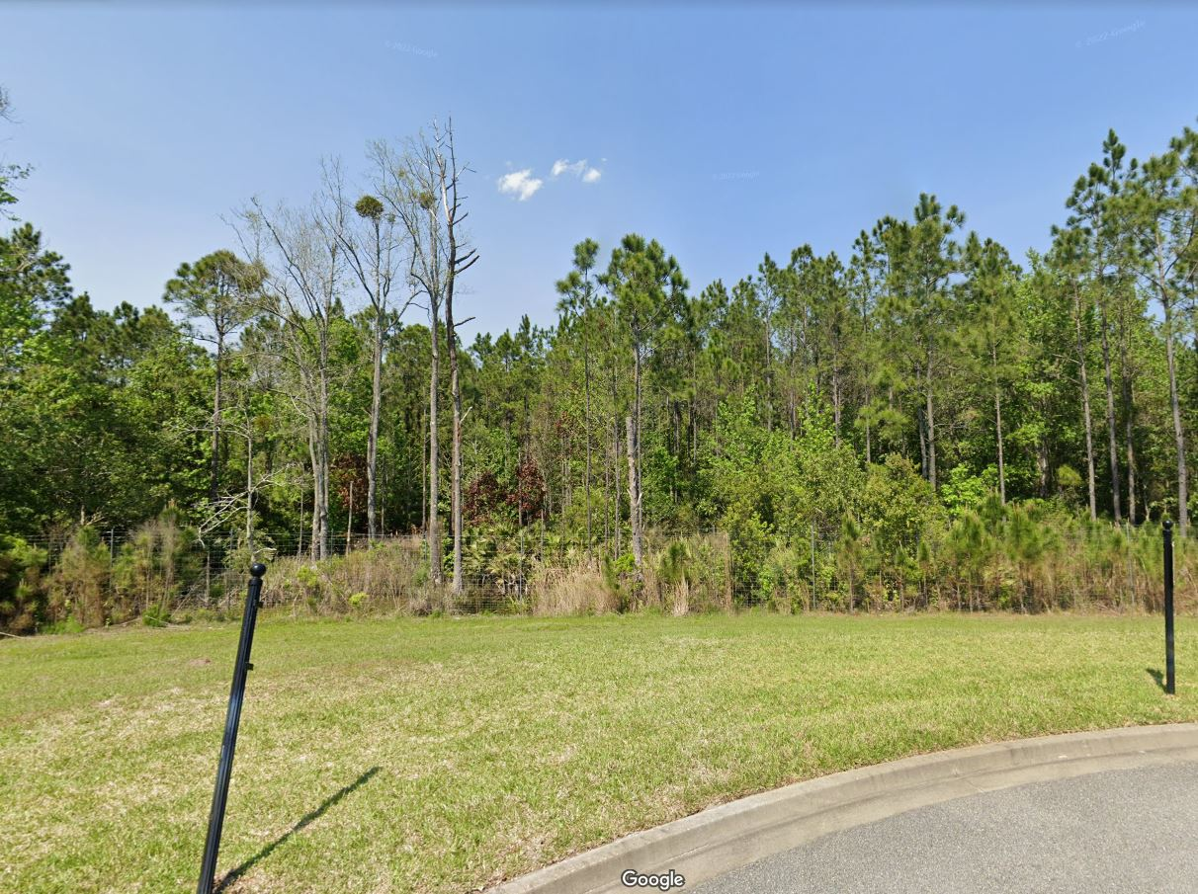
Land Use Amendment
L-5861-23A
Ordinance 2023-649
Northerly view from Timberland Forest Drive

Slide 11
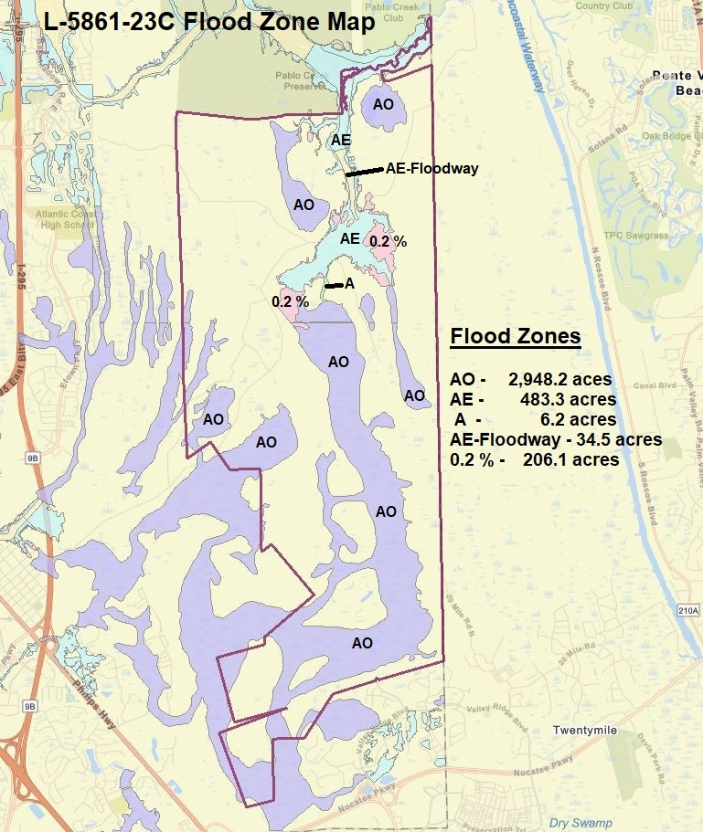
L-5861-23A Flood Zone Map
Land Use Amendment
L-5861-23A
Ordinance 2023-649
Flood Zones Map

Slide 12
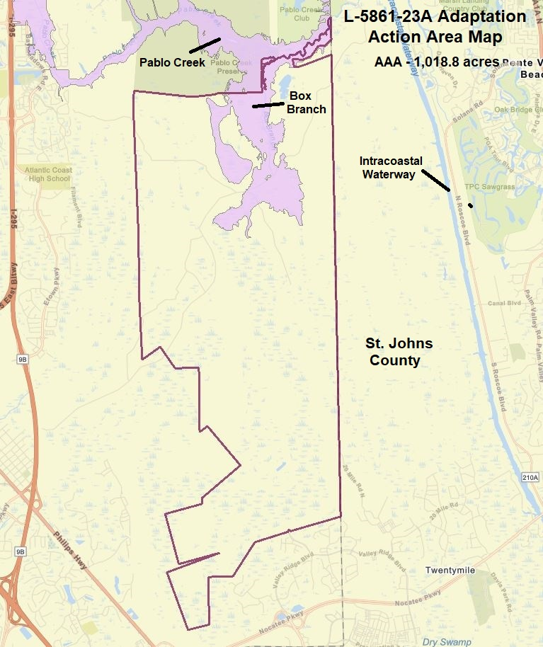
Land Use Amendment
L-5861-23A
Ordinance 2023-649
Adaptation Action Area Map

Slide 13
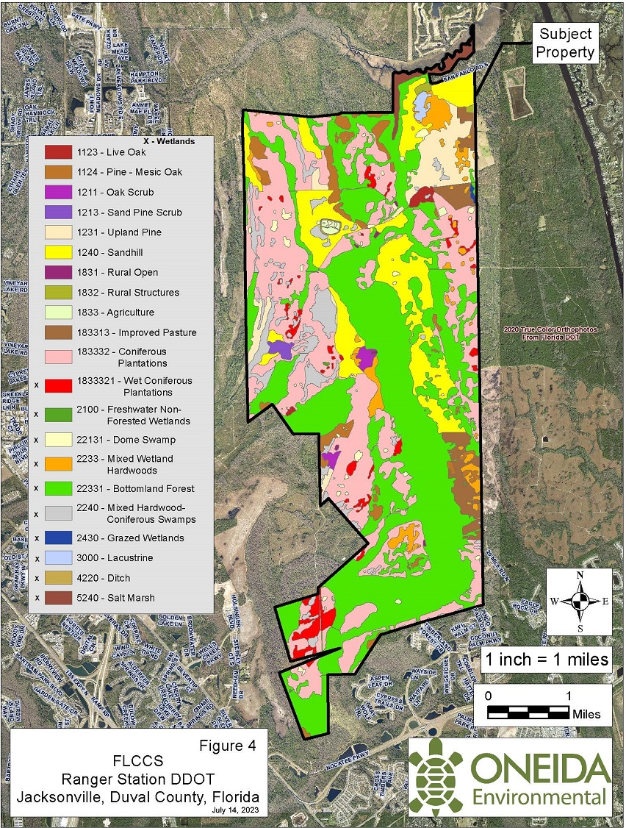
Land Use Amendment
L-5861-23A
Ordinance 2023-649
Florida Land Cover Classification System Map

Slide 14
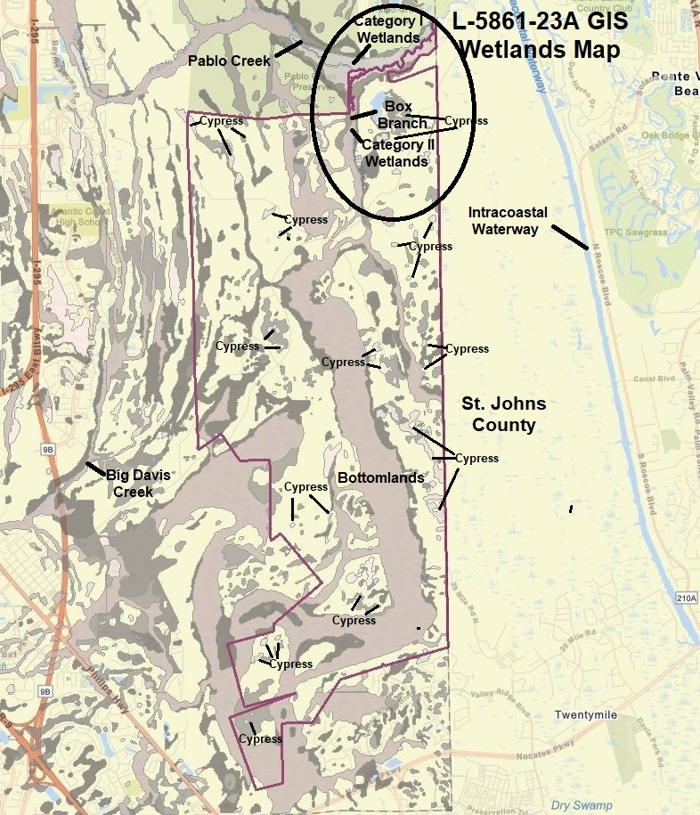
Land Use Amendment
L-5861-23A
Ordinance 2023-649
Wetlands Map
Total Wetland Acreage 7,160.45 acres
Category I –
66,00 acres
Category II – 177.60 acres
Category III – 6,916.85 acres

Slide 15
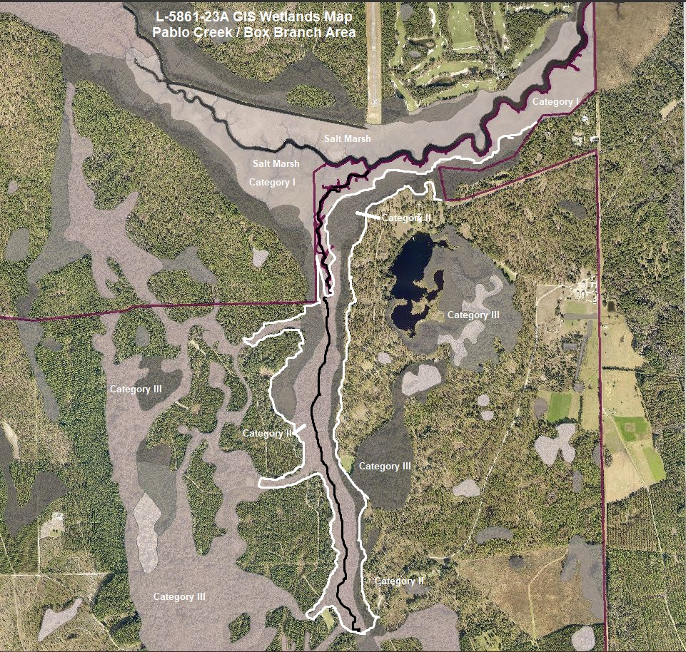
Land Use Amendment
L-5861-23A
Ordinance 2023-649
Wetlands Map
Total Wetland Acreage 7,160.45 acres
Category I –
66,00 acres
Category II – 177.60 acres
Category III – 6,916.85 acres

Slide 16
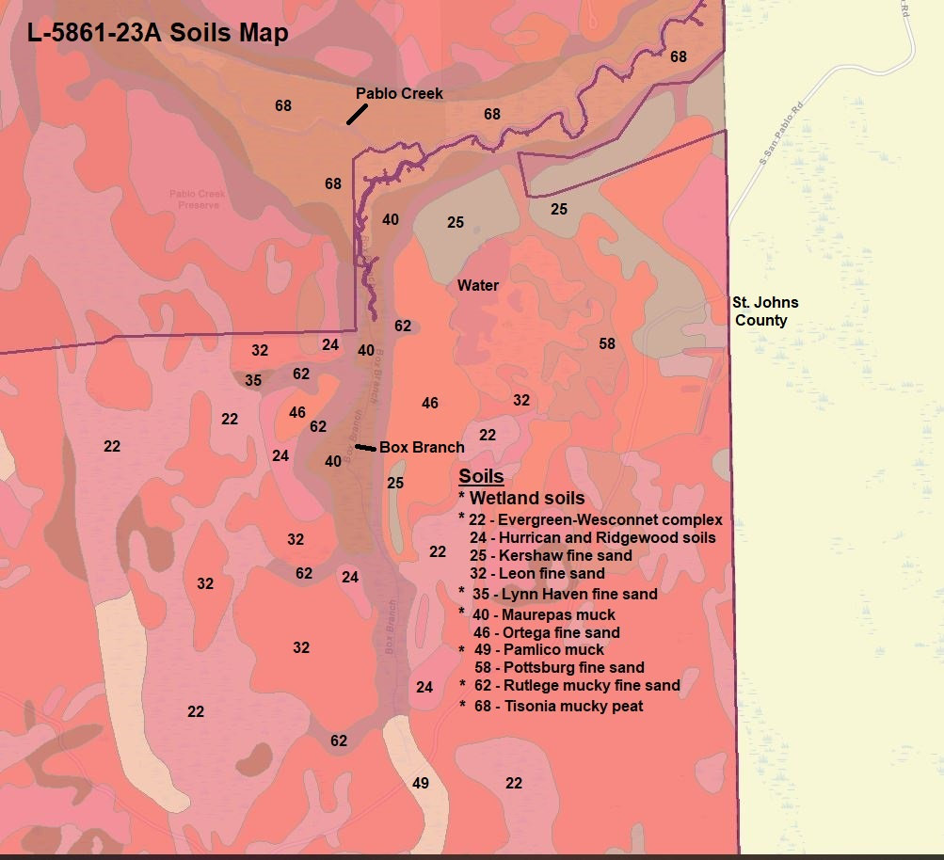
Land Use Amendment
L-5861-23A
Ordinance 2023-649
Soils Map

Slide 17
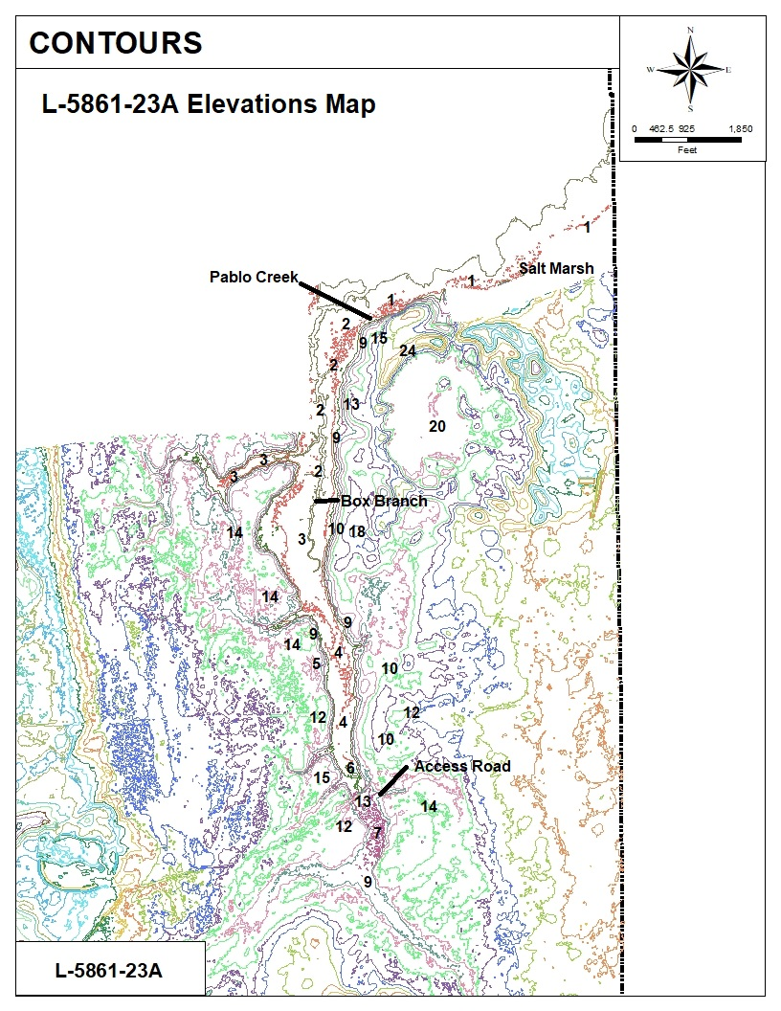
Land Use Amendment
L-5861-23A
Ordinance 2023-649
Elevations Map

Slide 18
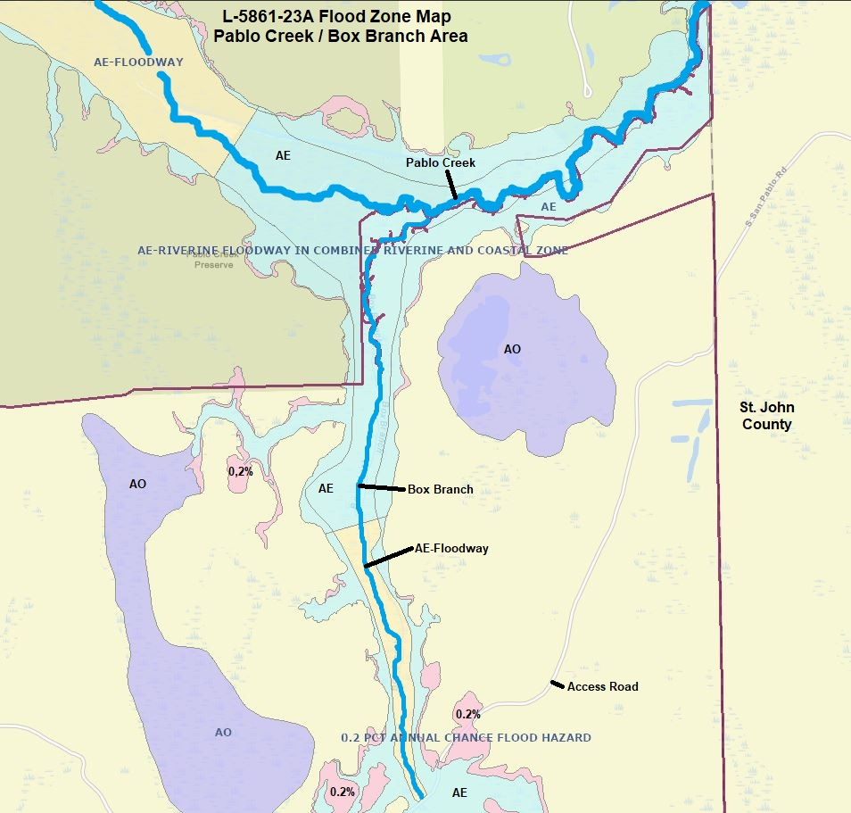
Land Use Amendment
L-5861-23A
Ordinance 2023-649
Flood Zones Map
Pablo Creek
And
Box Branch

Slide 19
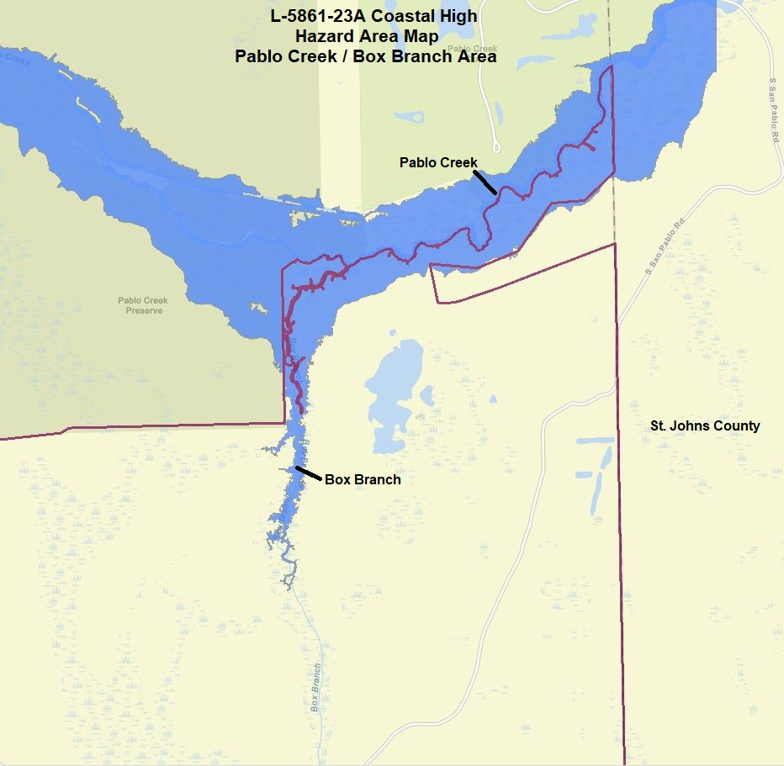
Land Use Amendment
L-5861-23A
Ordinance 2023-649
Coastal High Hazard Area Map
Pablo Creek
And
Box Branch

Slide 20
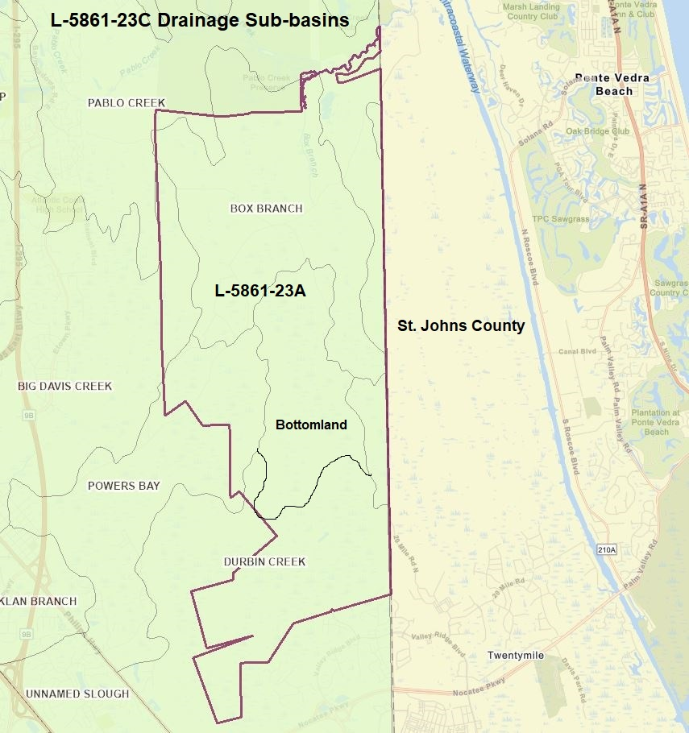
L-5861-23A Drainage Sub-basins
Land Use Amendment
L-5861-23A
Ordinance 2023-649
Sub-Drainage Basins Map

Slide 21
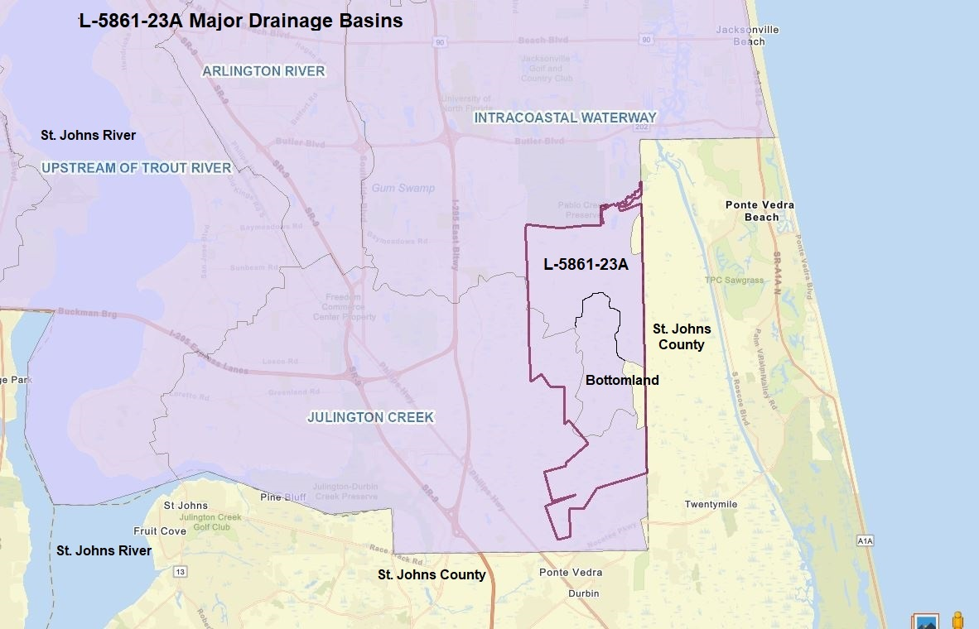
Land Use Amendment
L-5861-23A
Ordinance 2023-649
Drainage Basins Map

Slide 22
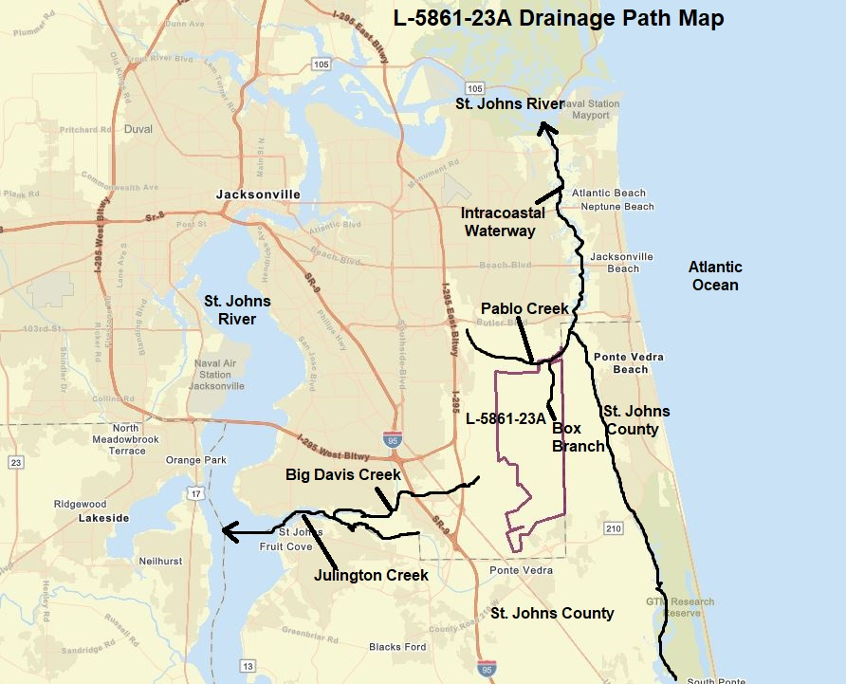
Land Use Amendment
L-5861-23A
Ordinance 2023-649
Drainage Path Map
Application Site
Box Branch
Pablo Creek
Intracoastal Waterway
St. Johns River

Slide 23
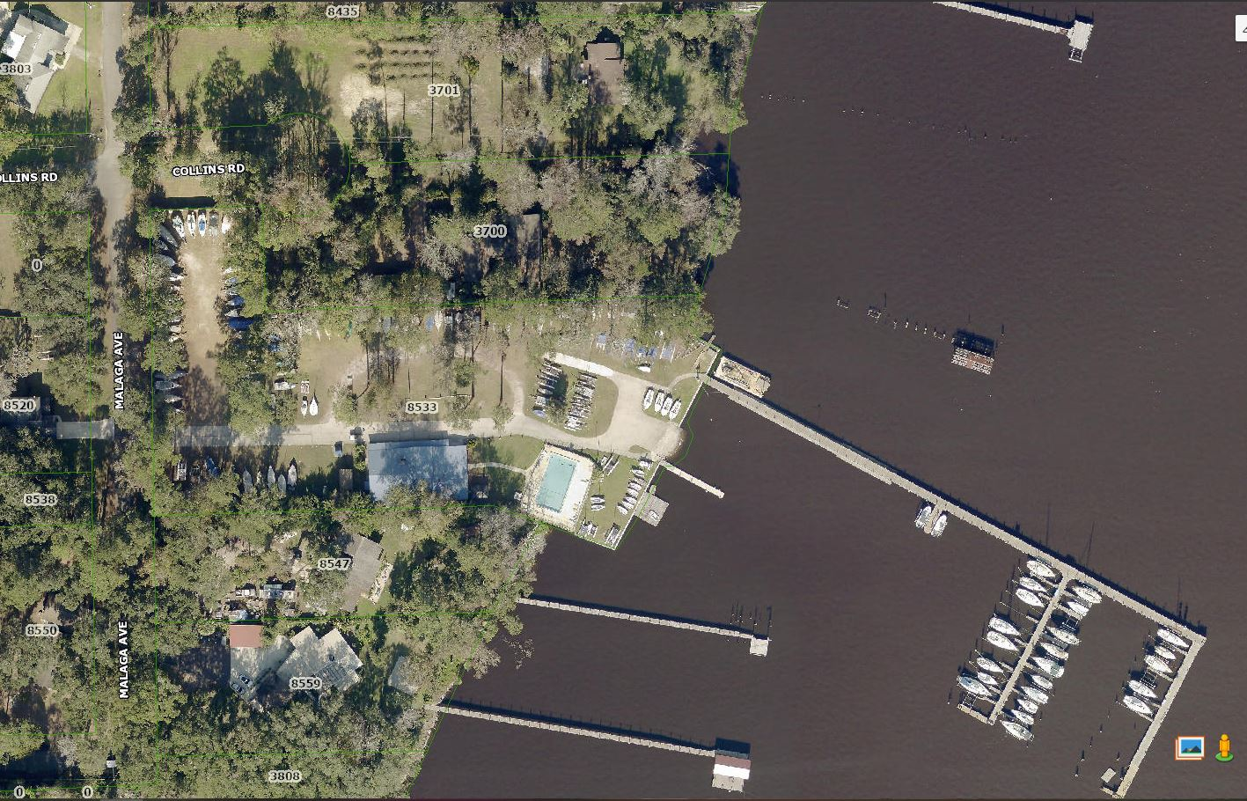
L-5849-23C Land Use Amendment
Adoption Ordinance
Ordinance Number 2023-654
Public Hearing Dates
Planning Commission – Thursday, October 19, 2023
City Councils First Hearing – Tuesday, October 24, 2023
City Council LUZ Committee – Wednesday, November 7, 2023
Final City Council Hearing – Tuesday, November 14, 2023

Slide 24
L-5849-23C (2023-654)
Location
8533 Malaga Avenue and 3700 Collins Rd.
PD-4 and CD-14
Size
Subject Site: 3.94 Acres
Wetlands: None
Current Land Use
Low Density Residential (LDR)
Sub-Drainage Basin
St. Johns River
Drainage Basin
St. Johns River
Proposed Land Use
Recreation Open Space (ROS)

Slide 25
L-5849-23C Development Potentials (2023-654)
Proposed Development
Potential: ROS
Current Development Potential: LDR
5 Dwelling Units per Acres (LDR)
19 Single-family Dwelling Units
0.15 FAR (ROS)
25,743.96 square feet

Slide 26
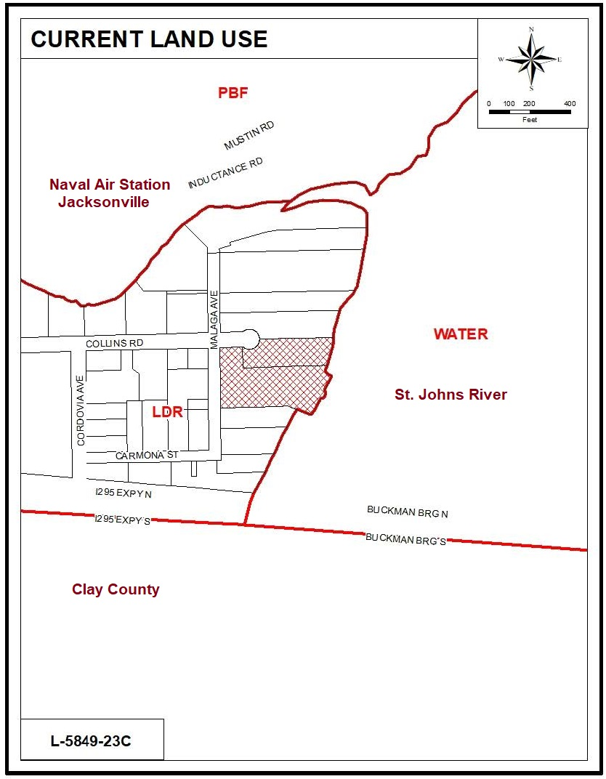
Land Use Amendment L-5849-23C
Ordinance 2023-654
Current Land Use Map
Site Land Use
Low Density Residential (LDR)
Surrounding Land Use
Low Density Residential (LDR) and Water
Land Use Amendment L-5849-23C is proposing a Land Use Change from LDR to ROS

Slide 27
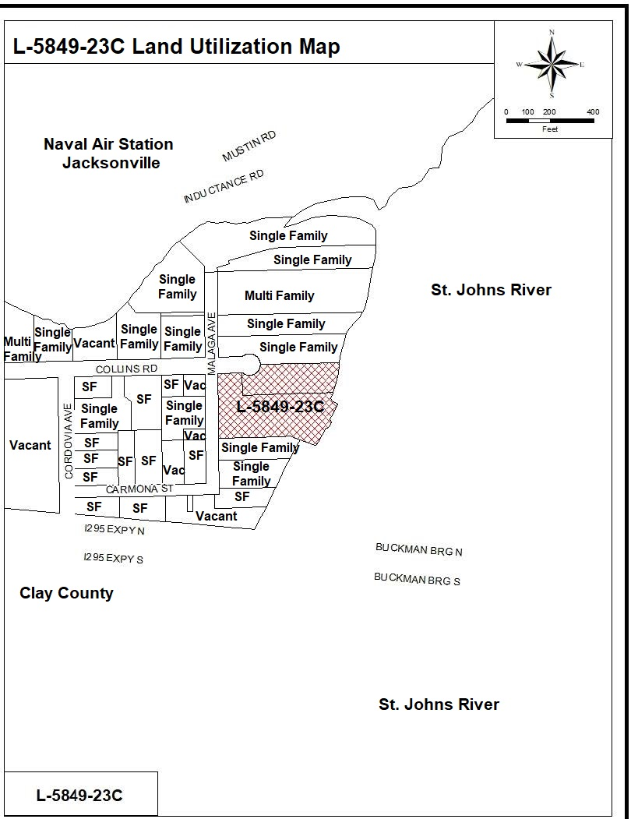
Land Use Amendment L-5849-23C
Ordinance 2023-654
Land Utilization Map

Slide 28
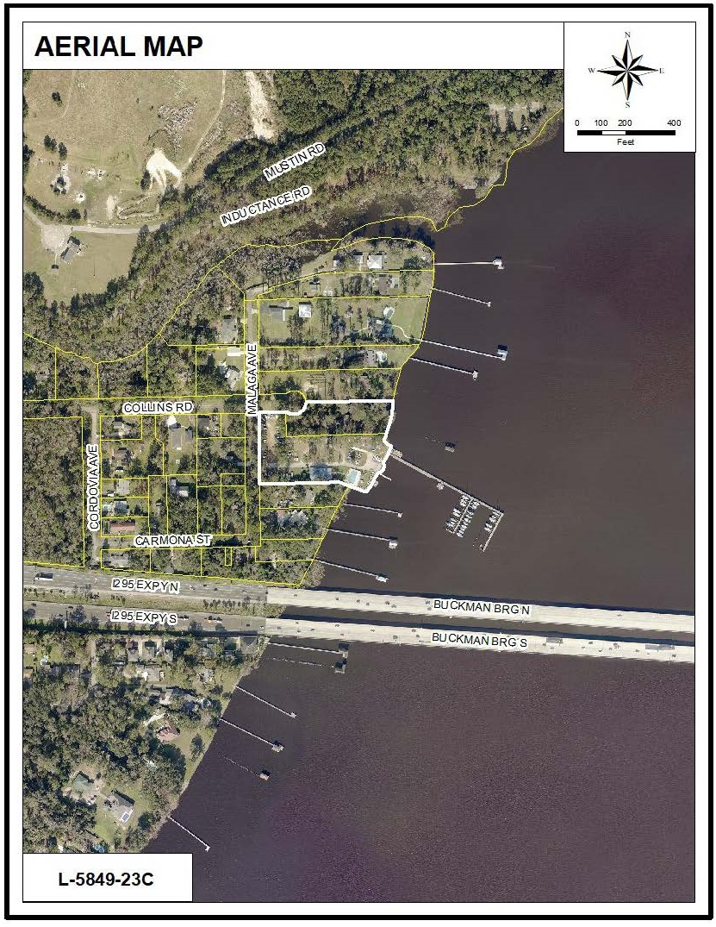
Land Use Amendment
L-5849-23C
Ordinance 2023-654
Aerial Map

Slide 29
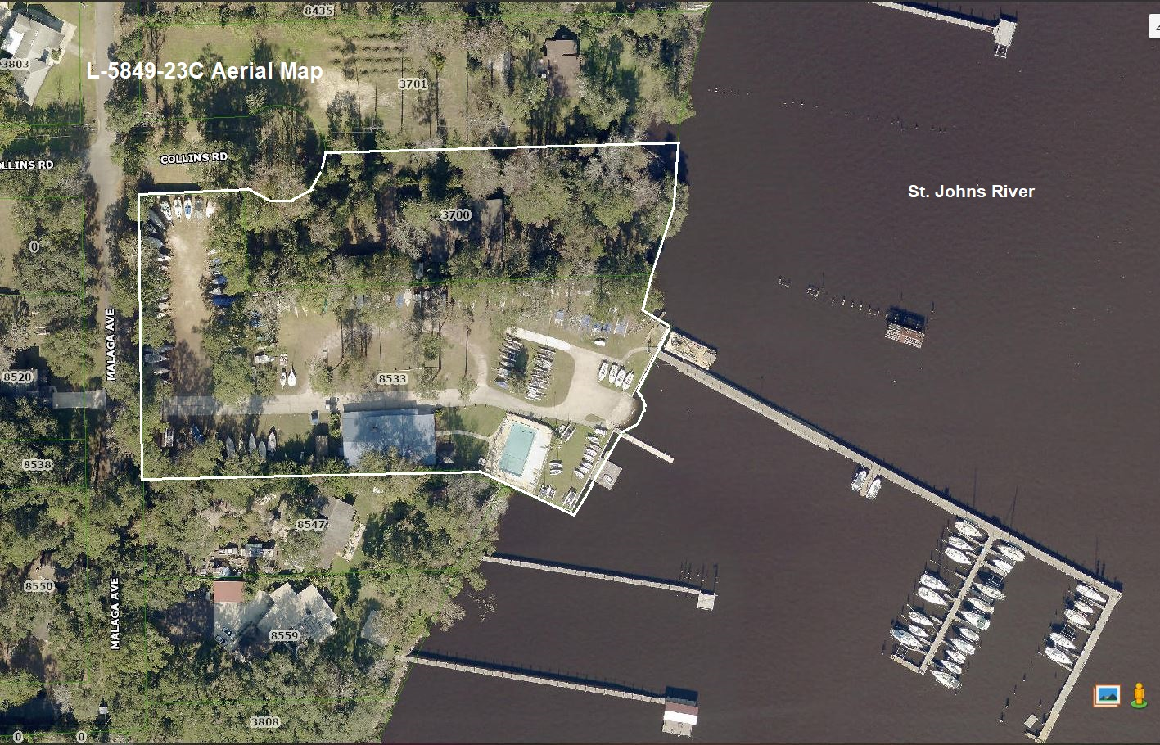
Land Use Amendment L-5849-23C Ordinance 2023-654 Aerial Map (Close-up)

Slide 30
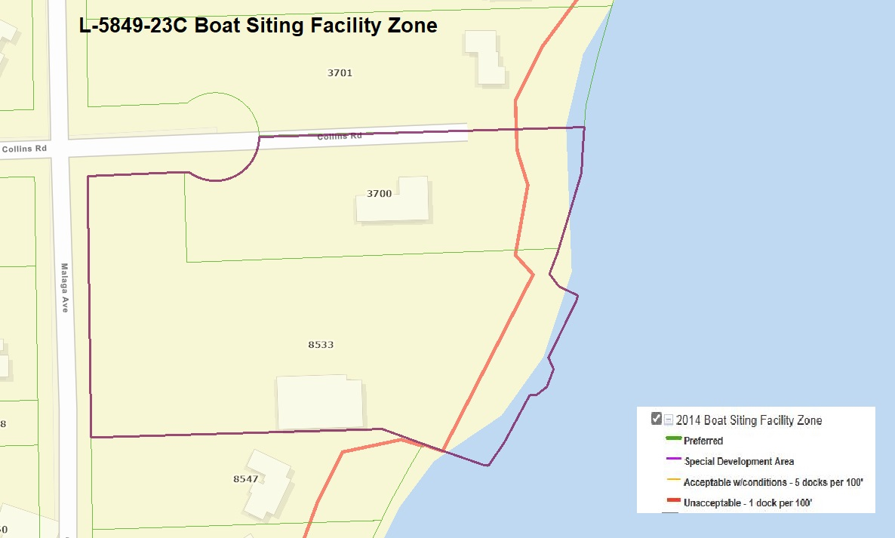
Land Use Amendment
L-5849-23C
Ordinance 2023-654
Boat Siting Facility Zone Unacceptable

Slide 31
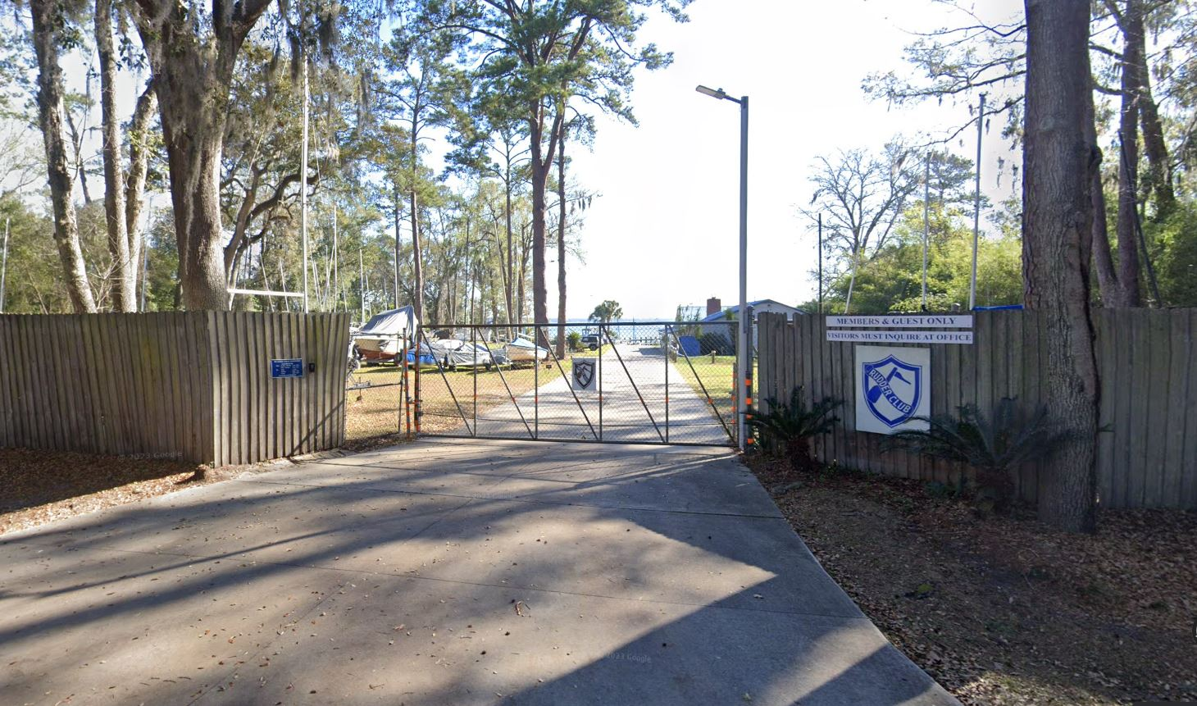
Land Use Amendment
L-5849-23C
Ordinance 2023-654
Easterly view of site from Malaga Avenue

Slide 32
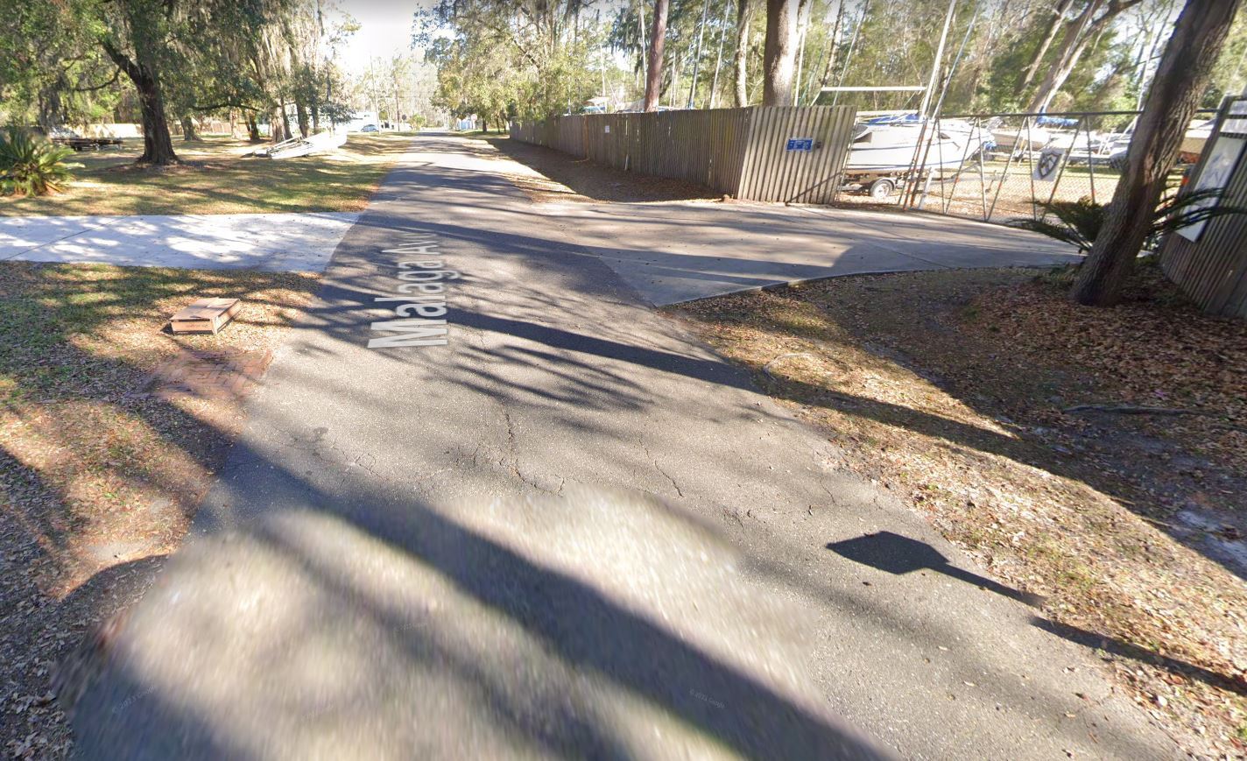
Land Use Amendment
L-5849-23C
Ordinance 2023-654
Northerly view of Malaga Avenue

Slide 33
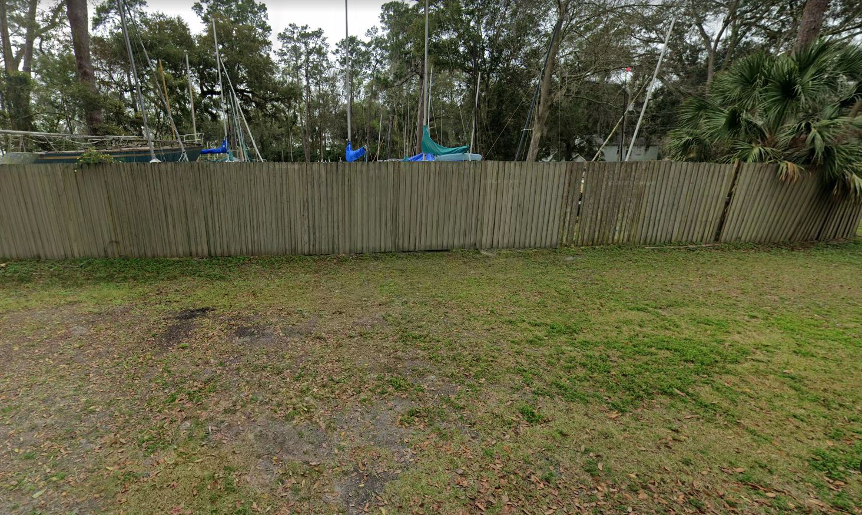
Land Use Amendment
L-5849-23C
Ordinance 2023-654
Southerly view of site from Collins Road

Slide 34
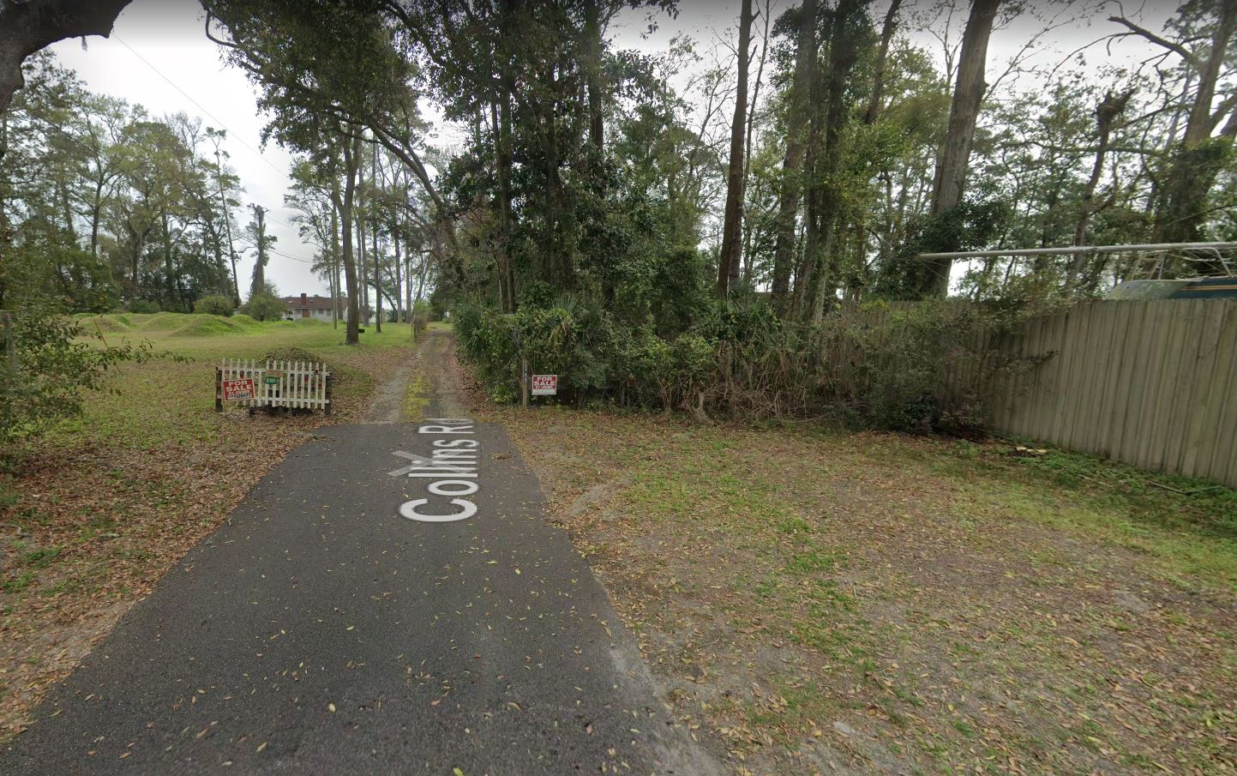
Land Use Amendment
L-5849-23C
Ordinance 2023-654
Easterly view from Collins Road

Slide 35
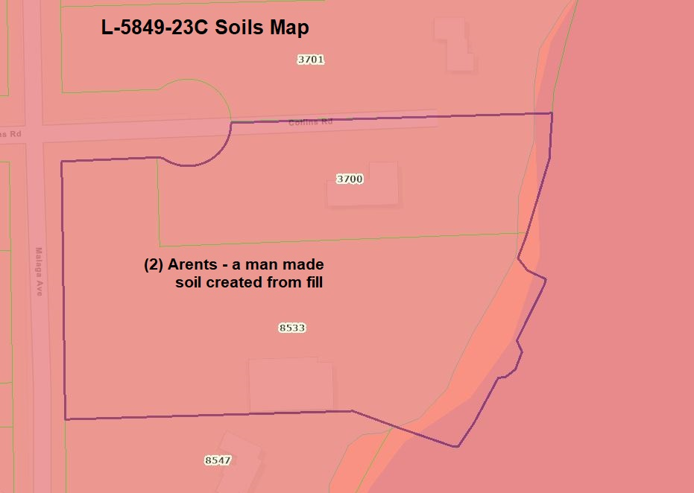
Land Use Amendment
L-5849-23C
Ordinance 2023-654
Soils Map

Slide 36
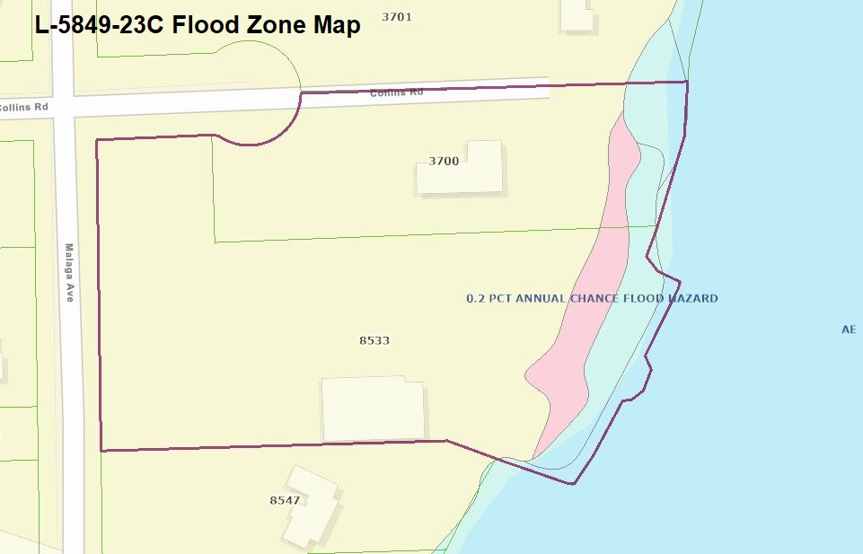
Land Use Amendment
L-5849-23C
Ordinance 2023-654
Flood Zones Map

Slide 37
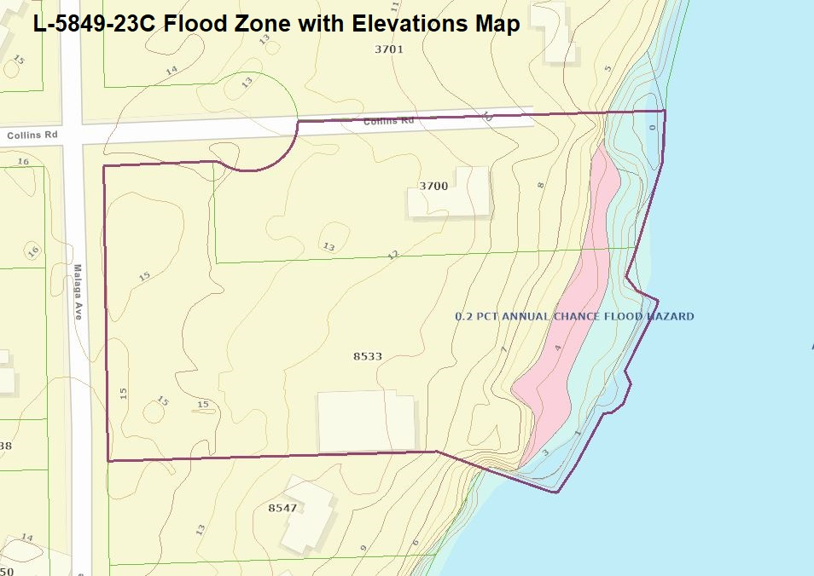
Land Use Amendment
L-5849-23C
Ordinance 2023-654
Flood Zones with Elevations Map

Slide 38
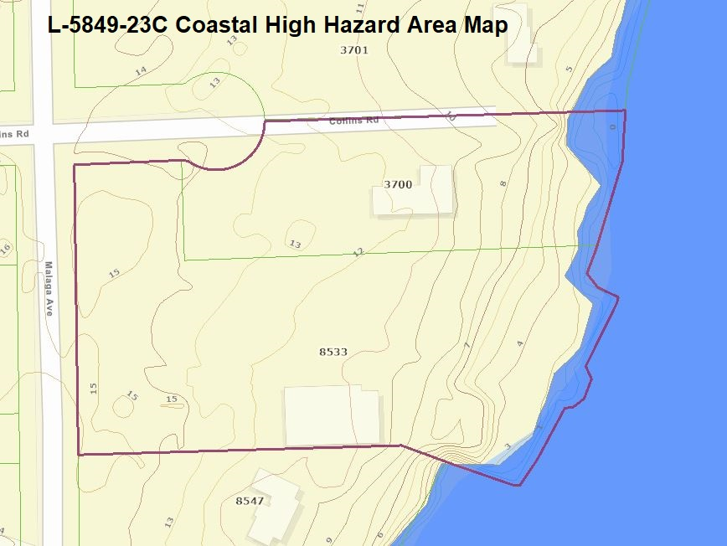
Land Use Amendment
L-5849-23C
Ordinance 2023-654
Coastal High Hazard Area Map

Slide 39
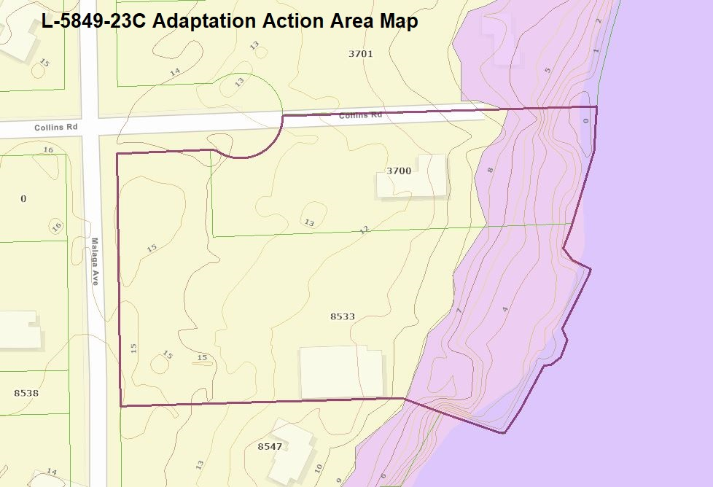
Land Use Amendment
L-5849-23C
Ordinance 2023-654
Adaptation Action Area (AAA) Map

Slide 40
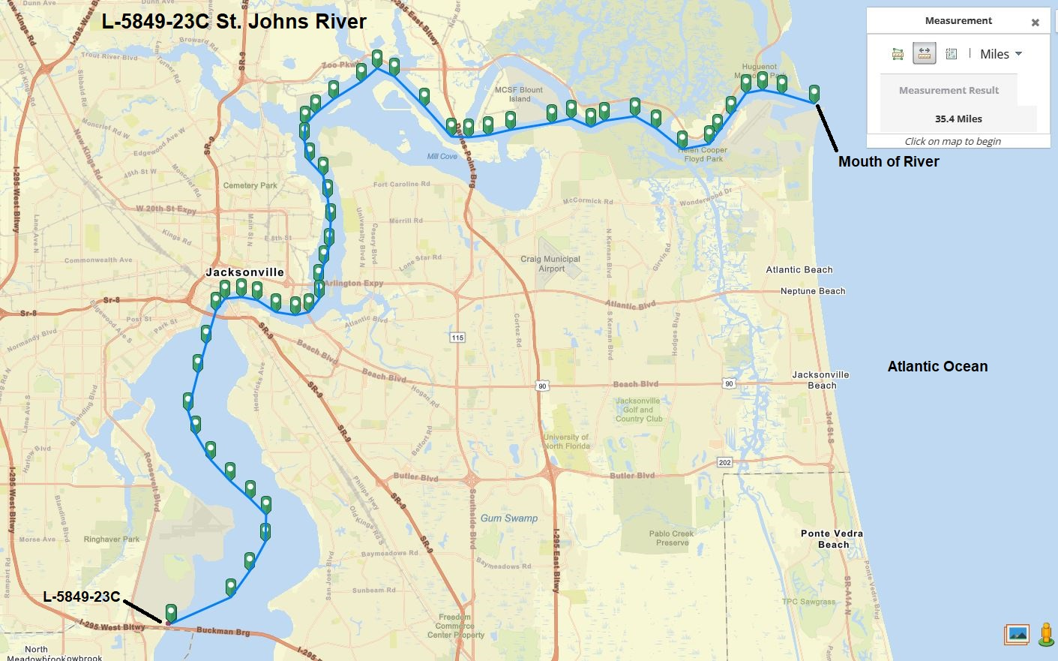
Land Use Amendment
L-5849-23C
Ordinance 2023-654
35.4 Miles to Application Site from Mouth of River

