Slide 1
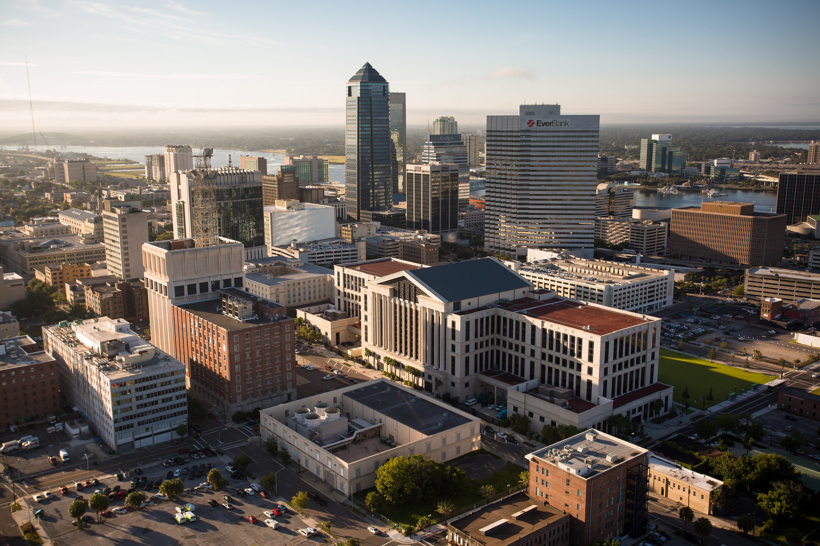

Office of Economic Development
Overview
June 6, 2019

Slide 2
OFFICE OF ECONOMIC DEVELOPMENT
Public Investment Policy (PIP) / Bill No. 2016-382-E
QTI
REV Grant
Northwest Jacksonville Economic Development Fund (NWJEDF)
Economically Distressed Areas
    Facade Renovation Matching Grant Program

Slide 3
OFFICE OF ECONOMIC DEVELOPMENT
Cecil Commerce Center
NWJEDF Legislative Initiatives
Failing Non-Residential Septic Grant Program
Food Deserts
Community Redevelopment Areas (CRAs)
JIA
KingSoutel Crossing
Renew Arlington

Slide 4
OFFICE OF ECONOMIC DEVELOPMENT
Economic Development Projects (July 1, 2015- present)
44 projects approved
7,016 jobs
$1.06 billion in private capital investment
$10.3 million in ad valorem taxes generated annually
Monitoring & Compliance

