Slide 1
Mary Tobin, Chief Operating Officer
June 6, 2019

Slide 2
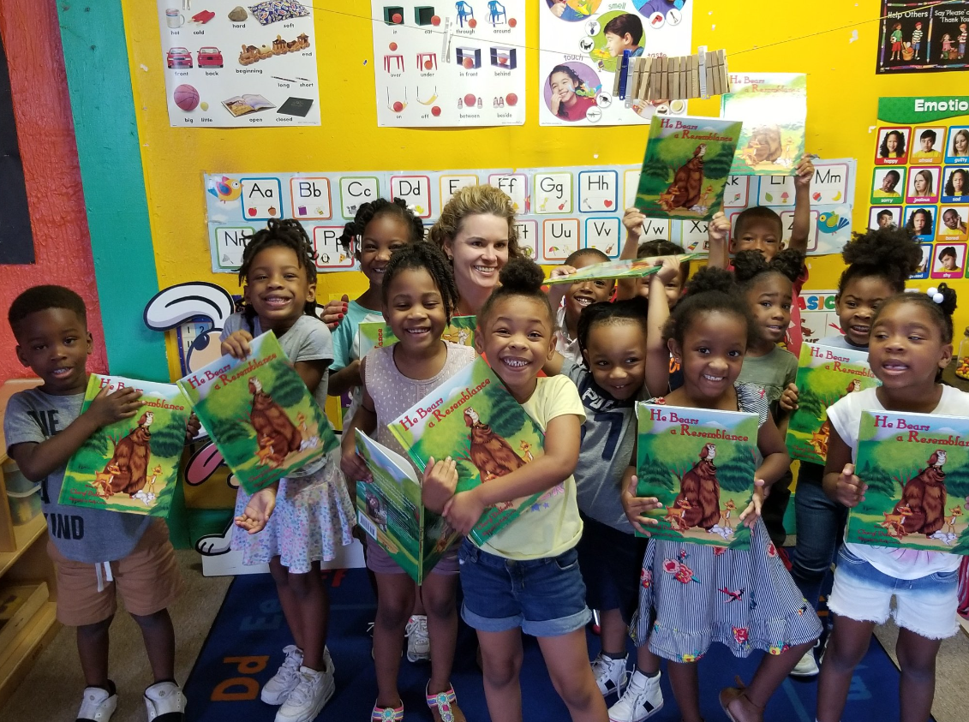
Agenda
Overview
Continuum of Services
Revenue Sources
Operating vs Program Funds
Program Funding by Essential Services
Board + Personnel
Essential Service Categories
Breakdown by District
Total Number of Kids Served
Questions
Mrs. Molly Curry is a literacy champion.

Slide 3
Overview
Vision: Every child and youth will reach his/her academic, career, and civic potential.
Mission: To build and ensure access to a continuum of comprehensive and integrated programs, services, and activities that address the critical needs of children and youth.
Core Values: Integrity, Empathy and Compassion, Innovation,
Cultural Inclusivity, Advocacy, Hope, Partnership, Courage, Resilience

Slide 4
Continuum of Services

Slide 5
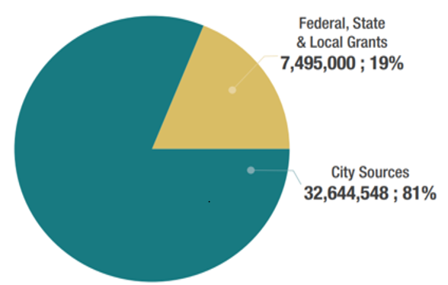
Revenue Sources

Slide 6
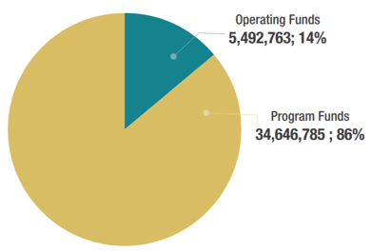
Operating vs Program Sources

Slide 7
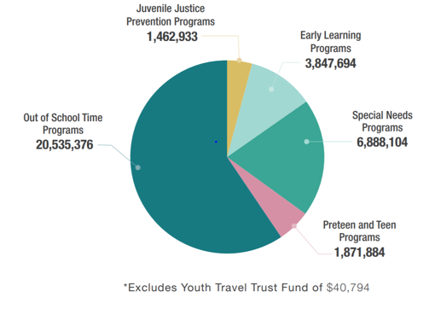
Funding by Essential Service Category

Slide 8
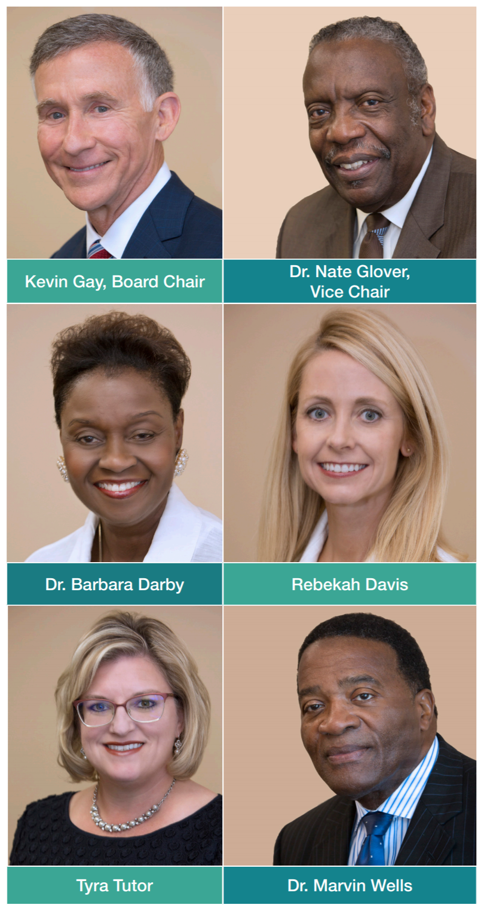
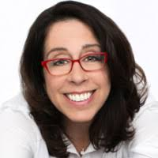
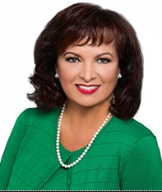
Board of Directors
Donna Orender
Rose Conry

Slide 9
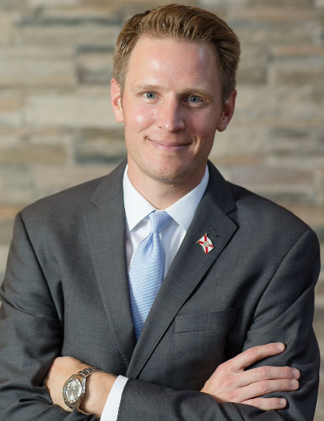
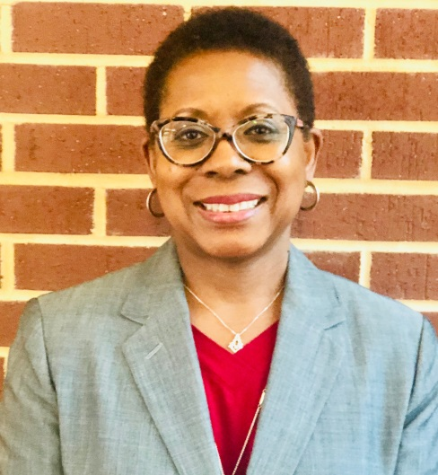
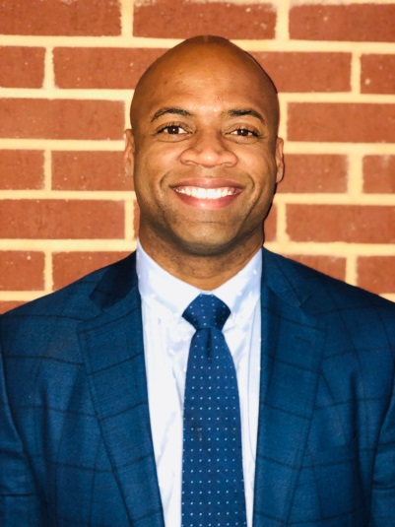
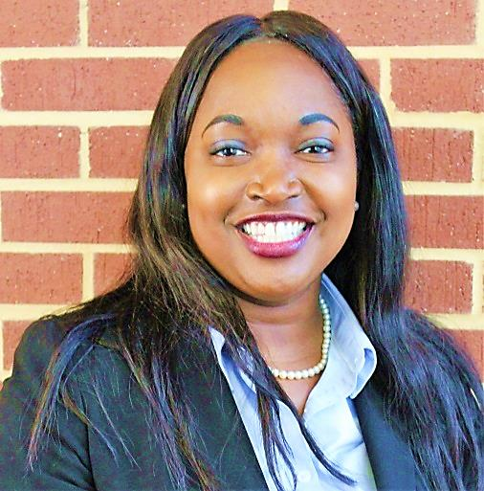
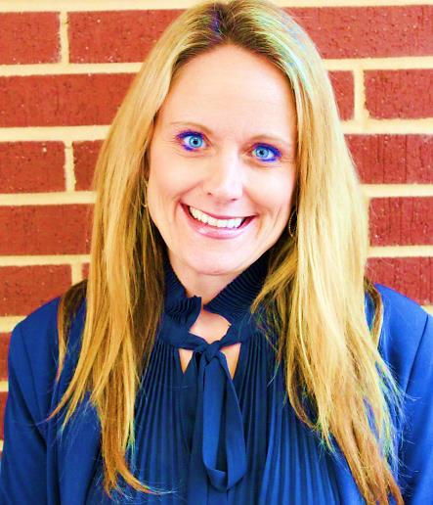
Meet the Senior Leadership Team
Senior Director of Communications
Donald Horner III
Communications
Cynthia Nixon
Finance
Joe Peppers
CEO
Mary Tobin
COO
Dr. Jennifer Blalock
Strategy

Slide 10
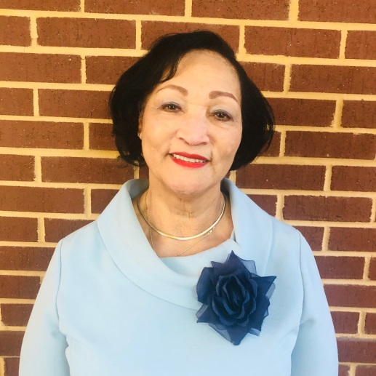
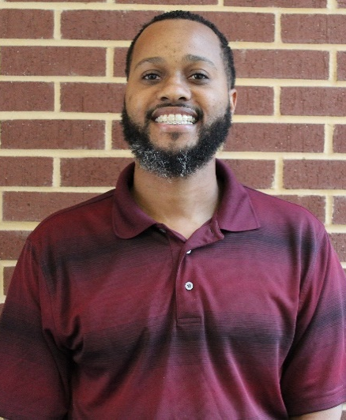
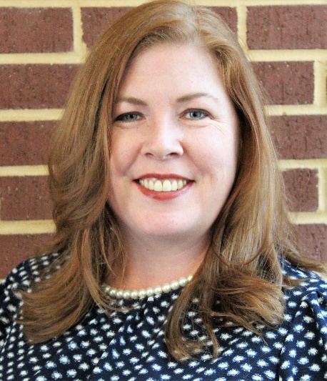
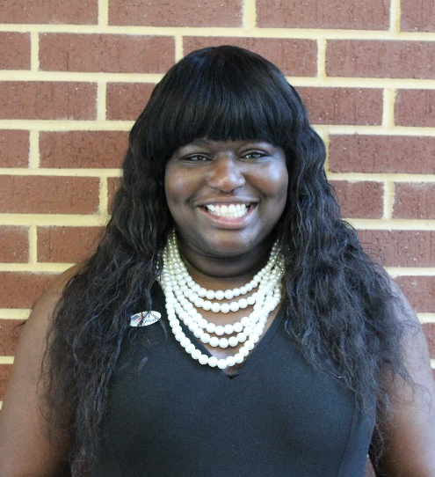
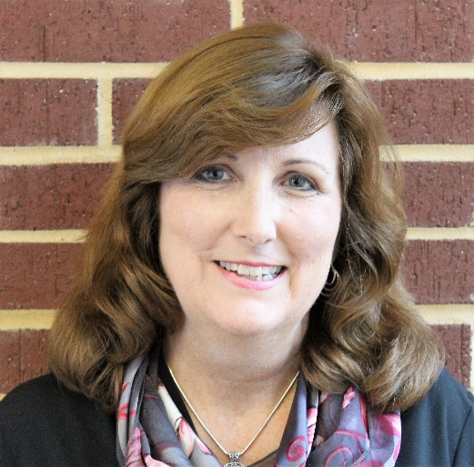
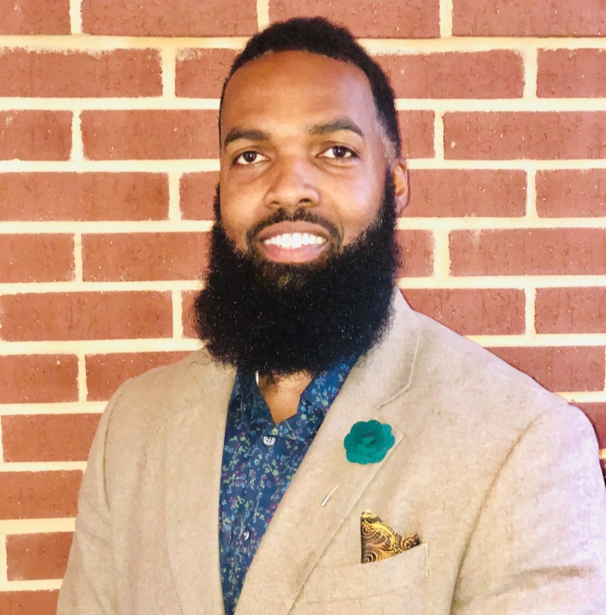
Meet the Directors
Joyce Watson Administration
Kenneth Darity
Out of School Time
Mary Nash
Special Needs
Tyrica Young 21st Century
Lenora Wilson
Early Learning
John Everett
Pre Teen & Teen
Katoia Wilkins
Juvenile Justice

Slide 11
KHA Board
Chief Executive Officer
Joe Peppers
Executive Assistant
Delores Williams
*Admin Aide
*Dir Early Intervention
Chief Operating Officer
Mary Tobin
Sr. Director Communications
Donald Horner III
Sr. Director Finance
Cynthia Nixon
Chief Strategy Officer
Jennifer Blalock
Director of Early Learning
Lenora Wilson
Ast Dir of Government & Partnership Initiatives
Adam Miller
Auditing/ Accounting Manager
Eunice Dumba
Dir of Pre-Teen/Teen
John Everett
Director of Administration
Joyce Watson
Ast Dir Community Engagement
Sylvester Pinckney
Contract Compliance -Christine McNeilly
-Shaterica Moore
Dir of Juvenile Justice
Katoia Wilkins
Dir. Out of School Time
Kenneth Darity
(PTE) Public Relations
Robin Franks
Ast Dir of
Grants & Development
Dae Lynn Helm
Admin Aide
Sandra Moody
Director of OST (Grants)
Tyrica Young
Ast Director of Training
LaRaya Strong
*Yellow boxes denotes vacant positions
Director of Special Needs
Mary Nash
Director of Data Systems and Innovation
Rodger Belcher

Slide 12
Essential Service Categories
Pre teen & Teen
Out of School Time
Juvenile Justice
Early Learning
Special Needs
Out of School Time Grants

Slide 13
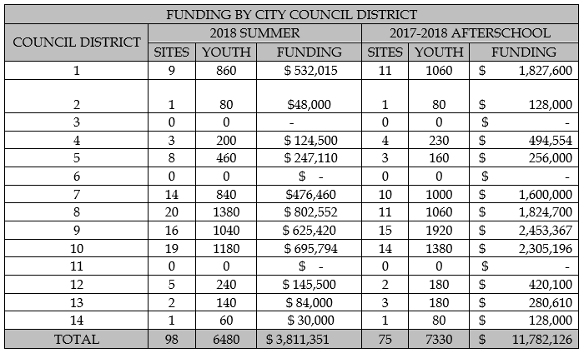
Breakdown by District

Slide 14
Total Numbers of Kids Served

Slide 15
Thank you! Any Questions?

