Slide 1
Ethics Training
TOP 10 DANGER AREAS
Office of Ethics, Compliance and Oversight
Carla Miller, Director
Jason Gabriel, General Counsel
City of Jacksonville, Florida
June 2019

Slide 2










Top Ten Danger Areas
Notes:
Graphics, gift boxes; asking for favors; going on a trip for a conference; checking forms for disclosure; man juggling different areas of his life for conflicts; someone picking one person out of a group to show voting conflicts; a police car to illustrate misuse of position; a sun to show Sunshine law; a paper shredder to illustrate saving public records; people asking questions.

Slide 3
Ethical Decision Guide
ASK FIRST, ACT SECOND:
Is it legal -- does it violate state law or City ordinance? If you’re not sure, consult with the Ethics Office.
Even if it’s legal, could the appearance cause problems?
Is it FAIR? Does it increase citizen trust in government?

Slide 4

Is there always a clear answer?
Notes:
Graphic, Two thought bubbles, one with a question mark, one with the word “answer” to illustrate the question, “is there always a clear answer”?

Slide 5
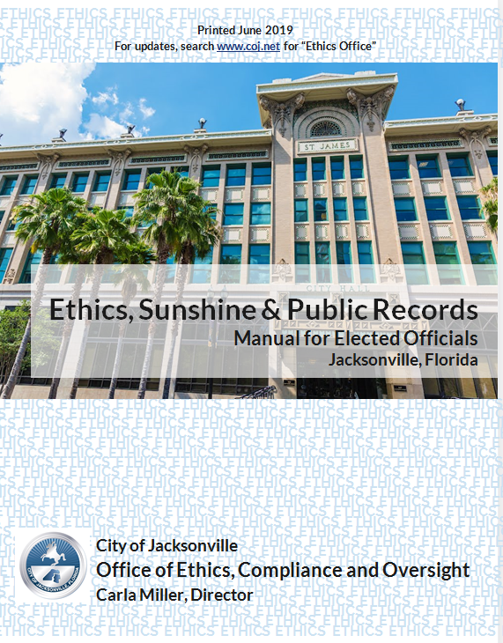
Use Your Manual!
Notes:
Graphic, Cover page of the Ethics, Sunshine & Public Records Manual for Elected Officials, featuring an image of Jacksonville City Hall and the City’s Seal.

Slide 6

Discussion Groups
Divide into teams of two people
One person is “A” and one is “B”
Notes:
Graphic, two figures sitting at small desks, one raising a hand, to represent participants should divide into groups of two.

Slide 7

Danger Area #1
GIFTS
Notes:
Graphic, four gift boxes of various sizes and colors to illustrate the danger area of gifts

Slide 8
BASIC LAW (there are 5)
Everything is a gift
Advice, trips, tickets, food, use of a home, a dinner, a free haircut, a discount
Notes:
Graphic, four gift boxes of various sizes and colors to illustrate the danger area of gifts

Slide 9
BASIC LAW
If value of gift is over $100 and the gift comes from a lobbyist or someone doing business with the City,
Ethics Violation
Notes:
Graphic, four gift boxes of various sizes and colors

Slide 10
BASIC LAW
$250 total limit per year from one entity.
(Can’t take four $80 gifts from one lobbyist or entity.)
Ethics Violation
Notes:
Graphic, four gift boxes of various sizes and colors

Slide 11
BASIC LAW
If value of gift is over $100 and it comes from a friend who isn’t a lobbyist and doesn’t do any business with the City, you can accept it.
But You Have To Report It.
Notes:
Graphic, four gift boxes of various sizes and colors

Slide 12
BASIC LAW
You can accept a gift of any amount given to you through the “City”.
But You Still Have To Report It.
Notes:
Graphic, four gift boxes of various sizes and colors

Slide 13
Discussion Groups
Notes:
Graphic, two figures sitting at small desks, one raising a hand.

Slide 14
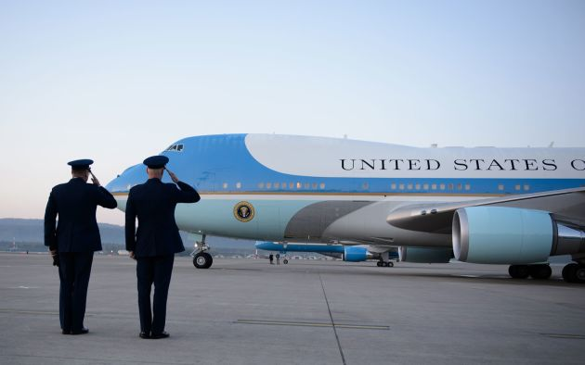
Gifts: Question 1
The President of the United States is in town and asks you to hop on Air Force One to talk with him as he flies to Tampa.
Is this a gift?
Can you accept it?
How would you handle this?
Notes:
Graphic, Two members of the military solute Air Force One to illustrate the gift scenario

Slide 15
Gifts: Question 1
The President of the United States is in town and asks you to hop on Air Force One to talk with him as he flies to Tampa.
Is this a gift? YES
Can you accept it? YES
How would you handle this?
Report It
Notes:
Graphic, Two members of the military solute Air Force One

Slide 16
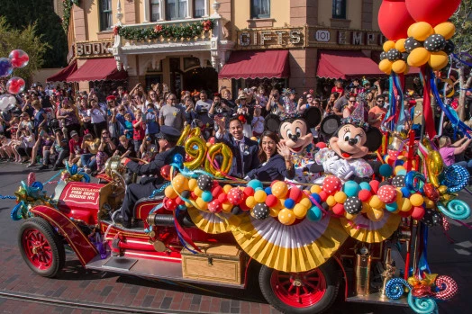
Gifts: Question 2
You are asked to ride in a parade for a statewide event at Disney World: “Elected Officials love Mickey”. Because you agreed to do this, you are given 4 free admission tickets for your family that day to see you ride on the float with Mickey.
Is this a gift?
Can you accept it?
How would you handle this?
Notes:
Graphic, parade float at Disney with Mickey, Minnie and a human couple in suits to illustrate the gift scenario.

Slide 17
Gifts: Question 2
You are asked to ride in a parade for a statewide event at Disney World: “Elected Officials love Mickey”. Because you agreed to do this, you are given 4 free admission tickets for your family that day to see you.
Is this a gift? YES
Can you accept it? YES
How would you handle this?
Report It
Notes:
Graphic, parade float at Disney with Mickey, Minnie and a human couple in suits

Slide 18
Gifts: Question 3
You have been asked to speak at a national conference of “Save the Children” because of your work on City Council. The organization has offered to pay for your flight and hotel.
Is this a gift?
Can you accept it?
How would you handle this?
Notes:
Graphic, four gift boxes of various sizes and colors

Slide 19
Gifts: Question 3
You have been asked to speak at a national conference of “Save the Children” because of your work on City Council. The organization has offered to pay for your flight and hotel.
ANSWER: This is not a “gift”. It is an expense related to a speech (an honorarium). You can accept it.
***It involves TRAVEL--needs pre-approval
(Ethics and OGC)
Notes:
Graphic, four gift boxes of various sizes and colors

Slide 20
Gifts: Question 4
Your next door neighbor, a friend since high school (who doesn’t do any business with the City or lobby), has a condo in St. Augustine. He offers it to you every year to use with your family for a week.
Is this a gift?
Can you accept it?
How would you handle this?
Notes:
Graphic, four gift boxes of various sizes and colors

Slide 21
Gifts: Question 4
Your next door neighbor, a friend since high school (who doesn’t do any business with the City or lobby), has a condo in St. Augustine. He offers it to you every year to use with your family for a week.
Is this a gift? YES
Can you accept it? YES
How would you handle this? Report It
Notes:
Graphic, four gift boxes of various sizes and colors

Slide 22

Gifts: Question 5
You slipped and fell rushing to a City Council meeting. You had to stay in the hospital for 2 days with a broken leg. On the first day, a huge flower arrangement arrives.
It is from someone you know is a lobbyist at City Hall.
Is this a gift?
Can you accept it?
How would you handle this?
Notes:
Graphic, flower arrangement to illustrate the gift scenario

Slide 23
Gifts: Question 5
You slipped and fell rushing to a City Council meeting. You had to stay in the hospital for 2 days with a broken leg. On the first day, a huge flower arrangement arrives. It is from someone you know is a lobbyist at City Hall.
Is this a gift? YES
Can you accept it? NOT IF VALUE OVER $100
How would you handle this? Check Value, Pay Down
Notes:
Graphic, flower arrangement to illustrate the gift scenario

Slide 24

Gifts: Question 6
You are in New York and your brother meets you and gives you 2 tickets for a sold out Broadway show.
Is this a gift?
Can you accept it?
How would you handle this?
Notes:
Graphic, Theater signs read Theater Tickets Broadway to illustrate the gift scenario

Slide 25
Gifts: Question 6
You are in New York and your brother meets you and gives you 2 tickets for a sold out Broadway show.
Is this a gift? MAYBE
Can you accept it? MAYBE
How would you handle this? Ask A Lot
Of Questions!
Notes:
Graphic, Theater signs read Theater Tickets Broadway to illustrate the gift scenario

Slide 26
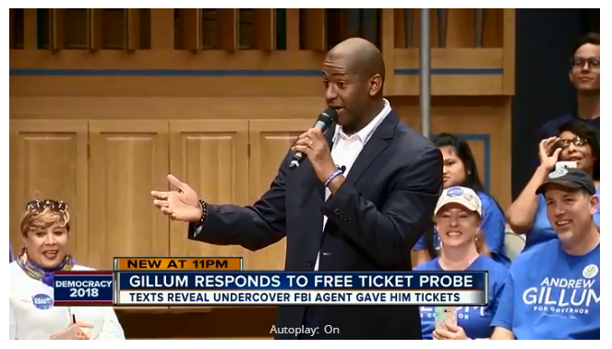
REAL-LIFE EXAMPLE
HOW IT PLAYS OUT WITH MEDIA AND ELECTIONS
Notes:
Graphic, Andrew Gillum on TV when he was responding to accusations on taking free tickets.

Slide 27
“Settlement reached in Andrew Gillum ethics case”—News Service of Florida Article 4/24/19
Gillum’s lawyer said “from Mayor Gillum’s standpoint it was the boat ride around the Statue of Liberty that he took with people that were his friends and it just didn’t occur to him that one of them was also a lobbyist and that he wasn’t supposed to accept the gifts.”
Notes:
Four of five charges of ethics violations related to trips to Costa Rica and New York, a boat ride around the Statue of Liberty and a ticket to the Broadway hit, “Hamilton.”

Slide 28

JAGUARS TICKETS
THREE ways to get tickets:
Buy them
Get them from City Council President or Mayor’s Office (Gift from City) and report it
Get them from someone else—could be a GIFT
Notes:
Graphic, Jaguars football team logo

Slide 29
BONUS QUESTION
On September 1, a lobbyist gives you 2 tickets to a concert for October 15. You take the tickets, but on October 14, there are hurricane warnings and the concert is cancelled.
Is this a gift if the concert was cancelled?
If a gift, do you have to report it if the value is over $100?
If a gift, do you have to report it if the value is under $100?

Slide 30
BONUS QUESTION
On September 1, a lobbyist gives you 2 tickets to a concert for October 15. You take the tickets, but on October 14, there are hurricane warnings and the concert is cancelled.
Is this a gift if the concert was cancelled? YES
If a gift, do you have to report it if the value is over $100? NO!!
If a gift, do you have to report it if the value is under $100? NO!!

Slide 31
BOTTOM LINE
Everything is a gift
“But everyone else was there….”
All should be doing the same thing with an event
Ask Ethics

Slide 32
Danger Area #2
Asking for Things
Notes:
Graphic, thought bubbles with “yes, no, maybe” to illustrate the danger area of asking for things.

Slide 33
ASKING FOR THINGS
Danger Area:
You ASK FOR anything of value from someone for
you, your family, your business associates or your friends.
Notes:
Photo of bubbles with “yes, no, maybe” to illustrate whether you can ask for things
Ex: asking for tickets to premiere sporting event or ask for legal advice on issue unrelated to board from attorney who appears before Board
Example: asking lobbyist for water bottle from vending machine
FS 112.3148 Florida Statutes. Cannot solicit gifts:
A reporting individual or procurement employee is prohibited from soliciting any gift from a vendor doing business with the reporting individual’s or procurement employee’s agency, a political committee as defined in s. 106.011, or a lobbyist who lobbies the reporting individual’s or procurement employee’s agency, or the partner, firm, employer, or principal of such lobbyist, where such gift is for the personal benefit of the reporting individual or procurement employee, another reporting individual or procurement employee, or any member of the immediate family of a reporting individual or procurement employee.

Slide 34
ASKING FOR THINGS: QUESTION 1
Your mother calls and begs you to get tickets for the tennis tournament up at Amelia Island—the final day is sold out. You see a lobbyist who is going to the match and represents the owners of the tournament.
Can you ask her to get tickets for you? Of course, you offer to pay the face value of the tickets
ANSWER:________
Notes:
Photo of bubbles with “yes, no, maybe” to illustrate whether you can ask for things

Slide 35
ASKING FOR THINGS: QUESTION 2
Your sister was arrested for shoplifting. Her court appearance is tomorrow. You see a lobbyist in City Hall who is also a lawyer.
Can you ask him about the judge who is hearing the case?
Can you go and speak on behalf of your sister at sentencing?
ANSWER:________
Notes:
Photo of bubbles with “yes, no, maybe” to illustrate whether you can ask for things

Slide 36
Danger Area #3
Going Places
Notes:
Graphic, person talking at a podium at a conference to illustrate the danger area of “going places”.

Slide 37
GOING PLACES
Two Options:
The City Council (or City) pays for you to go as an official expense.
You write up the details and email to Ethics; Ethics and OGC have to approve of this type of travel.
Notes:
Photo of person talking at a podium at a conference.

Slide 38
GOING PLACES: QUESTION 1
The Bill Gates Foundation has chosen you to attend an all expense paid trip to Seattle for a conference on the environment.
Is it a gift?
Can you go?
How would you handle it?
ANSWER:________
Notes:
Photo of person talking at a podium at a conference.
Ex: asking for tickets to premiere sporting event or ask for legal advice on issue unrelated to board from attorney who appears before Board
Also, asking lobbyist for water bottle from vending machine

Slide 39
Danger Area #4
Not Filing Disclosures
Notes:
Graphic, person checking off a form to illustrate the danger area of not filing discosure forms.

Slide 40
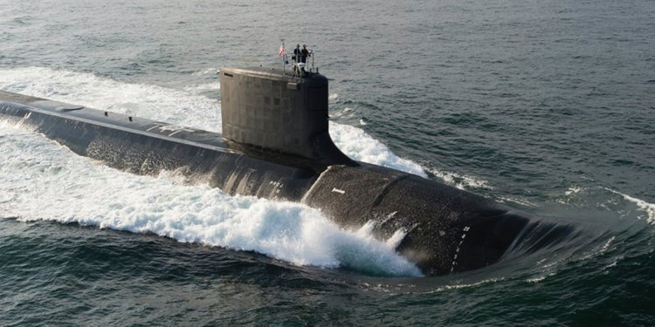
IT’S NOT A SIN TO FILE A FORM 9 GIFT DISCLOSURE!
Navy Submarine Trip
Notes:
Graphic, a navy submarine moving through water to illustrate the kinds of gifts Councilmembers should not be afraid to accept and disclose.

Slide 41
Danger Area #5
CONFLICTS
OF INTEREST
Notes:
Graphic, a man, left side dressed for business, has three left hands touching money, a chart with graphs, and an illustration of a business network, right side dressed casually, has three right hands touching his home, two beer bottles, and a map/hot air balloon to illustrate danger area conflicts of interest.

Slide 42
CONFLICTS OF INTEREST
Overlap between governmental duties and personal interests that may tempt City official or employee to put personal interests ahead of government responsibilities
Notes:
General definition of conflicts of interest

Slide 43

CONFLICTS OF INTEREST
Family and Friends
Government
Office
Business Associations
Notes:
Graphic, three red circles, one labeled Government office, one labeled family and friends, one labeled business associations, overlap to demonstrate the danger area conflicts of interest.

Slide 44
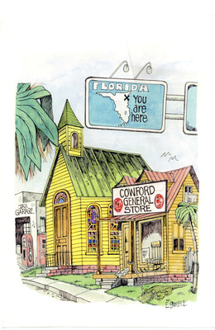
CONFLICTS OF INTEREST IN JACKSONVILLE
You likely will have conflicts
It is how you deal with them that is important
Notes:
Graphic, small historical town labeled “Cowford” is seen under a Florida Highway sign with a X marking Jacksonville. This is to illustrate the small-town nature of Jacksonville that contributes to the certainty of overlap between personal and public life for local elected officials.
This is especially true in Jacksonville—big city (land mass wise) that feels like a small town. There are small degrees of separation and everyone seems to know everyone or someone connected to everyone. Example: misplaced wedding ring & UNF officer student of mother-in-law
This means that you will likely have conflicts. It is not a bad thing and does not mean that it is catastrophic. Need to address them to protect yourself.

Slide 45
LITTLE CONFLICTS vs. BIG CONFLICTS
Little Conflicts: You can abstain from voting
Big Conflicts: You either have to end private interest or cannot serve on Council

Slide 46
CONFLICTS OF INTEREST
Council Buying or Contracting
\with CM Related Entity
CM Related Entity
Selling
to City
CM Working with Entity that Works with City
3 Most Common
Notes:
Graphic, city council chambers to signify Council Buying or contacting with an entity related to a Council Member
Graphic, person one holding a credit card and person two holding a shopping bag illustrating a Council Member selling something to the City.
Graphic, Two business people shake hands illustrating a Council Member working with a business that in turn does business with the City.
Most conflict situations fall into one of three areas.
We are go through each one and illustrate with an example

Slide 47
Common Conflict #1
Council Buying or Contracting
Company you/spouse/child own or serve as officer or director
Council purchasing or leasing from a company with which you, your spouse or child have a connection
Notes:
Graphic, a family to illustrate a company that is connected to a Council Member’s family.
Note: this is a big conflict--abstaining from voting is not sufficient
Also, you don’t have to vote for there to be a prohibited conflict of interest—Council voting is enough to create the conflict

Slide 48
Common Conflict #1
Council Leases Space for City
First Coast Realty
Son is President
Example
Notes:
City needs additional office space near Ed Ball building and wants to lease space from First Coast Realty, company in which your son is President
ANSWER: Potentially 1 conflict
Leasing as a Council Member from company in which child is officer

Slide 49
Common Conflict #2
The City
Company you own or serve as
officer or director
Selling in private or business capacity to the City
Notes:
Also applies if you just an employee for company and you are personally involved in the sale

Slide 50
Common Conflict #2
The City
First Coast Flowers
Owned by You
Selling Flowers City for Installation
Example
Notes:
Your company wants to sell flowers to City and Council for upcoming installation ceremony

Slide 51
Common Conflict #3
Council or the City
Company Doing Business with City
Business Relationship
Employment or contract with company doing business with the City

Slide 52
Common Conflict #3
Council or the City
Chamber of Commerce
Contracts with City
Employee of Chamber of Commerce
Example
Notes:
ANSWER: Potentially 1 conflict
Conflicting employment relationship with Chamber, entity doing business with the City (contract/money). Not purchasing in public capacity or selling in private capacity because only employee of Chamber and not personally involved with getting money from Council; not officer, partner, director, proprietor, or owner of Chamber
Thanks to CM Bowman for allowing us to use this example. Process is important. He identified potential conflict after attending ethics training his first year on Council and worked with Ethics and OGC to address it. We requested opinion from State Ethics Commission and they advised exemption applies to clear the conflict. Process matters. . . Protect yourself by working with Ethics and OGC to address any conflicts.

Slide 53
KNOWLEDGE CHECK # 1
You are a City Council Member. You also serve as an UNPAID member of the Board of Directors of First Coast Children’s Charity, a local non-profit. City Council wants to fund a program offered by the non-profit.
Is this a conflict of interest?
How would you handle this?
Notes:
Potentially 2 conflicts
Contracting with non-profit as a Council Member
Selling to City in private capacity as member of Board of Directors
Public capacity because Council is funding the program and private capacity because you are member of Board of Directors of non-profit receiving money
NOTE DANGER AREA: Serving as director of company (non-profit or for profit) that is receiving City funding. Need to get this cleared by Ethics Office and OGC.
A public officer "acts in his or her official capacity" for purposes of the first prohibition when a board of which he or she is a member (e.g., a county commission) acts collegially to purchase, rent, or lease, regardless of whether the public officer abstains from voting on the matter. CEO 90-24, CEO 10-4.

Slide 54
KNOWLEDGE CHECK #1
Council Funding Charity Program
First Coast Charity
You are on Board of Directors
Answer
Notes:
Potentially 2 conflicts
Contracting with non-profit as a Council Member
Selling to City in private capacity as member of Board of Directors
Public capacity because Council is funding the program and private capacity because you are member of Board of Directors of non-profit receiving money
NOTE DANGER AREA: Serving as director of company (non-profit or for profit) that is receiving City funding. Need to get this cleared by Ethics Office and OGC.
A public officer "acts in his or her official capacity" for purposes of the first prohibition when a board of which he or she is a member (e.g., a county commission) acts collegially to purchase, rent, or lease, regardless of whether the public officer abstains from voting on the matter. CEO 90-24, CEO 10-4.

Slide 55
KNOWLEDGE CHECK # 2
You \are a City Council Member. You also own an electrical company. Your company is asked by a general contractor to serve as a subcontractor on a contract approved by City Council.
Is this a conflict of interest?
How would you handle this?
Notes:
ANSWER: Potentially 1 conflict
Have contract with general contractor doing business with the City
Not purchasing from or selling to City because your company is only subcontractor to general contractor and is not doing business with the City

Slide 56
KNOWLEDGE CHECK #2
Council or the City
General Contractor Company Doing Business with City
Your Electrical Company
Subcontractor
Answer
Notes:
ANSWER: Potentially 1 conflict
Have contract with general contractor doing business with the City
Not purchasing from or selling to City because your company is only subcontractor to general contractor and is not doing business with the City

Slide 57
HELPFUL HINTS
Create list of those with whom you have connection:
  Spouse and Children
  Business Associates & Organizations
  Companies for which You Serve on Board of Directors
Ask them if they have any business with the City or want to do business with the City

Slide 58
Danger Area #6
Voting Conflicts
Notes:
Graphic, a large hand chooses one of three small men from a group. The one he chooses is wearing a crown to illustrate the danger area voting conflicts.

Slide 59
VOTING CONFLICTS
Danger Area:
You vote on any matter that might economically impact you, your family or your business associates

Slide 60
VOTING CONFLICTS: QUESTION 1
You are a City Council Member. You also are employed full-time with the Chamber of Commerce. The Chamber of Commerce receives money from the City Council each year for business development.
Can you vote on that issue?
Can you participate in discussion?
How would you handle this?

Slide 61
VOTING CONFLICTS: QUESTION 1
ANSWER:
Can you vote on that issue? NO
Can you participate in discussion? NO
How would you handle this? Contact Ethics Office or OGC prior to vote to ensure you follow correct procedure to declare voting conflict
Notes:
Cannot vote because measure would provide special economic gain to your employer/”principal”
Cannot participate because exemption for prohibitive conflict of interest requires CM not participate
Procedure: Need to complete and file Form 8B—disclosure of voting conflict form, provide to Legislative Services to be filed in the minutes, announce conflict and reason for abstention before vote and abstain from vote

Slide 62
VOTING CONFLICTS: QUESTION 2
You are a City Council Member. City Council is going to vote on a bill to purchase land to develop a new City park. Your business client owns the land.
Can you vote on that issue?
Can you participate in discussion?
How would you handle this?

Slide 63
VOTING CONFLICTS: QUESTION 2
ANSWER:
Can you vote on that issue? NO
Can you participate in discussion? YES
How would you handle this? Contact Ethics Office or OGC prior to vote to ensure you follow correct procedure to declare voting conflict
Notes:
Cannot vote because measure would provide special economic gain to your business client, which is your “principal”
Can participate, but must follow correct procedure
Procedure: Need to complete and file Form 8B—disclosure of voting conflict form, provide to Legislative Services to be filed in the minutes, announce conflict and reason for abstention before vote and abstain from vote

Slide 64
VOTING CONFLICTS: QUESTION 3
You are a City Council Member. City Council is going to vote on a bill to provide grants to daycare providers. Your sister owns a daycare business and you know she is interested in applying for a grant.
Can you vote on that issue?
Can you participate in discussion?
How would you handle this?

Slide 65
VOTING CONFLICTS: QUESTION 3
ANSWER:
Can you vote on that issue? POSSIBLY
Can you participate in discussion? YES
How would you handle this? Contact Ethics Office or OGC prior to vote to determine if you can vote
Notes:
May not be a voting conflict because it may be remote and speculative if there are many other steps intervening. However, if sister is one of few providers likely to get it, then it may be voting conflict.
Even if not voting conflict, CM may abstain from voting under Florida Statutes section 286.012 due to appearance of conflict:
No member of any state, county, or municipal governmental board, commission, or agency who is present at any meeting of any such body at which an official decision, ruling, or other official act is to be taken or adopted may abstain from voting in regard to any such decision, ruling, or act; and a vote shall be recorded or counted for each such member present, except when, with respect to any such member, there is, or appears to be, a possible conflict of interest under the provisions of s. 112.311. s. 112.313, or s. 112.3143. In such cases, said member shall comply with the disclosure requirements of s. 112.3143. (CEO 10-2)

Slide 66
VOTING CONFLICTS: QUESTION 4
You are a City Council Member. City Council is going to vote on a bill to provide economic incentives to a company for whom you previously performed work. There is no immediate work being performed by you for this company.
Can you vote on that issue?
Can you participate in discussion?
ANSWER: Yes because no current work
Notes:
Not a voting conflict because there is no business relationship or connection at time of vote. Relationship must exist at time of vote.

Slide 67
Danger Area #7
MISUSE OF POSITION
Notes:
Graphic, police car to illustrate the danger area of misusing position.

Slide 68
MISUSE OF POSITION
Danger Area:
Don’t use your title or position to get things for you or anyone else
Follow the same process as all citizens
“Do you know who I am…..”
Notes:
Ex: City Council and Atlantic Beach Commissioner traffic stop cases
Florida Ethics Commission found probable cause Atlantic Beach City Commissioner attempted to use his position as a public official to try to get preferential treatment during traffic stops when pulled over by Atlantic Beach police
Ex: Chris Christie 4th of July beach access

Slide 69

MISUSE OF POSITION: QUESTION 1
Your aunt calls. There is a rabid raccoon in her backyard. She insists you get someone today to trap it.
Can you have your ECA call Animal Control to get it done? They do it for other citizens.
How would you handle this?
ANSWER:________
Notes:
Graphic, racoon with his paws up to illustrate the scenario.

Slide 70

MISUSE OF POSITION: QUESTION 2
There is a City Employee that you find particularly attractive. You put your arm around the person and tell them “you look really hot in that outfit”.
Is this misuse of position?
ANSWER:________
Notes:
Graphic, person standing, putting his hand on another person’s shoulder who is sitting to illustrate the misuse of position scenario.

Slide 71
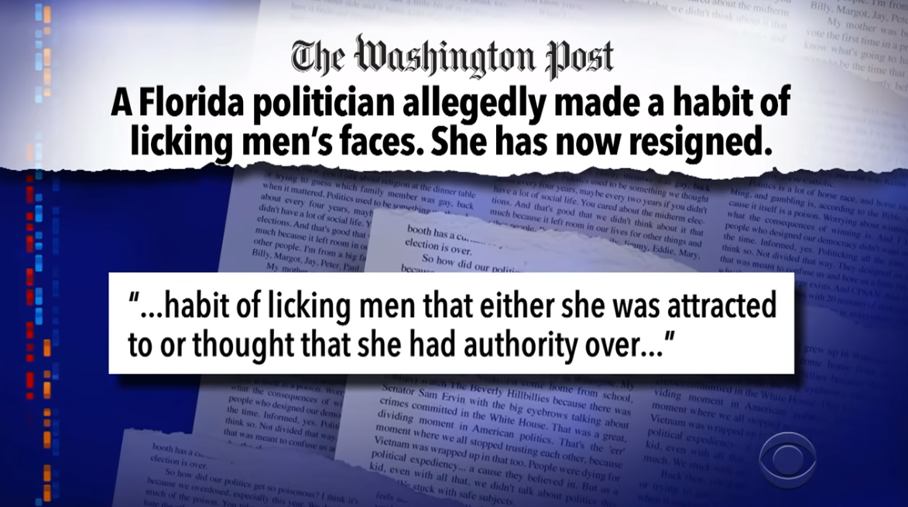
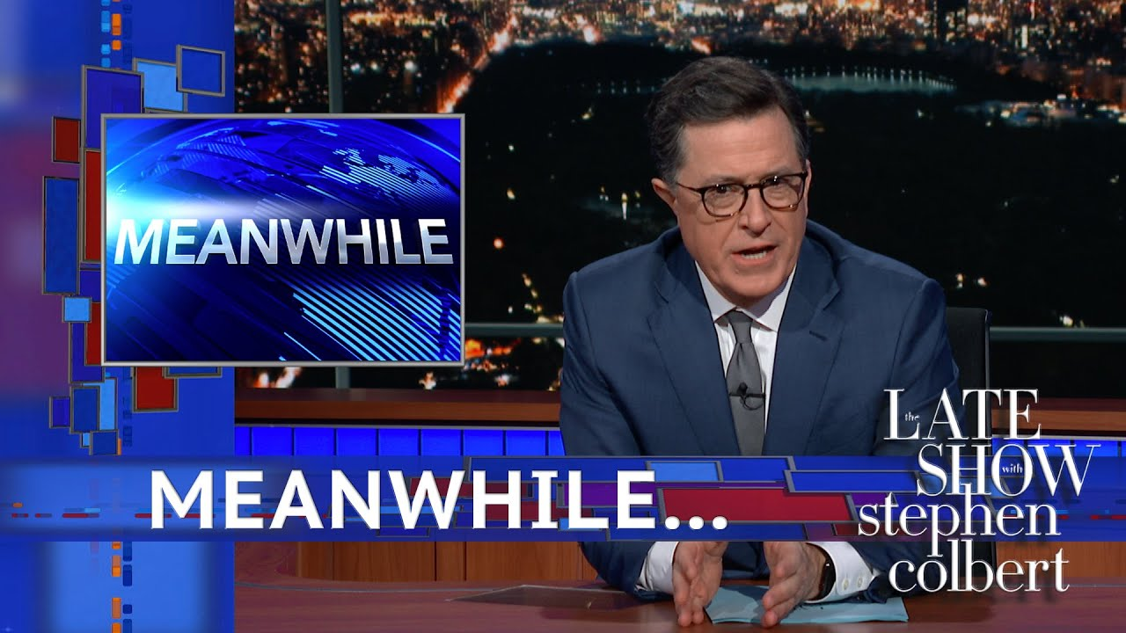
REAL-LIFE EXAMPLE
City Commissioner forced to resign for licking men’s faces…
Notes:
Graphic, Washington Post newspaper headline about a Florida politician licking men’s faces and Stephen Colbert on the Late Show doing a segment called, “Meanwhile”.

Slide 72
MISUSE OF POSITION: QUESTION 3
You are running late for a very important meeting so you’re speeding a little bit. Unfortunately, you get pulled over. Can you tell the police officer that you’re on your way to a City Council meeting and in a hurry?
ANSWER:________
Notes:
Photo of police car

Slide 73
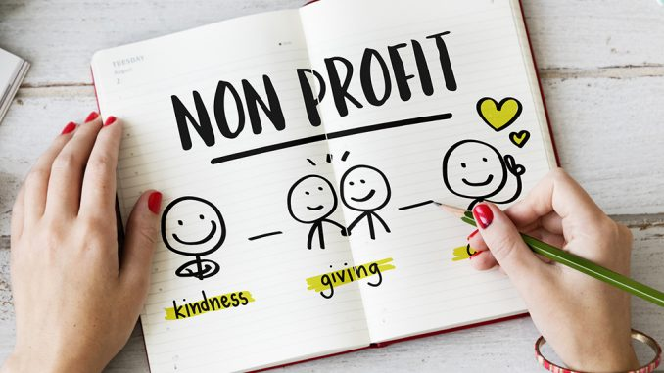
MISUSE OF POSITION: QUESTION 4
As a council member, you are very interested in fighting crime in your district. You sit on the Board for a non-profit that counsels mentally ill teenagers.
Can you send out a letter about funding the
non profit to City Council?
Notes:
Graphic, piece of paper that says “non-profit” on it to illustrate the misuse of position scenario.

Slide 74
Danger Area #8
SUNSHINE
MEETINGS
Notes:
Graphic, Sun to represent the danger area of sunshine meetings

Slide 75

CLUE ON SUNSHINE
Notes:
magnifying glass that says “Clue” on it

Slide 76
Danger Area #9
PUBLIC RECORDS
Notes:
Graphic, paper shredder to illustrate the danger of destroying public records.

Slide 77

PUBLIC RECORDS
EVERY document connected to public business is to be preserved and made available upon request for inspection and copying.

Slide 78
Danger Area #10
Not Asking Questions
Notes:
Graphic, a group of people with thought bubbles to illustrate the danger area of not asking questions.

