Slide 1
Government Ethics
Carla Miller, Ethics Director
June 5, 2019

Slide 2
Topics for Today
Ethics—Big Picture
Ethics---the Top Ten Danger List
Sunshine
Public Records
Meets 4 hour ethics requirement (state law)

Slide 3

Notes:
Graphic, road sign reads, “The Big Picture, next exit”

Slide 4
Why?
What is the purpose of this activity?
What is the purpose of the Ethics Office?
Why are we here?
Just to get state law requirement?

Slide 5
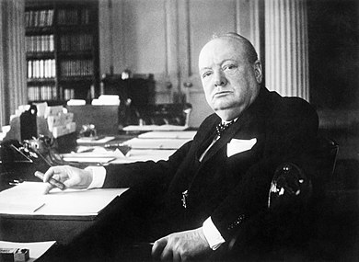
“Those who fail to learn from history are condemned to repeat it.” Winston Churchill
Notes:
Graphic, Black and White photograph of Winston Churchill sitting at a desk with papers and a cigar.

Slide 6
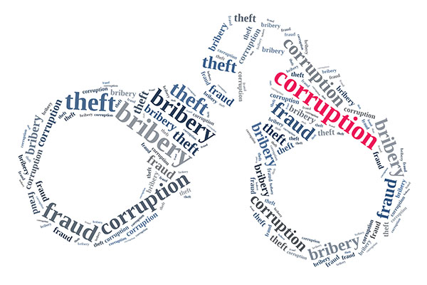
JACKSONVILLE HISTORY
Notes:
Graphic, handcuffs made of the words, theft, bribery, fraud, corruption

Slide 7
1965 massive corruption—led to
1968 Consolidation
1980 massive corruption—Federal cases

Slide 8
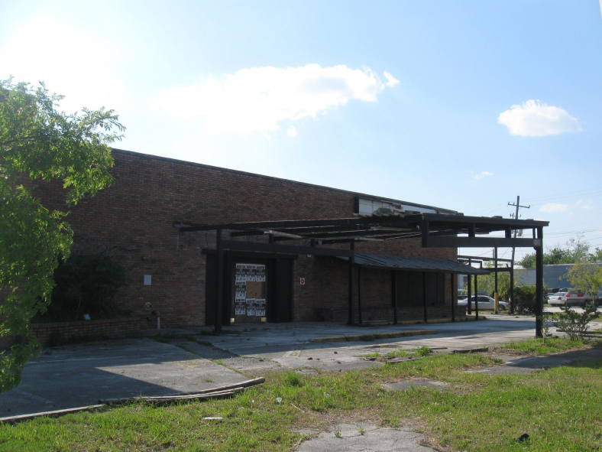
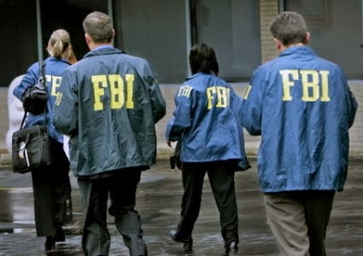
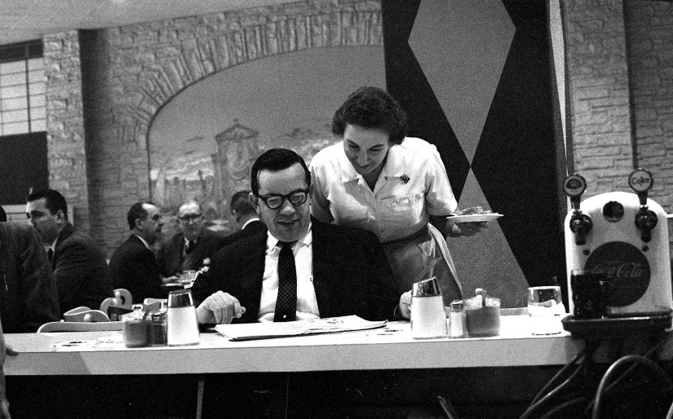
FBI Sting Operation
Notes:
Graphic, dilapidated restaurant building, the former Abbott’s Restaurant
Graphic, four FBI agents wearing blue jackets with yellow FBI letters walk away from the camera.
Graphic, Man in suite wearing glasses sits and diner counter while waitress reads over his shoulder.

Slide 9
Defendants
President Pro Tem of the Florida Senate
Attorney and Chair of the Democratic Party
Former Mayor of Jacksonville
A Tallahassee lobbyist

Slide 10
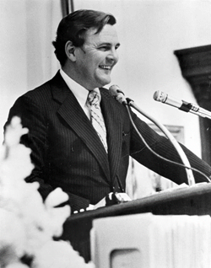
Senator Dan Scarborough
Notice of Death:
Former state senator was champion for employees
A fraud and extortion conviction marred his 14 years of service.
Former state Sen. Dan Scarborough, once Florida's most powerful senator until his political career ended with his 1982 conviction of mail fraud and extortion, died in a Jacksonville nursing home Wednesday.
Notes:
Graphic, Senator Dan Scarborough stands smiling at a podium

Slide 11
H. Haimowitz, Attorney
Chairman of the Democratic Party
Notice of Death:
Harold Haimowitz, 73, passed away November 28, 2003 in Boca Raton. He was a longtime resident of Jacksonville. Mr. Haimowitz was a graduate of the University of Florida School of Law, president of Phi Lamda Phi, member of the Blue Key Society, past Chairman of the Duval County Democratic Committee, and held executive positions in the Masonic Lodge and the Elks. Mr. Haimowitz practiced law in Jacksonville for many years and was practicing in Boca Raton until the time of his death.

Slide 12
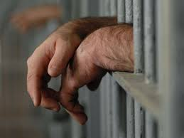
Notes:
Graphic, a man’s hands resting on jail cell bars.

Slide 13
1985 General Counsel indicted
1989 Grand Jury on local corruption (John Delaney)
1992 Ethics Commission (Matt Carlucci)
1995 Mayor Delaney (1999 Ethics Code)
1999 First Ethics Training for Officials

Slide 14
2000 First Ethics Officer for the City
2011 Ethics Office made independent
2014 Inspector General Office started

Slide 15
So now, 40 years later…..
I have some ideas to share with you

Slide 16
Notes:
Graphic, a man’s hands resting on jail cell bars.

Slide 17
My theory on what makes a good Ethics Program

Slide 18
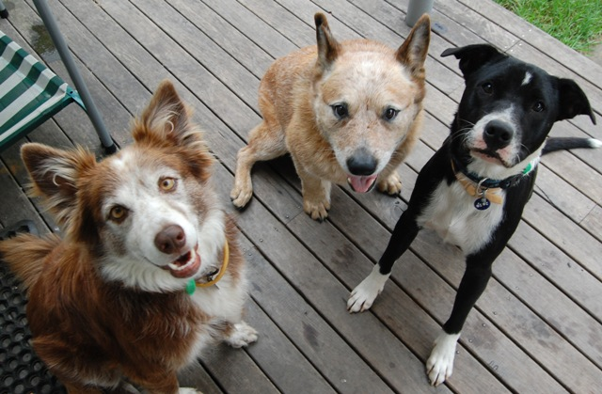
THE “THREE DOG THEORY OF ETHICS”
Notes:
Graphic, three dogs sit on a wood deck looking up
18

Slide 19
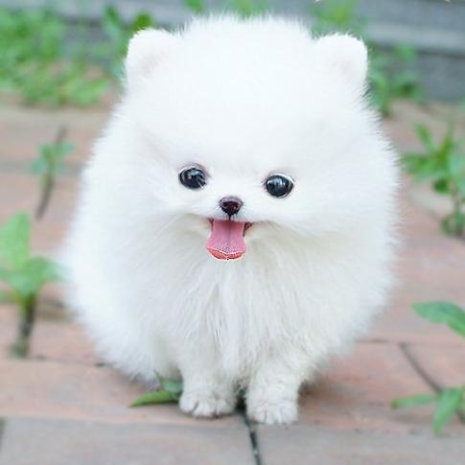
1. The LAPDOG
Notes:
Graphic, tiny white fluffy dog with his tongue sticking out to illustrate the idea of the lap dog.

Slide 20
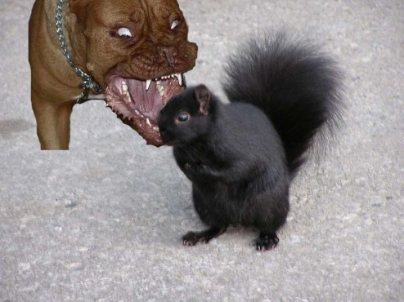
2. The ATTACK DOG
Notes:
Graphic, aggressive dog with mouth open and teeth bared, symbolically attacking a black squirrel.

Slide 21
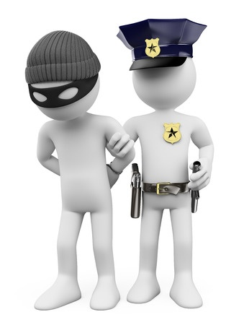
The “Gotcha” System
Notes:
Graphic, two figures, one wearing a face mask and ski cap with his hands behind his back, the other with a police hat and badge illustrating the idea of a “gotcha” system.

Slide 22
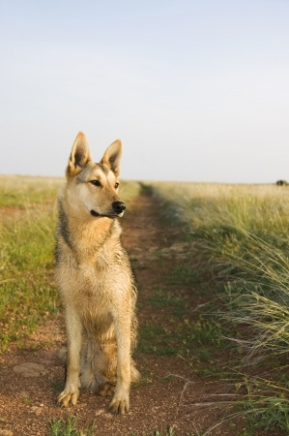

3. The WATCHDOG
Notes:
Graphic, dog stands watch in a field.
Graphic, a man’s hands resting on jail cell bars.

Slide 23
Why good people become corrupt
Notes:
THERE ARE A FEW CHALLENGES THOUGH IN LEARNING ABOUT GOVERNMENT ETHICS THAT WE SHOULD TAKE A LOOK AT.

Slide 24
Why good people become corrupt #1

Slide 25
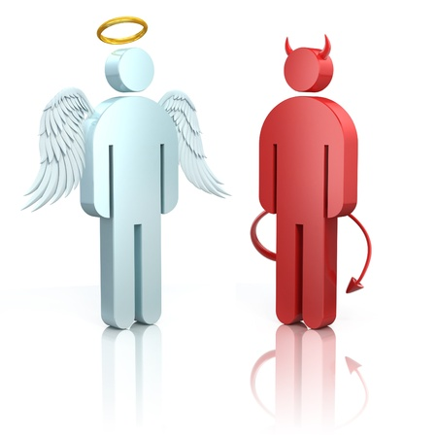
THINKING THAT THERE ARE “GOOD” PEOPLE AND “BAD” PEOPLE
Notes:
Graphic, two figures, one an angel, the other a devil illustrating the belief in go

Slide 26
OR
I already am ethical…
Notes:
HERE IS THE NEXT CHALLENGE. STUDIES SHOW THAT PEOPLE ALREADY THINK THEY ARE ETHICAL AND THAT WHEN A SITUATION COMES UP, THEY WILL NATURALLY DO THE “RIGHT THING”

Slide 27
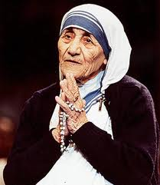
In fact, I have a better chance of getting into heaven than Mother Theresa
Notes:
Graphic, Mother Teresa holds her hands in front of her chest, seemingly in Prayer
A STUDY SHOWED THAT WHEN SURVEYED, MOST PEOPLE THOUGHT THEY STOOD A BETTER CHANCE OF GETTING INTO HEAVEN THAN MOTHER THERESA!
WHY IS THAT?
WE HAVE A VERY HIGH OPINION OF OUR ETHICS WHEN WE THINK ABOUT HOW WE ARE GOING TO ACT IN THE FUTURE.
BUT AT THE TIME OF THE ACTUAL DECISION, THERE ARE OTHER FORCES THAT ARE IN PLAY.

Slide 28
Mistake:
Relying on your “instincts”, assuming you are a good person all of the time

Slide 29
Why good people become corrupt #2

Slide 30

All I need to know about ethics I learned in Kindergarten
Notes:
Graphic, group of small children gather around a teacher with an open book in her lap symbolizing a kindergarten class.
I HEAR THIS A LOT. AND IT STEMS FROM A MISUNDERSTANDING THAT MOST PEOPLE HAVE.

Slide 31
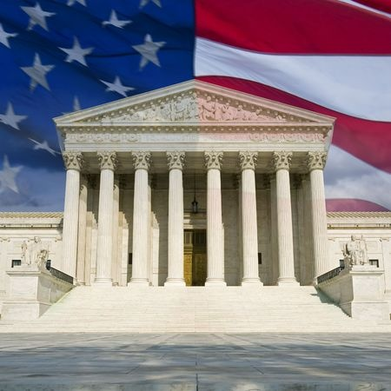

2 CONCEPTS OF ETHICS
Personal Organization
Notes:
Graphic, two business people have a conversation, representing personal ethics
Graphic, Government building with the American Flag, representing government ethics
THERE ARE 2 KINDS OF ETHICS WE ARE DISCUSSING; ONE IS PERSONAL ETHICS AND THE OTHER IS THE ETHICS OF THE ORGANIZATION ITSELF.

Slide 32
Organization Ethics/Values
No conflicts—independent judgment
Transparency
Fairness
Voting Conflicts
No Personal Gain
Notes:
Graphic, Government building with the American Flag, representing government ethics
WHAT WE ARE LEARNING TODAY IS “GOVERNMENT ETHICS” OR THE ETHICS OF THE INSTITUTION. ALTHOUGH RELATED TO PERSONAL ETHICS, THE VALUES ARE DIFFERENT AND RELATE TO HOW PEOPLE VIEW THEIR GOVERNMENT.

Slide 33
Problem:
Taking a casual attitude about ethics; you can figure it out when things come up

Slide 34
Why good people become corrupt #3

Slide 35
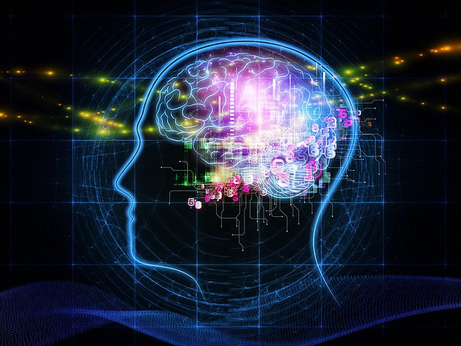
NOT KNOWING ABOUT SUBCONSCIOUS TRICKS YOUR MIND PLAYS ON YOU
Notes:
Graphic, the outline of a head with a drawing of the brain visible and glowing with lights to represent the way the mind works

Slide 36
Behavioral ethics
I am never tempted and always 100% rational….

Slide 37
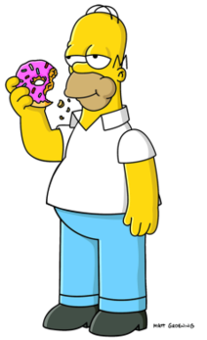
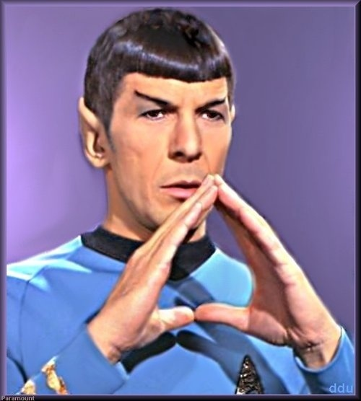
Mr. Spock vs. Homer Simpson
We don’t always act the way we want to!
Notes:
Graphic, Spock from Star Trek, to represent reason
Graphic, Homer Simpson from the Simpsons, to representing chasing wants

Slide 38
To make ethical decisions, you need to recognize your vulnerability to your own unconscious biases.
Notes:
SO THE LATEST RESEARCH IS IN THIS AREA—HOW TO RECOGNIZE YOUR BIASES; HOW NOT TO GET TRICKED WHEN YOU HAVE TO MAKE A DECISION. THAT COULD BE THE SUBJECT OF A WHOLE SESSION, BUT JUST MENTIONING IT HERE.

Slide 39

Blind Spots
Bazerman, Tennbruzel
Notes:
Graphic, Book cover, yellow with the words Bind Spots
IF YOU WANT MORE DATA ON THIS, I RECOMMEND “BLIND SPOTS”. IT IS FUN TO READ AND YOU WILL UNDERSTAND THIS TOPIC BETTER AND SEE YOUR BIASES AND THOSE OF YOUR CO-WORKERS.

Slide 40
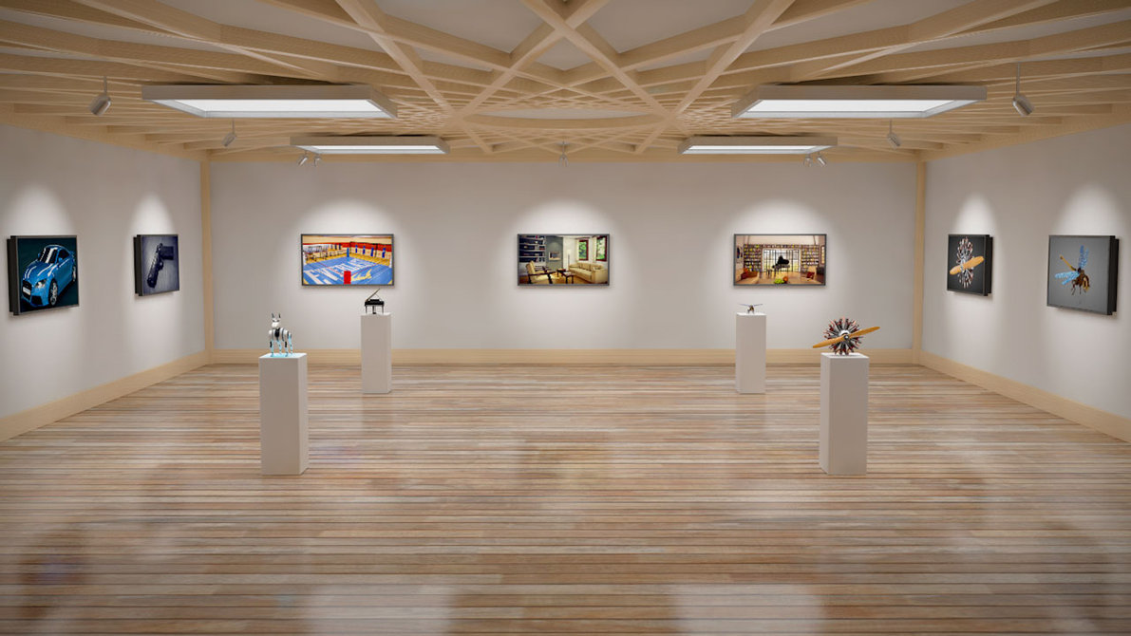
Notes:
Graphic, a large room with wood floors, several paintings hang on three walls, four pillars hold sculptures. The art gallery represent a study on subconscious bias taking place in an art gallery.

Slide 41
Why good people become corrupt #4

Slide 42
BUT IT’S LEGAL…..
I WAS TOLD BY A LAWYER I COULD DO THIS….

Slide 43
Law is about what you can do;
Ethics is about what you should do.

Slide 44
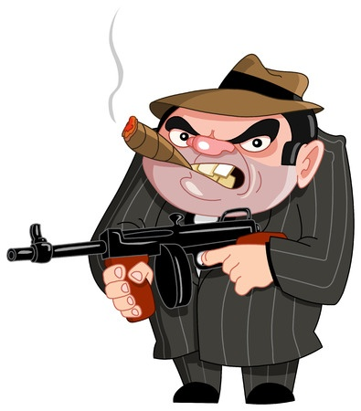
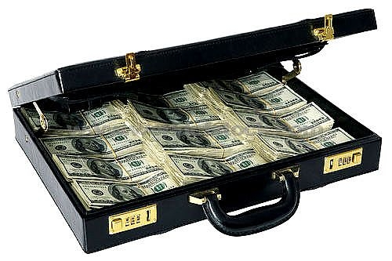
Notes:
Graphic, Cartoon image of a 1950s mobster holding a tommy gun and smoke a cigar
Graphic, Briefcase that is cracked open to show it is full of $100 bills
WHEN WE HEAR THE WORD CORRUPTION, TYPICALLY WE THINK OF GROSSLY ILLEGAL ACTIVITIES. LIKE THE MOB, OR TAKING BRIBES, CASH IN SUITCASES.

Slide 45
CORRUPTION
CORRUPTION IS AN ABUSE OF PUBLIC POWER FOR PRIVATE GAIN THAT GOES AGAINST THE PUBLIC INTEREST. IT IS NOT ALWAYS ILLEGAL.
Notes:
BUT THE WORD HAS A BROADER MEANING. (READ THE DEFINITION ABOVE)
THE MAIN IDEA IS THAT POWER YOU HAVE AS A PUBLIC OFFICIAL CAN BE MISUSED FOR YOUR OWN BENEFIT; AND THIS CAN BE LEGAL! ALL CORRUPT ACTIVITIES ARE NOT ILLEGAL. SOMETIMES PEOPLE FIGURE OUT LOOPHOLES IN THE LAW. IT DOESN’T MAKE THE ACTIVITY OK; YOU JUST DON’T GO TO JAIL FOR IT. INSTEAD, IT CAN HIT THE FRONT PAGE OF THE NEWSPAPER.

Slide 46

HARVARD ETHICS CENTER
INSTITUTIONAL CORRUPTION
INFLUENCES THAT SHIFT PRIORITIES
WEAKEN THE ORGANIZATION
WEAKEN PUBLIC TRUST
That are legal.
Notes:
Graphic, Official Crest of Harvard University
AN INTERESTING DEFINTION OF CORRUPTION COMES FROM THE HARVARD ETHICS CENTER. (READ)
LET’S SEE WHAT THAT LOOKS LIKE:

Slide 47
Why good people become corrupt #5

Slide 48
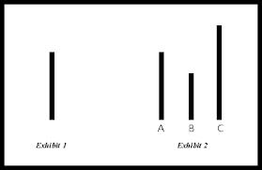
The Asch Experiment
Notes:
Graphic, a large white box, One line labeled Exhibit 1 appears on the left, Three lines Labeled A, B, and C appear on the right. A is the same length as Exhibit 1, B is slightly shorter, C is slightly longer

Slide 49
Why good people become corrupt #6

Slide 50
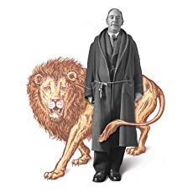
C. S. Lewis
Notes:
Graphic, A man identified as C.S. Lewis stands with a drawing of a lion surrounding him

Slide 51
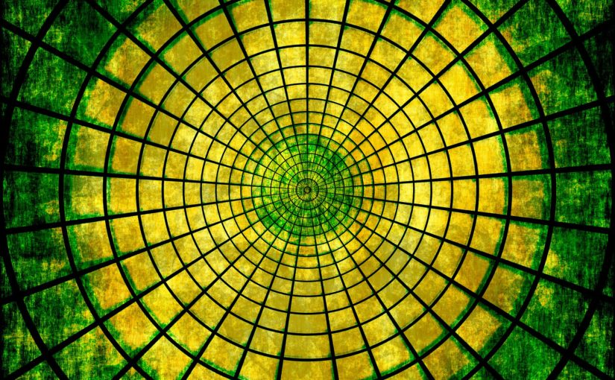
Notes:
Graphic, a series of circles getting progressively smaller and green on the outside and become more yellow as you approach the smallest circles in the middle.

Slide 52
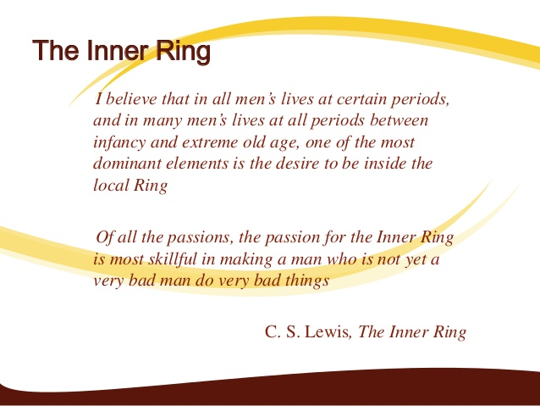
Notes:
The Inner Ring
I believe that in all men’s lives at certain periods, and in many men’s lives at all periods between infancy and extreme old age, one of the most dominant elements is the desire to be inside the local Ring. Of all the passions, the passion for the Inner ing is most skillful in making a man who is not yet a very bad man do very bad things. C.S. Lewis, The Inner Ring

Slide 53

Forget purpose
Notes:
Graphic, a compass pointing toward Southeast with a paper tag attached reading Purpose.

Slide 54
WHY SHOULD WE CARE?

Slide 55
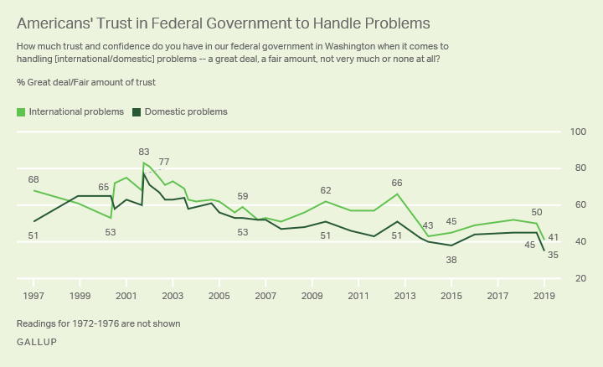
Trust in Government
Notes:
Graphic, line graph that shows a downward trend in “Americans’ Trust in Federal Government to Handle Problems” both international and domestic. From a gallup poll taken 199 to 2019. Trust in government is down to 35% for domestic problems and 41% for international problems in 2019.

Slide 56
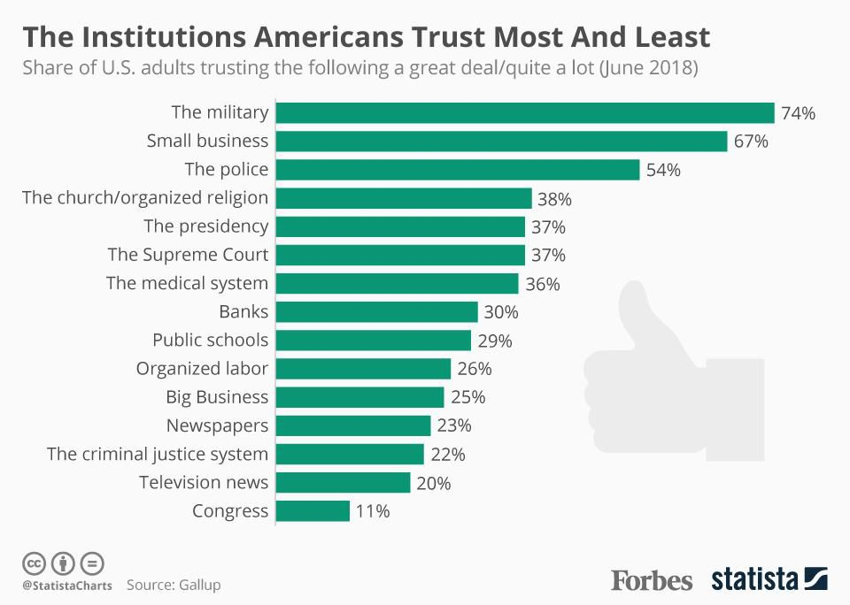
Trust
Notes:
Graphic, bar graph showing the Institutions Americans Trust Most and Least
Share of U.S. Adults trusting the following a great deal/quite a lot (June 2018)
The military 74%
Small business 67%
The police 54%
The church/organized religion 38%
The presidency 37%
The Supreme Court 37%
The medical system 36%
Banks 30%
Public schools 29%
Organized labor 26%
Big Business 25%
Newspapers 23%
The criminal justice system 22%
Television news 20%
Congress 11%

Slide 57
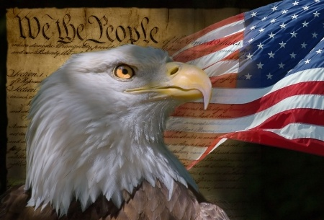
Our History, Our Heritage
Notes:
Graphic, Bald eagle, the constitution and American flag to represent the history of American government.
One of the key goals of the 1787 Constitutional Convention in Philadelphia was the creation of checks and balances that would prevent corruption. Corruption was the topic of discussion in 25% of the Convention meetings. There was strong resentment at the time against the actions of King George III of Britain and his appointed "royal governors" who used their offices in America to enrich themselves and the King. Offices were bought and sold and land unfairly taxed. The accepted British and European culture at the time was to use your public office to make money for yourself, at the expense of the citizens. The English Parliament was not the voice of the people; it was the voice of the King. The American patriots waged a revolution to reverse this culture of corruption. They believed that public service required that officials put the interests of the people over their own private interests.

Slide 58
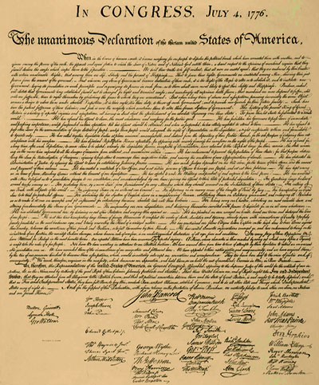
Our Declaration of Independence was a declaration of freedom from Corruption
Notes:
Graphic, declaration of independence

Slide 59
Framers Fear of Corruption
Defined as “excessive private interests influencing the exercise of public power”

Slide 60
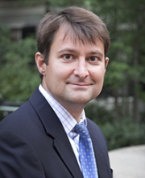
Dr. Bill English
Safra Center for Ethics, Harvard
Institutional Corruption and the Crisis of Liberal Democracy
We are in crisis; institutions are increasingly corrupted; our form of government is fragile; threat of demise
Notes:
Graphic, Bill English from the Safra Center for Ethics at Harvard

Slide 61
The Worst Corruption
“True danger of a republic is when citizens turn away from their government” Montesquieu

Slide 62
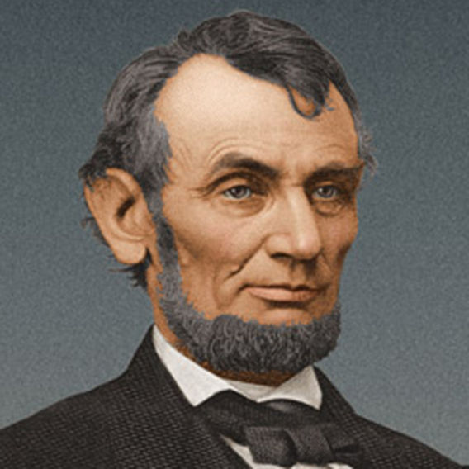
America will never be destroyed from the outside. If we falter and lose our freedoms, it will be because we destroyed ourselves. Abraham Lincoln
Notes:
Graphic, President Abraham Lincoln

Slide 63
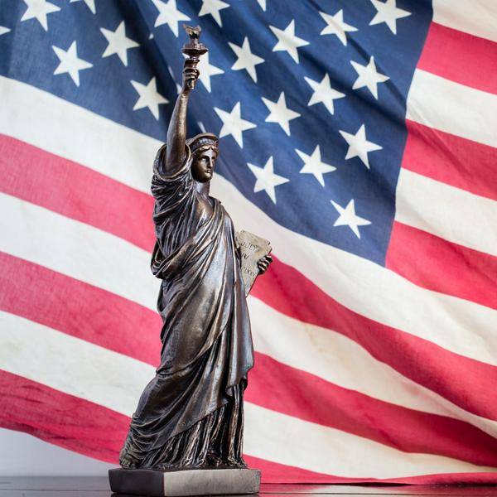
The fight for our freedoms in the U.S. is a fight that can be won at the municipal level. It is a fight against corruption.
Notes:
Graphic, Statue of Liberty in front of the American Flag

Slide 64
Question at Start…
What is the purpose of this activity?
What is the purpose of the Ethics Office?

Slide 65
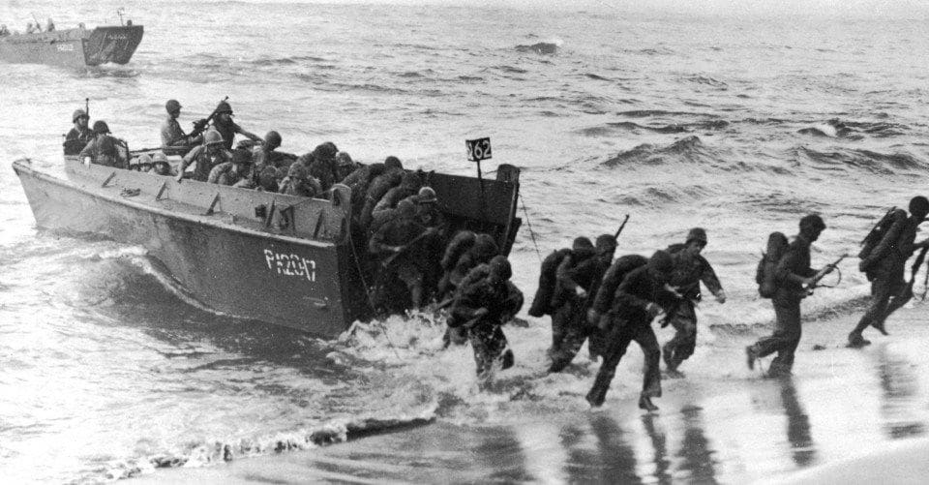
D-Day June 6
Notes:
Graphic, one boat load of World War two soldiers reaches the shore and men run off on D-day to represent the anniversary of D-Day, June 6

Slide 66
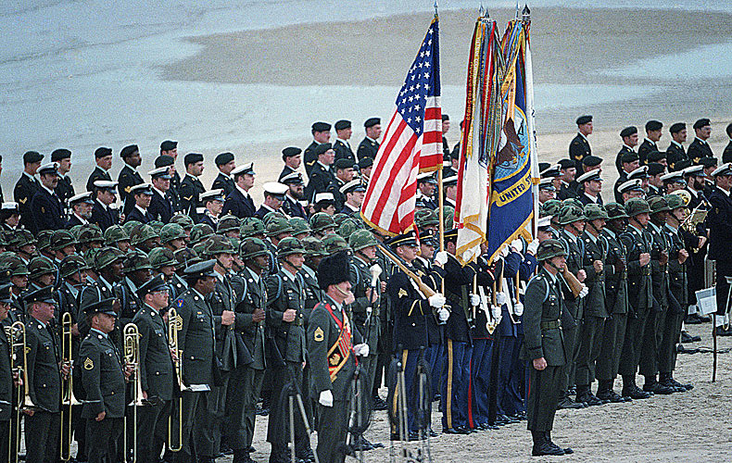
Notes:
Graphic, members of various militaries gather on a beach, stand in rows. They present the flags of the United States and branches of the military. Several hold instruments while others hold ceremonial weapons.

Slide 67
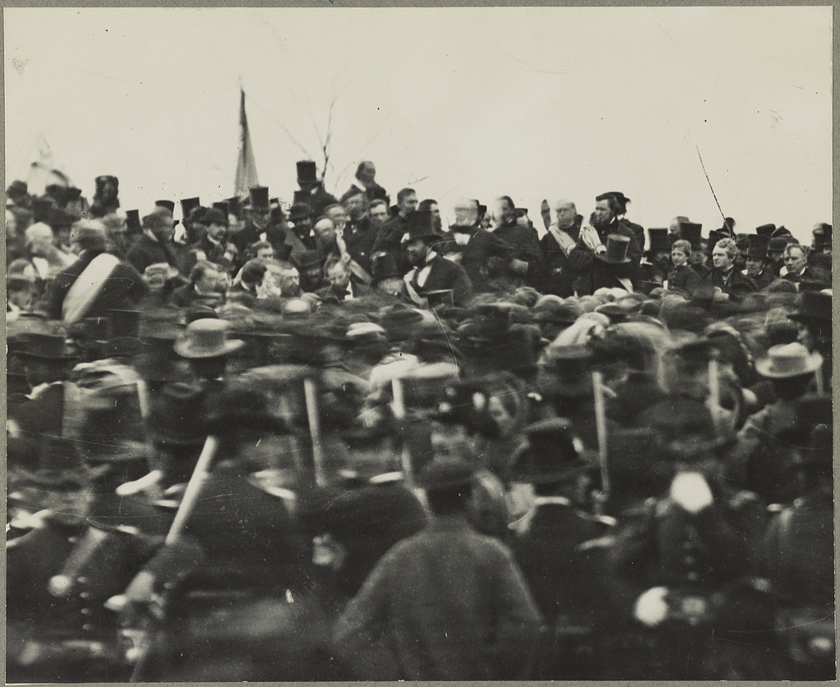
Gettysburg
Notes:
Graphic, a large group of soldiers gather around President Lincoln during the Civil War.

Slide 68

It is for us to be dedicated to the great task remaining before us—that from these honored dead we take increased devotion to that cause for which they gave the last full measure of devotion—that we resolve that these dead shall not have died in vain—that this …government of the people, by the people, and for the people, shall not perish from the earth.”
Abraham Lincoln, Gettysburg address
Notes:
Graphic, Statue of Liberty in front of the American Flag

