Slide 1

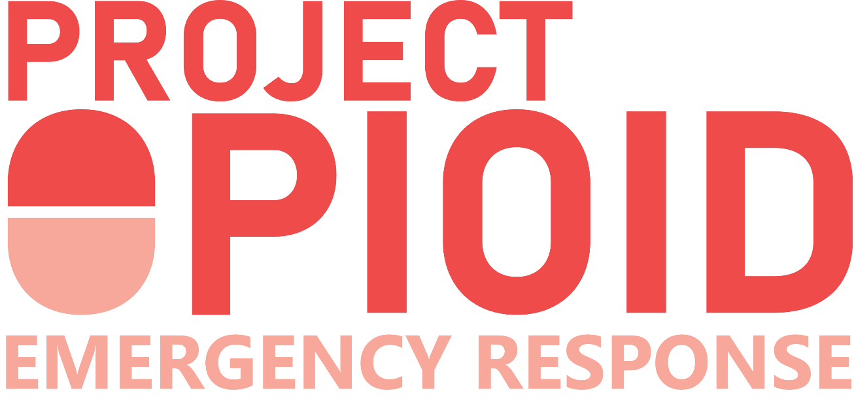

INSPIRING LEADERS TO SAVE LIVES

Slide 2

The opioid crisis is still an epidemic...
60%
of opioid-related deaths in Florida (2018) were under the age of 45
636,000+
Floridians are misusing opioids
14,334
opioid overdose calls were responded to by EMS in Florida (2018)
138,000
children in Florida were affected by the opioid epidemic in 2017 alone
$78.5 billion
a year is spent on healthcare costs, lost productivity, addiction treatment & criminal justice involvement associated with opioid misuse

Slide 3

… and the COVID-19 crisis has magnified it.
16%
increase in opioid overdoses from this time last year
50%
of Americans say the pandemic has affected their mental health
100%
Increase in telehealth services for one Orlando company within one month of COVID lockdowns
65,000
Additional deaths from suicide, drug & alcohol overdoses are anticipated due to COVID-19 alone
⅓
of Americans have displayed clinical signs of anxiety, depression, or both since the pandemic began

Slide 4
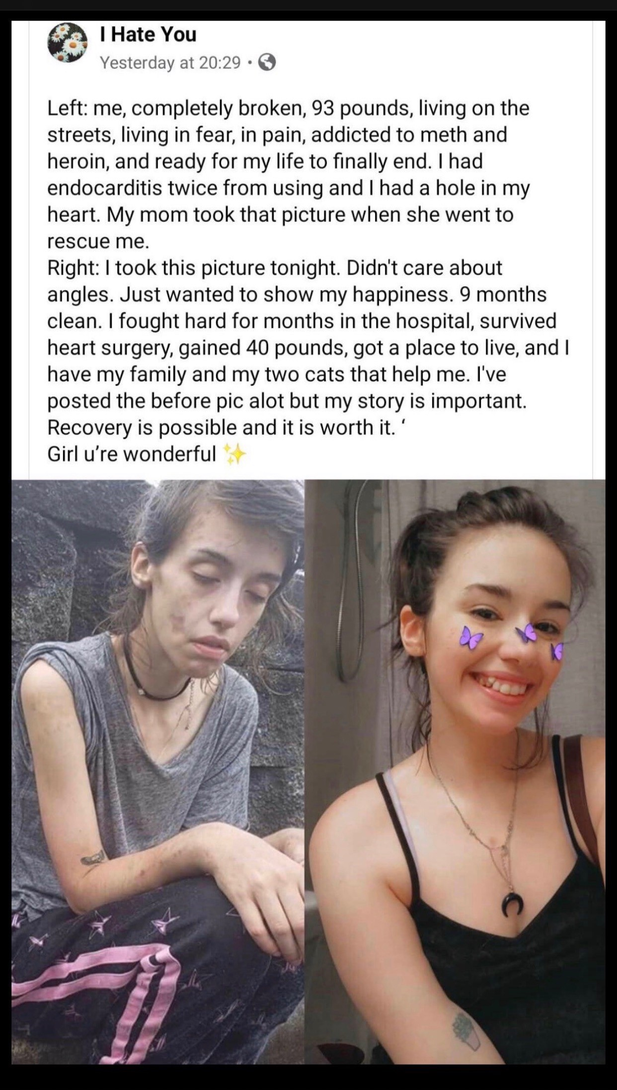

Why we do what we do…
Notes:
Andrae begins meeting, Dr. Ward says something, then introduce Dr. Wohl

Slide 5

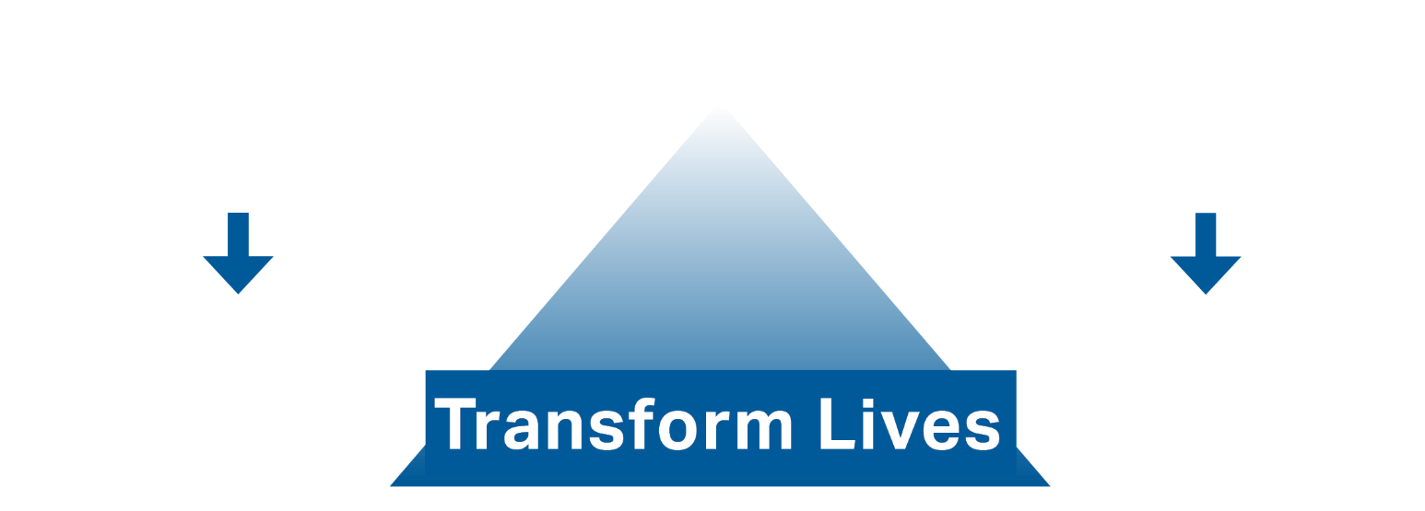
Project Opioid is a coalition of influential leaders who can no longer tolerate thousands of lives being lost every year to drug overdoses that are 100% preventable.
What is Project Opioid?
Our ultimate goal is to transform lives by reducing overdose deaths, opioid misuse and mental distress in communities across Florida.
Uniting leaders in your community to stop the addiction crisis
REDUCE
OPIOID DEATHS & MISUSE
REDUCE
MENTAL DISTRESS
Notes:
Banner image with the 3 at the top

Slide 6
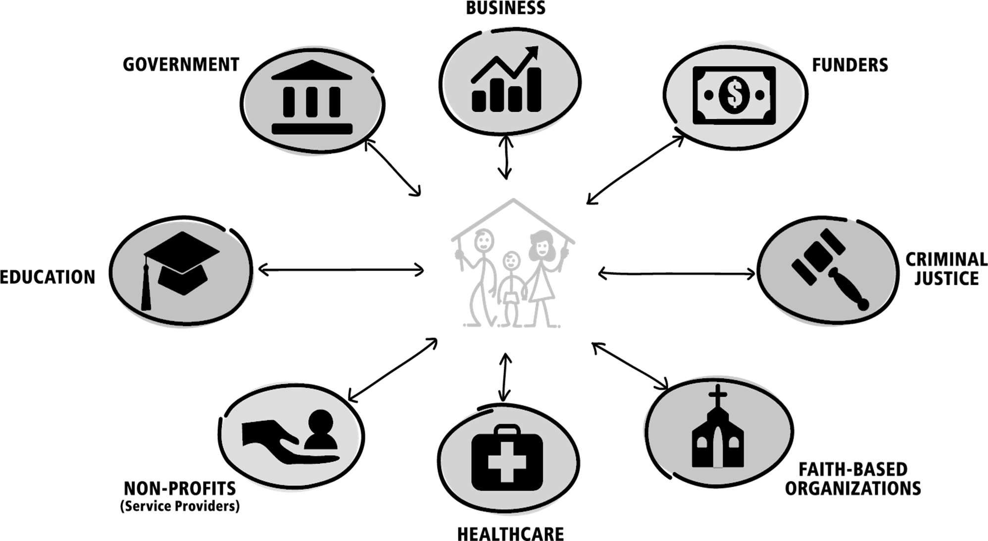
We exist to mobilize your community’s business, faith, and philanthropic leaders under one banner to end the addiction and mental health crisis, transform communities, and save lives.
What is Project Opioid?
Uniting leaders in your community to stop the addiction crisis
Notes:
Banner image with the 3 at the top

Slide 7



Business, faith, and philanthropic leaders can directly impact the lives of their employees, worshippers, and neighbors. They are the gatekeepers to real, progressive change within their communities.
Creating
the New Community Frontline
Meeting people where they work and worship to bring hope and healing to those struggling with opioids and mental health
Our vision is for every leader to recognize their important responsibility in bringing hope and healing to their communities, and courageously play their part in ending the opioid and mental health crisis.

Slide 8
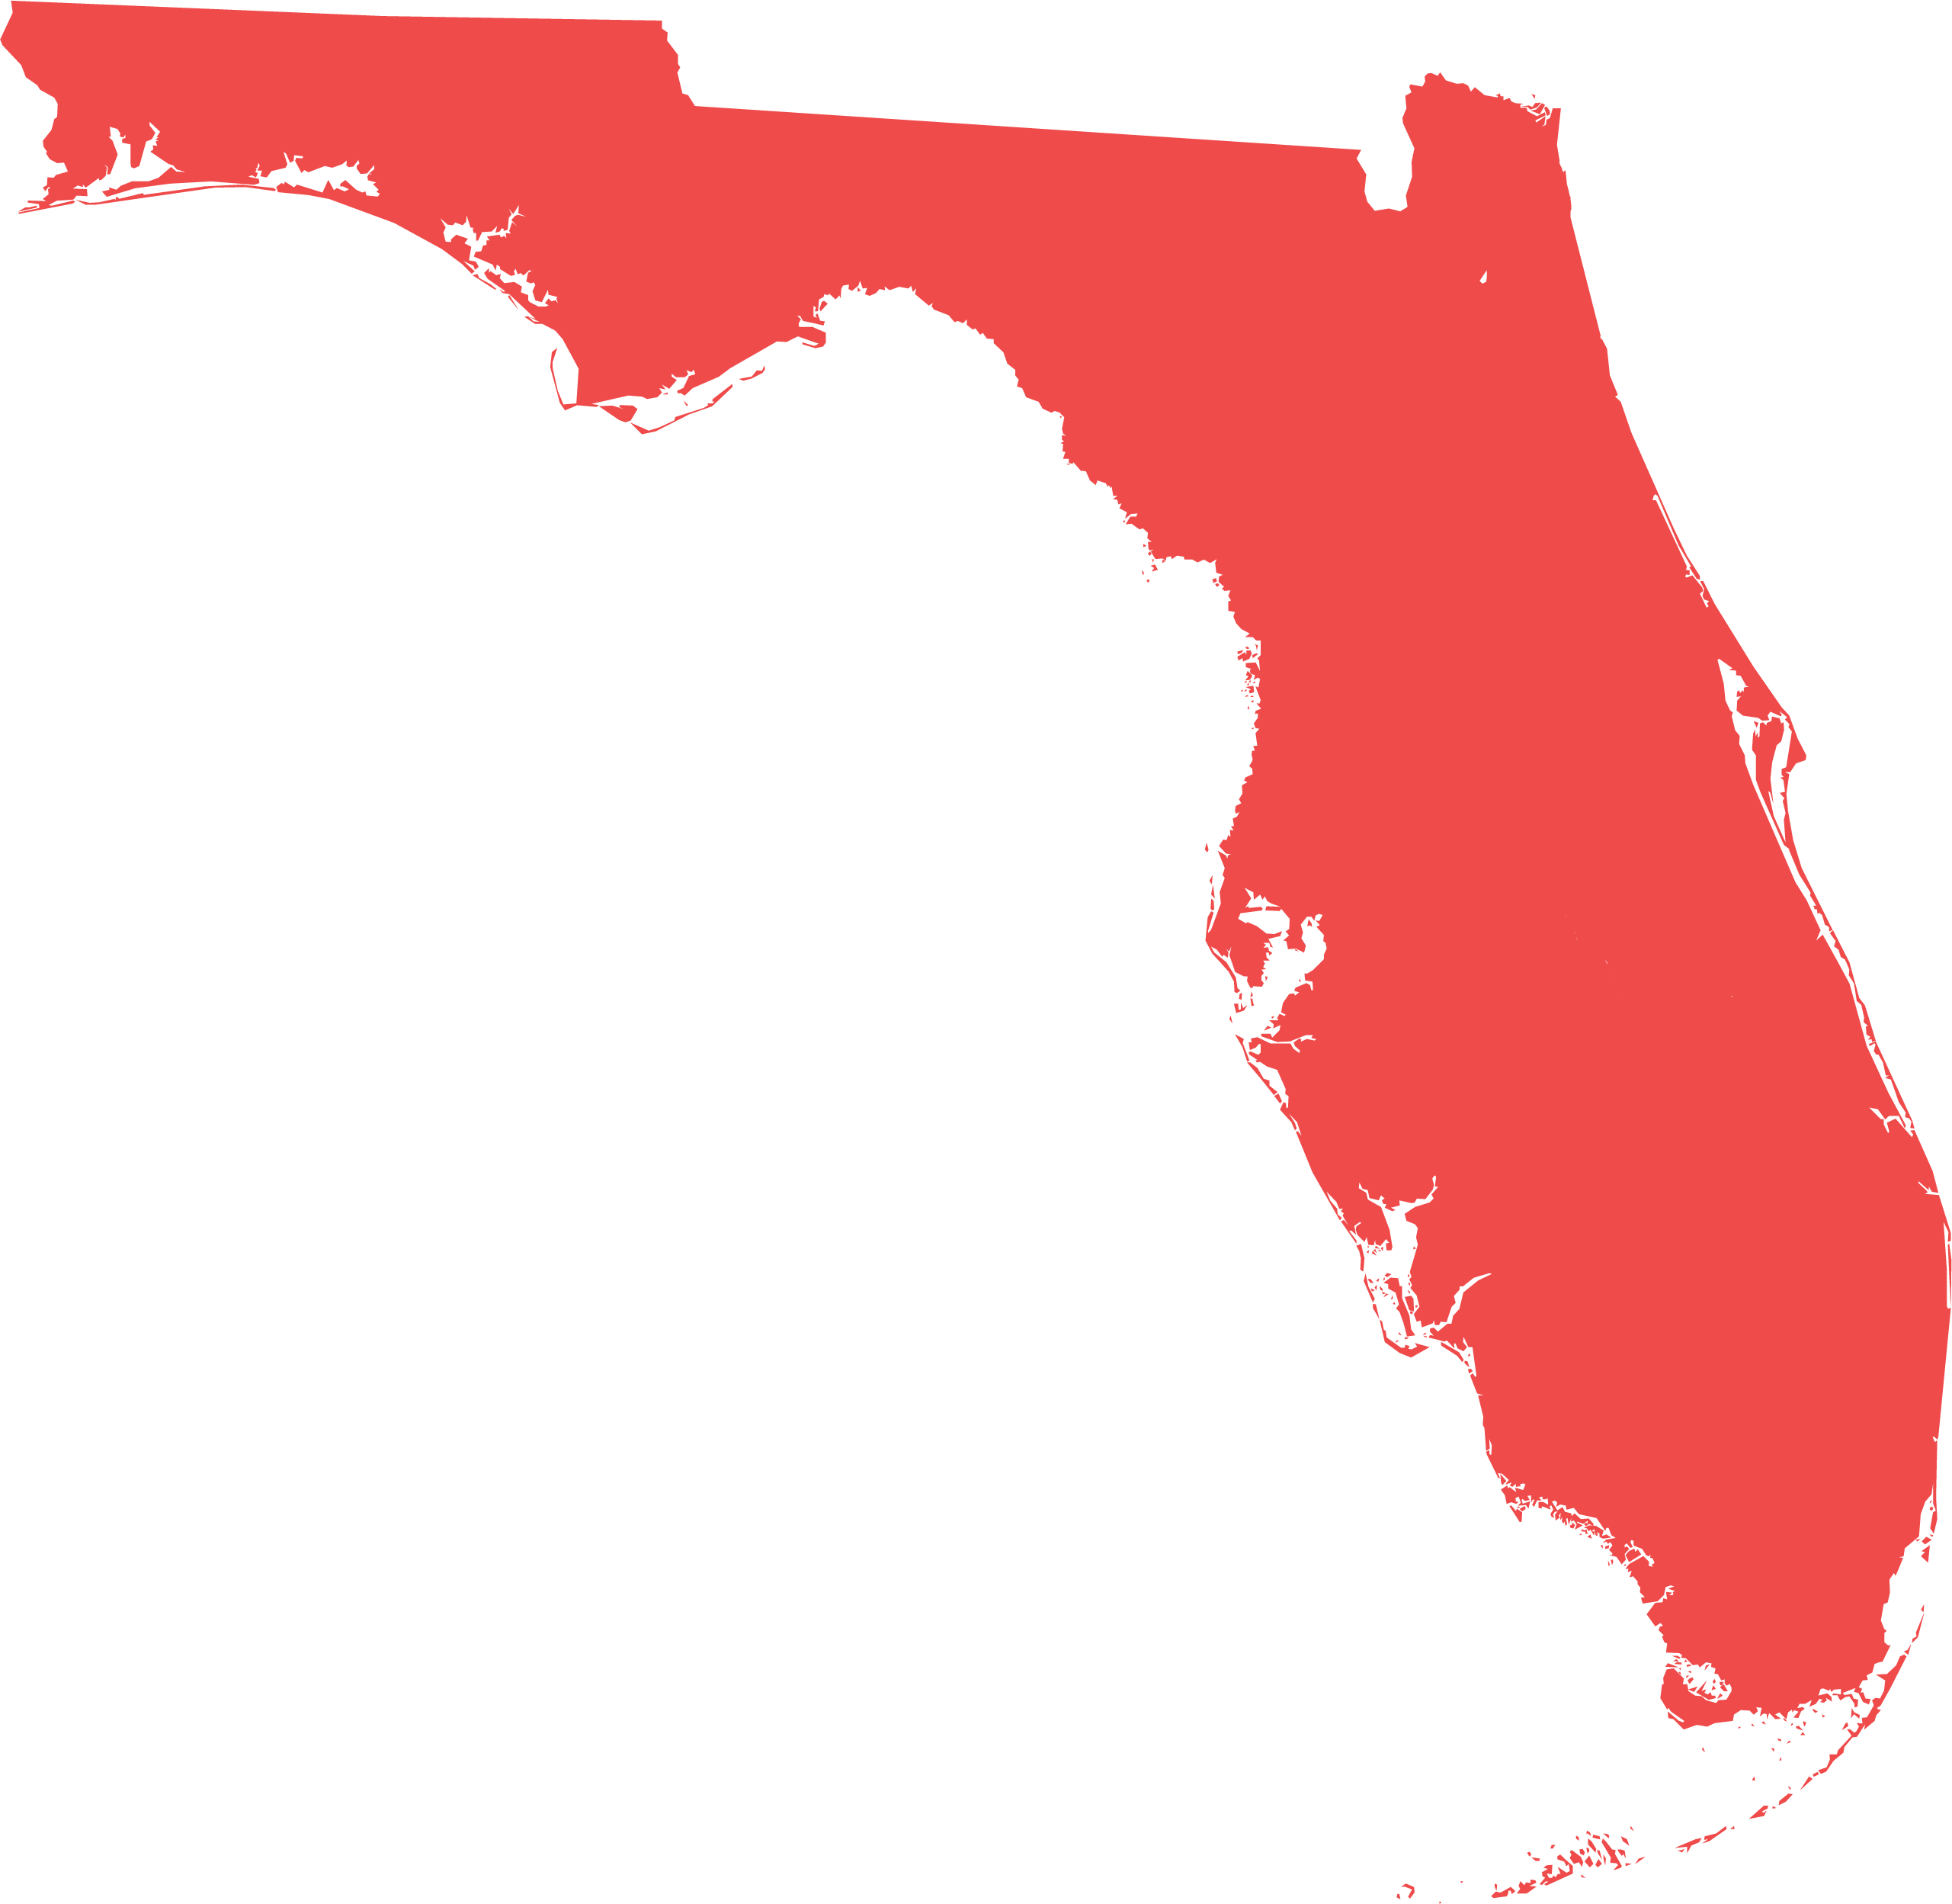
How will we reduce the opioid crisis?
Our Goals
Project Opioid’s ultimate goal is to reduce opioid overdose deaths in Florida by 50% over the next 36 months.
1
2
3
4
5
Increase access to naloxone
Expand access to medications for opioid use disorder
Expand access to mental health services & resources
General advocacy & education targeting Millennials & Gen Z
Empower leaders to solve the opioid crisis within their communities
Notes:
Kendall goes through goals

Slide 9

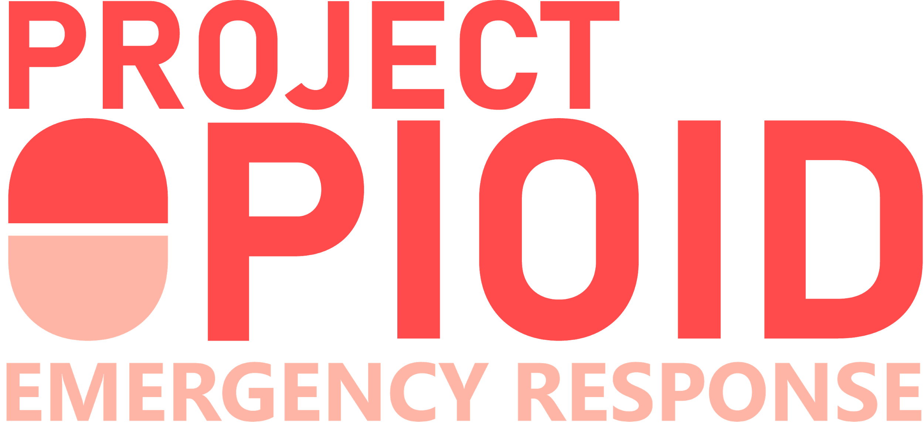
Driving Real Solutions:
01
02
03
04
05
Formulate High-Impact Strategies
Coordinate Between Stakeholders
Align Cross-Sector Leaders
Educate & Increase Awareness
Collect & Share Data
Recruit leaders from key industries that are passionate about making a difference
Analyze the needs of local regions through cross-sector data sharing
Using knowledge gained from our analysis
Begin the process of implementation with key partners
Educate leaders on the issues and inspire ideas for change
HOW TO IMPLEMENT SOLUTIONS THAT SAVE LIVES

Slide 10
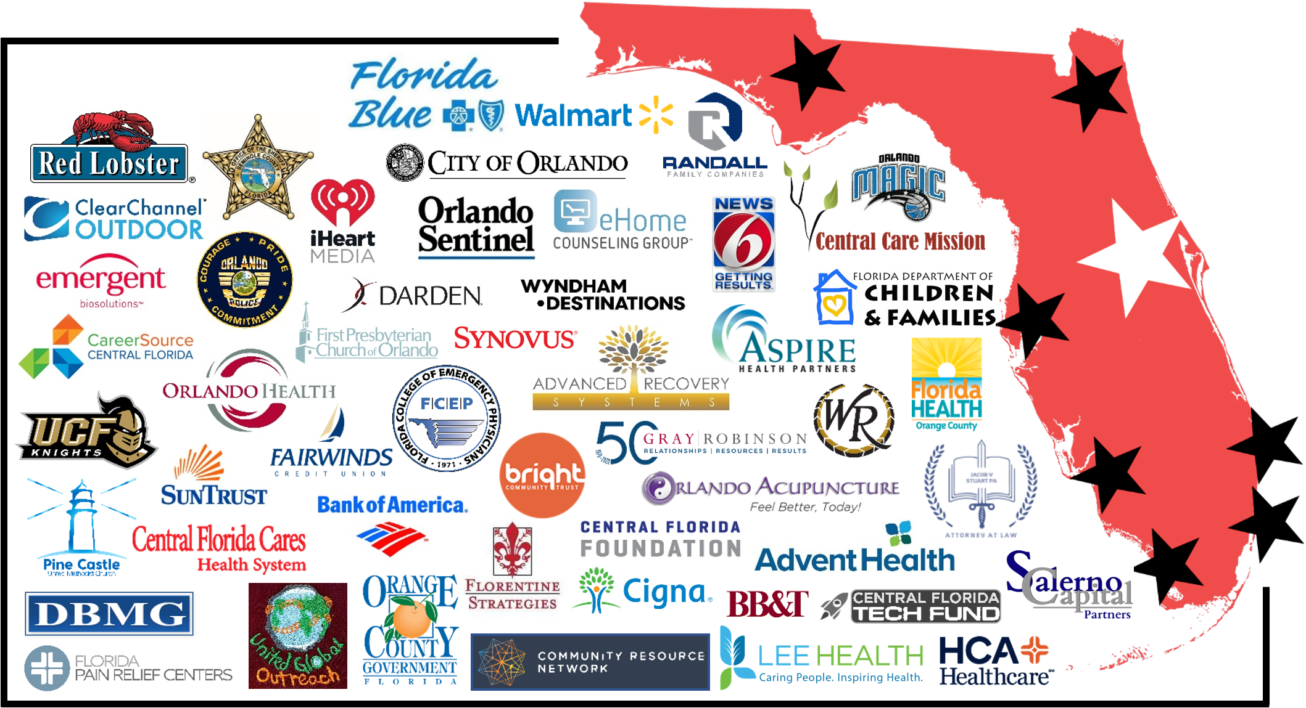
The Central Florida Coalition
CO-CHAIRMEN:
Kim Lopdrup,
CEO of Red Lobster
Sheriff Dennis Lemma,
Seminole County
Over 100 leaders from influential companies in Central Florida alone

Slide 11
Successes in Central Florida
Jan. 2019
Oct. 2019
May 2020
April 2019
Jan. 2020
Project Opioid was founded in Orlando
The Central Florida coalition grows to 100 members
Leadership releases data & regional recommendations
Project Opioid begins expanding statewide
Project Opioid launches the Naloxone Direct Connect program

Slide 12
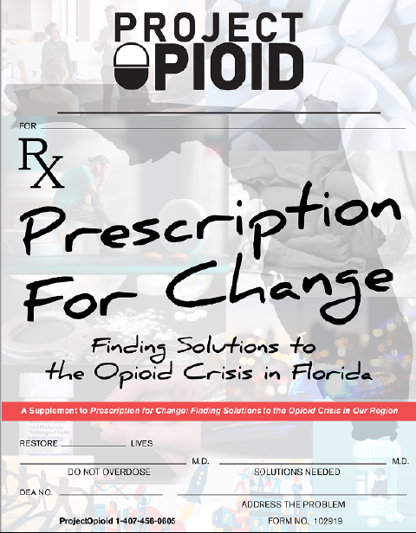
Data Drives Solutions
WHAT WE’VE DONE:
Statewide & Regional Study
“Prescription for Change: Finding Solutions to the Opioid Crisis in Florida” (Oct. 2019) is Project Opioid’s first needs assessment in the Central Florida region
Notes:
Go over findings

Slide 13
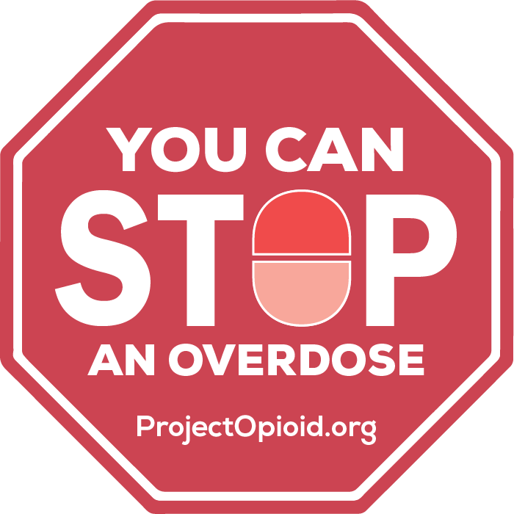
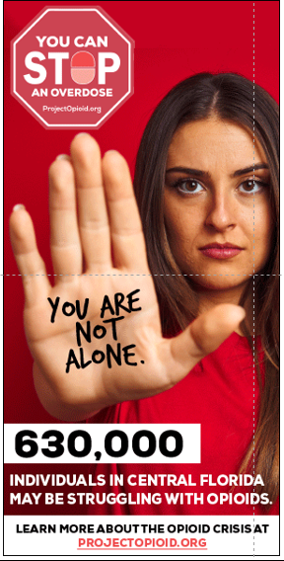
WHAT’S NEXT:
The STOP! Campaign is designed to significantly increase naloxone distribution in Central Florida.
“Leaders, help us teach your employees, worshippers and community that they have the power to STOP an overdose”
Educate your employees about naloxone & direct them to ProjectOpioid.org to order
Stock your shelves with emergency naloxone
Host an in-person distribution event
STOP! Campaign
Expanding Access to Naloxone

Slide 14


Slide 15
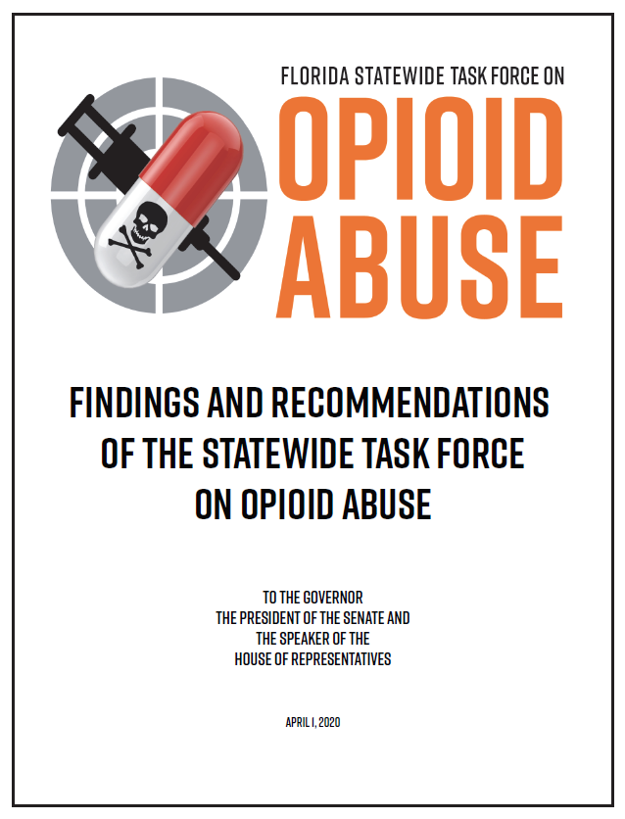
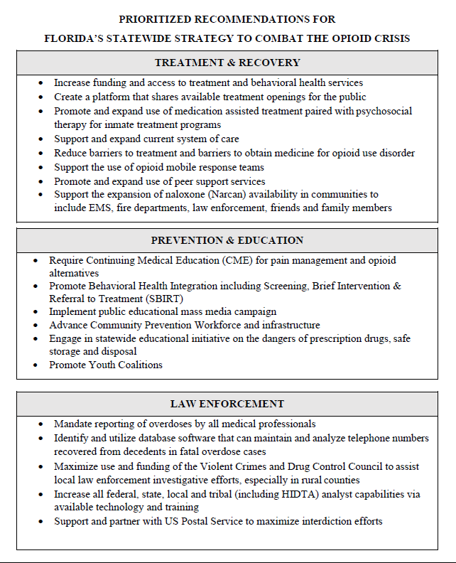
Driving Statewide Solutions
TREATMENT & RECOVERY
Increase access to treatment and behavioral health services
Support and expand current system of care
Reduce barriers to treatment and barriers to obtain medicine for opioid use disorder
Support the expansion of naloxone (Narcan) availability in communities
PREVENTION & EDUCATION
Implement public educational mass media campaign
Advance Community Prevention Workforce and infrastructure
DATA COLLECTION
Improve data collection and sharing across agencies

Slide 16
How You Can Help Us in 2020:
Project Opioid is creating coalitions across Florida and we need Leaders like you!
Florida Blue
& Funders
Frontline Leaders
Corporate &
Faith Leaders
Statewide Partners

Slide 17


1. Join with other leaders in your community to make a difference

Slide 18

2. Recruit your fellow business and faith leaders to join Project Opioid.

Slide 19
3. Advocate for and implement these solutions in your communities

Slide 20


We Need You in 2020!
We need strong and influential leaders, like you, in each community to save lives and make a difference.

Slide 21
What are your next steps?
Email me to receive your welcome invitation
Once admitted, select the committee you would like to be a part of and begin making changes in your community
Share our mission with three other influential business or faith leaders in your community

Slide 22

- Sheriff Lemma
“
When I meet with the families of individuals who are overdosing, I realize that behind every person navigating their path to recovery, there are 5-6 people crying in their pillow at night, on the verge of losing a loved one, and don't know where to turn. If that doesn't inspire you to want to do something more, I don't know what will.
- Seminole County Sheriff Dennis Lemma
Project Opioid Co-Chairman

Slide 23



Thank You
Kendall Ward, PhD, Director of Data , Analytics, & Strategy
kendall@projectopioid.org
Andrae Bailey, Founder
andrae@change-everything.com

