Slide 1
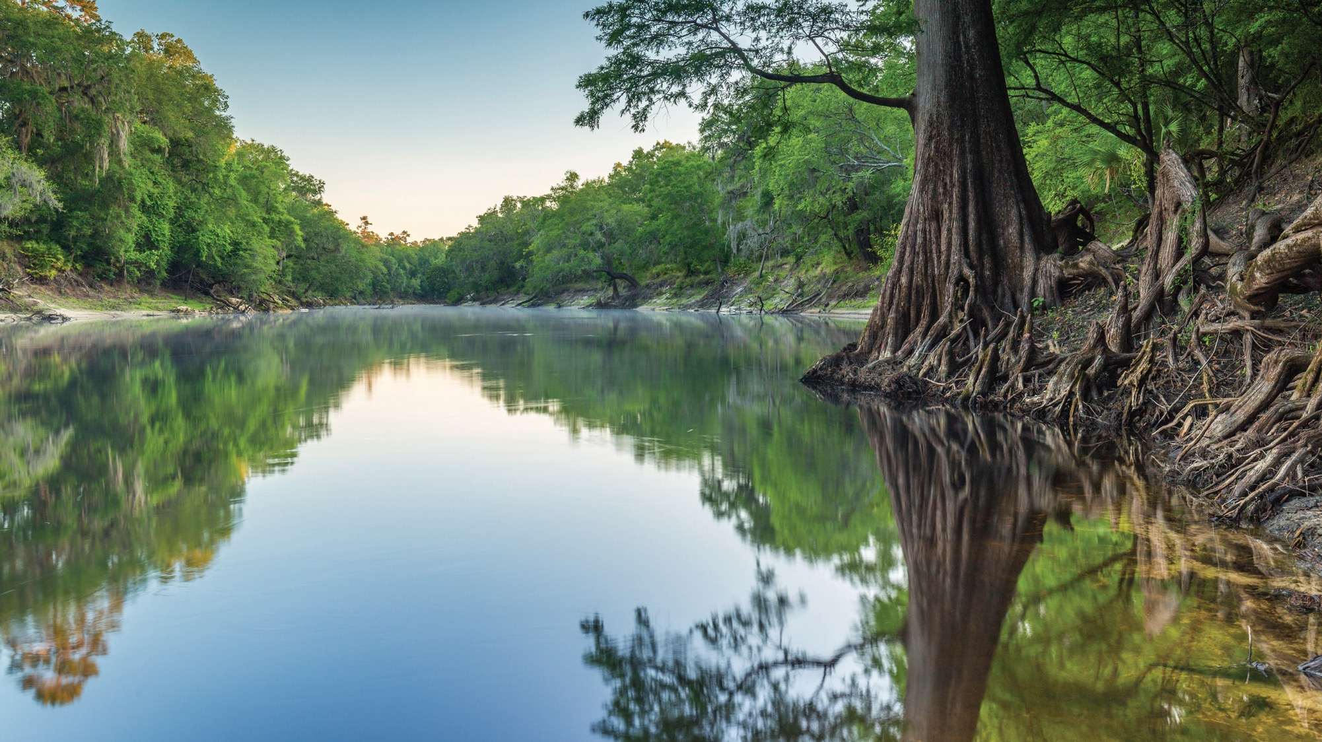
WHO IS DEP
A look into what DEP does, regulatory programs and how we can help protect the environment together
Kathryn Craver
Regulatory and Communication
Florida Department of Environmental Protection
Jacksonville | Oct. 5, 2023

Slide 2
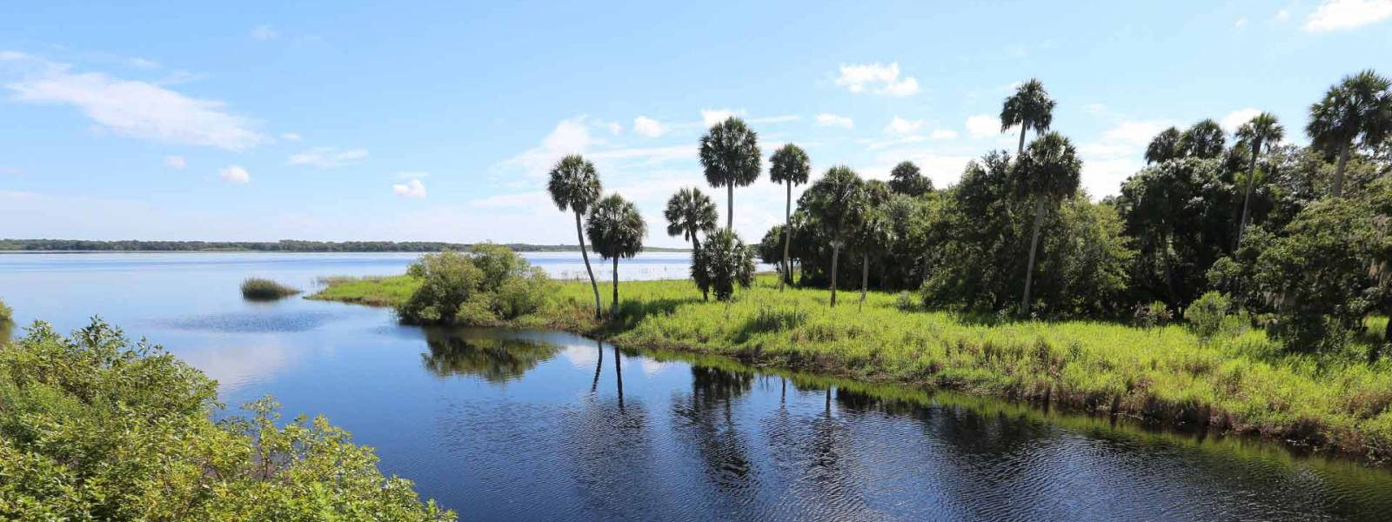
FLORIDA DEPARTMENT
OF ENVIRONMENTAL PROTECTION
Presentation Agenda
Who is DEP?
Our roles:
  Education.
  Communication.
  Outreach.
Regulatory Programs.

Slide 3

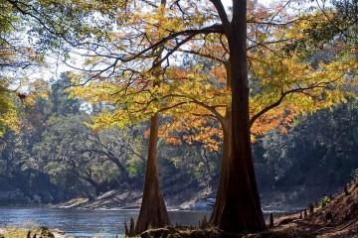
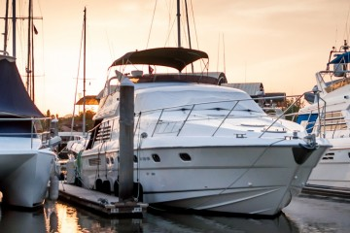
WHAT IS DEP?
The Florida Department of Environmental Protection (DEP) is the state’s lead agency for environmental management and stewardship, protecting our air, water and land.

Slide 4
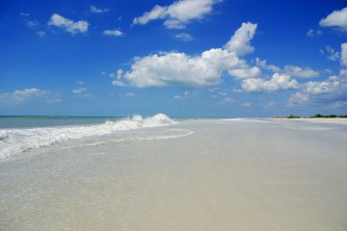
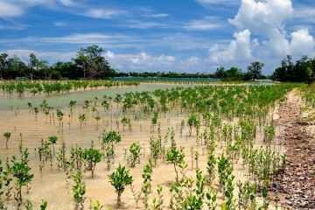
DEP VISION AND MISSION
DEP Vision
To advance Florida’s position as a world leader in protecting natural resources while growing the state’s economy.
DEP Mission
DEP’s mission is to protect, conserve and manage the state’s natural resources and enforces its environmental laws. DEP values are leadership, integrity, accountability, communication, innovation and service.

Slide 5
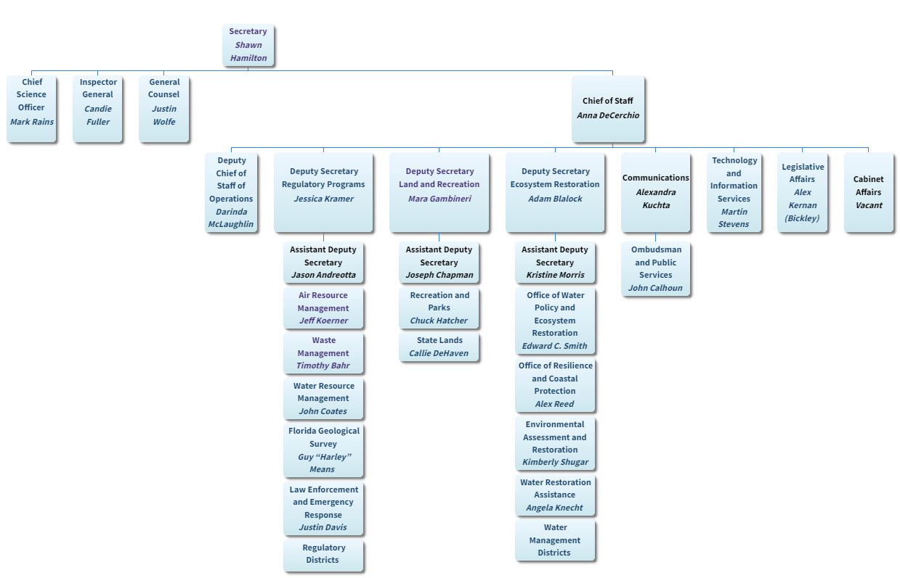
ORGANIZATIONAL CHART
Notes:
Air, Water Resources, and Waste Management.
Florida Geological Survey.
Division of Law Enforcement.
Emergency Response.
Six district offices.

Slide 6
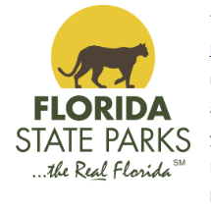
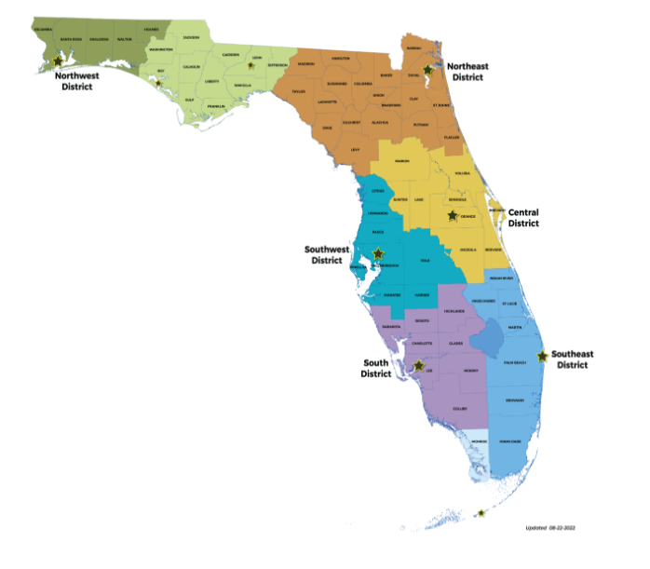
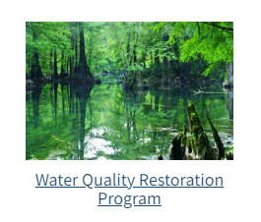
THE THREE PILLARS
Land and Recreation
Regulatory
Ecosystems Restoration
Notes:
About The Florida Department of Environmental Protection
DEP is divided into three primary areas:
Land and Recreation.
Regulatory.
Ecosystems Restoration.
Land: Acquiring and protecting lands for preservation and recreation. DEP oversees 175 state parks and trails and more than 12 million acres of public lands and 4 million acres of coastal uplands and submerged lands.
Regulatory: programs safeguard natural resources by overseeing permitting and compliance activities that protect air and water quality, and manage waste cleanups
Ecosystem: DEP works with communities, local governments and other agencies to protect and restore water quality and supply and to provide funding assistance for water restoration and infrastructure projects, as well as coordinates the protection of Florida’s submerged lands and coastal areas.

Slide 7
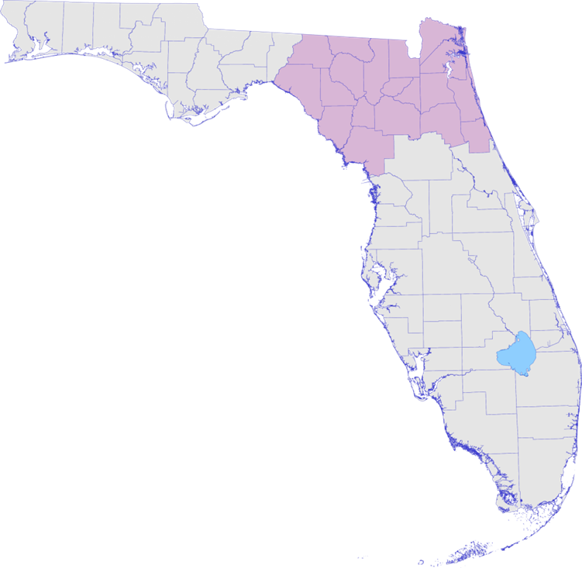

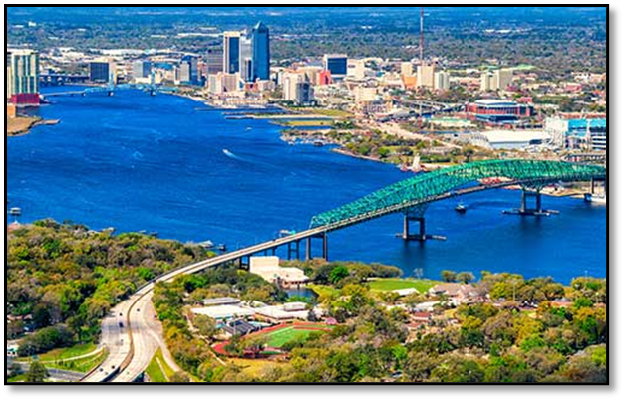
REGULATORY DISTRICTS
Central District - Orlando.
Southeast District – West Palm Beach.
South District – Fort Myers.
Southwest District – Temple Terrace (Tampa).
Northeast District – Jacksonville.
Northwest District – Pensacola.
FloridaDEP.gov
Notes:
Headquartered in Tallahassee
The Northeast District encompasses the largest land mass of any department regulatory district. Consisting of 19 counties, the area includes portions of the Atlantic coastal plain and regions bordering the Gulf of Mexico and the state of Georgia.
The district has more rivers than any other district including the St. Johns, Nassau, Tolomato Rivers, as well as the historic Suwannee and Santa Fe Rivers.
The District’s counties include Alachua, Baker, Bradford, Clay, Columbia, Dixie, Duval, Flagler, Gilchrist, Hamilton, Lafayette, Levy, Madison, Nassau, Putnam, St. Johns, Suwannee, Taylor and Union counties.

Slide 8
NORTHEAST DISTRICT PERMITTING
Northeast District Permitting Program
Environmental permits help minimize potential environmental disruption as the result of common human activities.
DEP’s Northeast District works proactively with stakeholders to consistently draft high quality permits in the shortest time possible.
In an average year, the Northeast District will handle over 2,000 permits, clearances and other authorizations.
Permitting Contacts for Northeast District | Title | Phone | Email
Katie Miller | Program Administrator | 904-256-1509 | Katie.Miller@FloridaDEP.gov
Paul Duff | Environmental Manager/CWE | 904-256-1625 | Paul.Duff@FloridaDEP.gov
Taylor Hohmann | Environmental Manager | 904-256-1640 | Taylor.Hohmann@floridaDEP.gov
Shannon Taylor | Environmental Manager | 904-256-1617 | Shannon.N.Taylor@FloridaDEP.gov
Brian Durden | Environmental Manager | 904-256-1575 | Brian.Durden@FloridaDEP.gov

Slide 9
NORTHEAST DISTRICT COMPLIANCE
Northeast District Compliance Assurance Program
Responsible for ensuring compliance with state and federal rules and regulations.
Divided into teams of field inspectors and subject matter experts.
Compliance Contacts for Northeast District | Title | Phone | Email
Tom Kallemeyn | Assistant Director | 904-256-1616 | Thomas.Kallemeyn@FloridaDEP.gov
Joni Petry | Environmental Administrator | 904-256-1606 | Joni.Petry@FloridaDEP.gov
Keri Armstrong | Environmental Manager | 904-256-1647 | Keri.Armstrong@FloridaDEP.gov
Shane Tierney | Environmental Manager | 904-256-1642 | Shane.Tierney@FloridaDEP.gov
Matthew Kershner | Environmental Manager | 904-256-1649 | Matthew.Kershner@FloridaDEP.gov
Vince Clark | Environmental Manager | 904-256-1559 | Vincent.Clark@FloridaDEP.gov

Slide 10
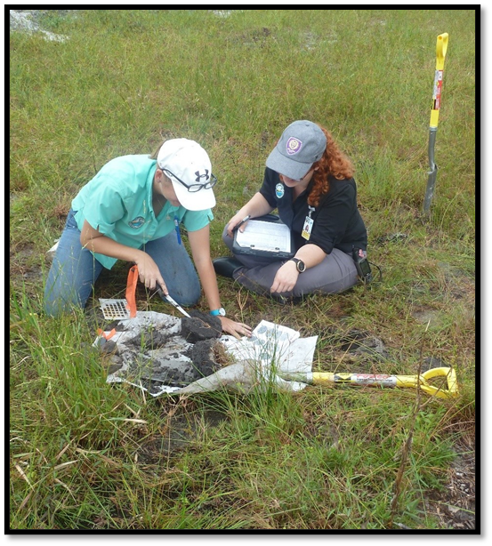
REGULATORY PROGRAM AREAS
Potable Water
Solid Waste
Hazardous Waste
Air
NPDES Stormwater
Wastewater
Storage Tanks
ERP/404

Slide 11
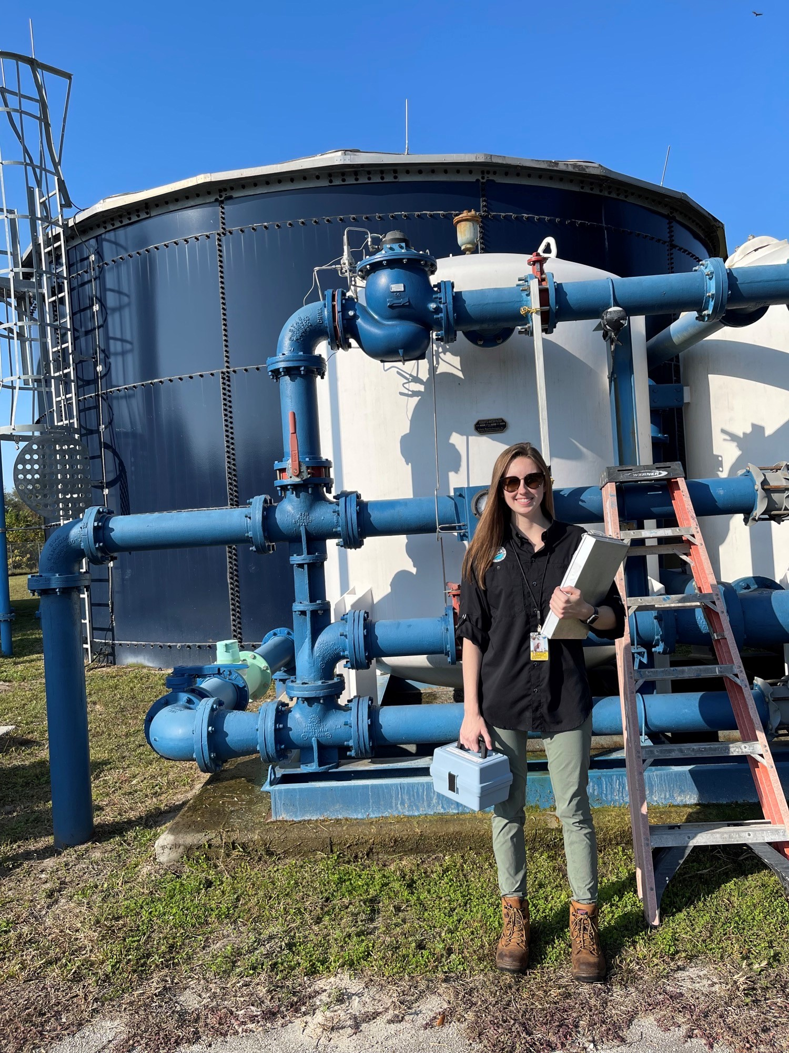
POTABLE WATER
Over 1,300 public water systems ranging from small businesses to major utilities.
Thousands of monitoring reports processed yearly.
Conduct sanitary surveys.
FloridaDEP.gov
Notes:
Permit construction of treatment and distribution systems that provide safe drinking water.
Inspect to ensure that operations and water are safe.
Our permitting team evaluates plans for distribution systems and issues permits for those systems.
Our compliance staff inspects the facilities that supply the water to their customers – every kind of supplier imaginable from the littlest mom & pop convenience store to the biggest civic suppliers (OUC has 425,000 customers and provides nearly 80 million gallons a day) – and even state parks.
And we read over 5,000 monitoring reports a year that tell us how clean the customer’s water is.

Slide 12
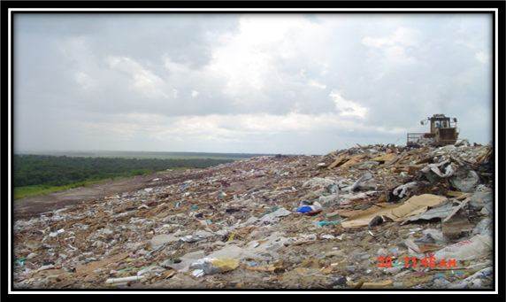
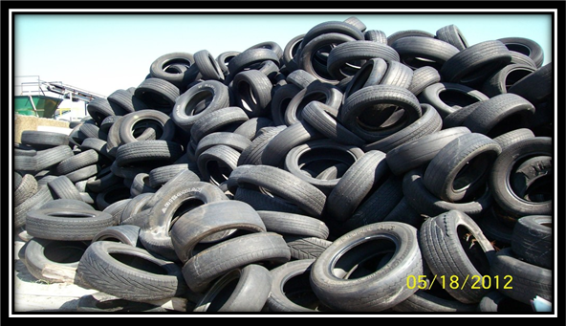
SOLID WASTE
Class I & III landfills (active and closed).
Transfer stations.
Hurricane debris sites.
Yard trash/organic material processors.
Waste tire inspectors.
FloridaDEP.gov
Notes:
Protecting air, surface water and groundwater through proper design and operation solid waste facilities
What is solid waste? “…garbage, rubbish, refuse, special waste, or other discarded material, including solid, liquid, semi-solid, or contained gaseous material…” - Rule 62-701.200(107), F.A.C.
From bags of leaves and grass clippings, to the stuff that goes in your trash barrel, to debris from construction sites, to electronics, to appliances...
“Dumps” are now a sophisticated operation. Designed by engineers and run by seasoned professionals.
The larger facilities are lined to capture all liquids so that leachate doesn’t pollute our groundwater – in fact, that leachate is collected, tested and disposed of properly.
But if you recall Hurricanes Charley, Frances and Jeanne, then you will recall how important our solid waste sites became to us.
If memory serves, there were enough downed trees and storm debris to fill the Citrus Bowl – and as tall as the Empire State Building.
So our staff works hard with the facilities prior to hurricane season to make sure that there are designated hurricane staging areas.
One of the main solid waste issues at state parks is the unauthorized/illegal dumping of:
Waste Tires.
Mixture of household waste & other debris.
Construction and Demolition (C&D) debris.
Discarded vehicles & small appliances, etc.

Slide 13
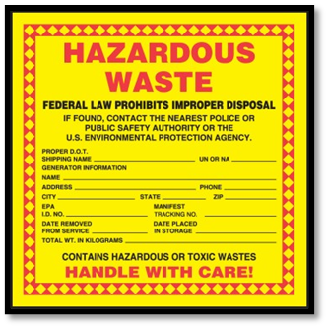
HAZARDOUS WASTE
Ranging from Very Small Quantity Generators (VSQGs) to Large Quantity Generators (LQGs).
Resource Conservation and Recovery Act (RCRA).
FloridaDEP.gov
Notes:
What is haz waste? 4 characteristics: ignitability, toxicity, reactivity, corrosivity
VSQG = auto body shop, LQG = Kennedy Space Center

Slide 14
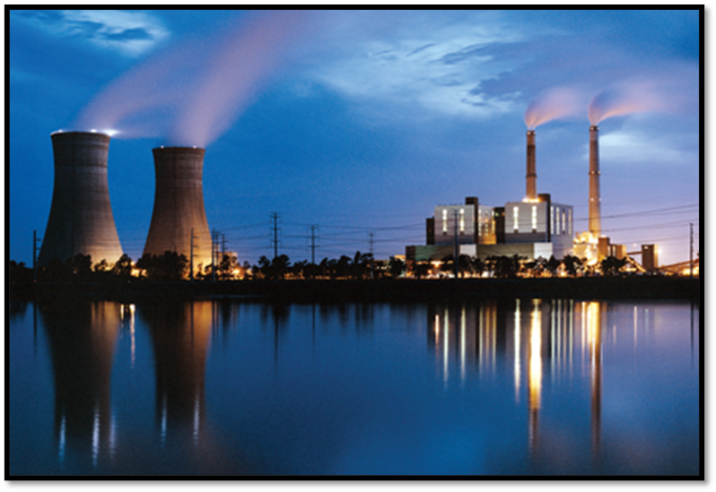
AIR RESOURCES
Air Permitting
  Title V Permits, True Minor Source Permits, Air General Permits.
Air Compliance
  Asbestos, Inspections of Stationary Sources.
Ambient Air Monitoring.
FloridaDEP.gov
Notes:
Over 400 facilities from concrete batch plants and dry cleaners to power plants, boat manufacturing, and theme parks.
Title V – EPA delegated to State of Florida
True Minor Source – state only permit
Air General Permit – state only permit
Compliance – Industrial, commercial sites
Ambient Air – QA/QC of monitors, NAAQS National Ambient Air Quality Standards

Slide 15

NPDES STORMWATER PROGRAM
NPDES = National Pollutant Discharge Elimination System.
Regulates point source discharges from three potential sources:
  Municipal Separate Storm Sewer System (MS4).
  Construction activities.
  Industrial activities.
FloridaDEP.gov
Notes:
Involves permitting, compliance, and enforcement activities
October 2000 EPA authorized DEP to implement the NPDES Stormwater Program in Florida

Slide 16
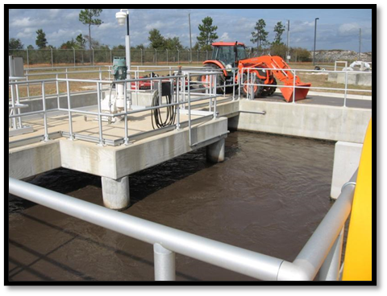
WASTEWATER
Industrial and Domestic wastewater facilities.
Regulate over 4,000 facilities.
Treated effluent and reclaimed water.
Discharge Monitoring Reports (DMRs).
Biosolids.
Spills.
FloridaDEP.gov
Notes:
Industrial: Carwashes, laundromats, concrete batch plants, slaughterhouses (roughly 2,100 facilities)
Domestic: (roughly 2,000 facilities) Approximately one-third of Florida’s population uses on-site sewage treatment and disposal (septic tanks) to treat their wastewater. These systems are permitted by the Florida Department of Health through the Bureau of Onsite Sewage. The remainder of Florida's population is served by domestic wastewater facilities permitted by DEP. (roughly 2,000 facilities)
Treated effluent/reclaimed includes disposal through surface water outfalls, deep aquifer injection wells, and other groundwater disposal such as percolation ponds and spray fields.
DMRs submitted on a monthly, quarterly, and annual basis.

Slide 17
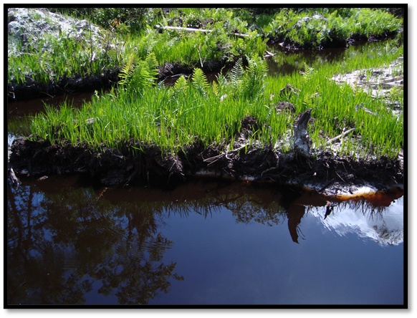
ENVIRONMENTAL RESOURCE PERMITTING (ERP)
Regulates activity in/on/over Wetlands.
Regulates activity in/on/over Surface waters.
Stormwater.
Regulates activity in/on/over State-owned, or sovereign submerged lands.
FloridaDEP.gov
Notes:
Wetlands, to shorelines... to mangroves to State Lands to docks to stormwater...
This program regulates activities in, on, or over surface waters or wetlands, as well as any activity involving the alteration of surface water flows. This includes activities in uplands that generate stormwater runoff from upland construction, as well as dredging and filling in wetlands and other surface waters.
In addition, activities that are located on submerged lands owned by the State of Florida, otherwise called state-owned, or sovereign, submerged lands also require a proprietary authorization for such use under Chapter 253, F.S. and Chapter 18-21, F.A.C. Such lands generally extend waterward from the mean high-water line of tidal waters, or the ordinary high-water line of fresh waters, both inland and out to the state’s territorial limit, which is approximately three miles into the Atlantic Ocean and ten miles into the Gulf of Mexico.

Slide 18
OPERATING AGREEMENT
DEP
History.
Single family residences.
Utility companies, if facility has other permits with DEP (i.e. air).
Stormwater east of A1A.
WMD
Commercial.
Agricultural.
Subdivisions.
Multi-family.
Stormwater.
  Industrial.
  Commercial.
Water Consumptive Use Permits.

Slide 19
404 PROGRAM
In 2018, Florida’s legislature passed a bill that gave DEP authority to begin the public rulemaking process to better protect the state’s wetlands and surface waters by assuming the federal dredge and fill permitting program under section 404 of the Clean Water Act.
FloridaDEP.gov
Notes:
In 2018, Florida's legislature passed a bill that gave DEP authority to begin the public rulemaking process to better protect the state's wetlands and surface waters by assuming the federal dredge and fill permitting program under section 404 of the federal Clean Water Act within certain waters. The rulemaking process was completed on July 21, 2020. Through this process, Chapter 62-331, Florida Administrative Code (F.A.C.), “State 404 Program,” was created to bring in the requirements of federal law not already addressed by the existing Environmental Resource Permitting (ERP) program.
The State 404 Program is responsible for overseeing permitting for any project proposing dredge or fill activities within state assumed waters. State assumed are any jurisdictional wetlands or surface waters that are not retained by the Army Corp of Engineers. Such projects include, but are not limited to: single family residences; commercial developments; utility projects; environmental restoration and enhancement; linear transportation projects; governmental development; certain agricultural and silvicultural activities; and in-water work within assumed fresh water bodies such as boat ramps, living shorelines and other shoreline stabilization.
Application forms can be found https://floridadep.gov/water/submerged-lands-environmental-resources-coordination/content/forms-environmental-resource; please note that ERP Individual and General Permit applications serve as both ERP and 404, if 404 was necessary.

Slide 20
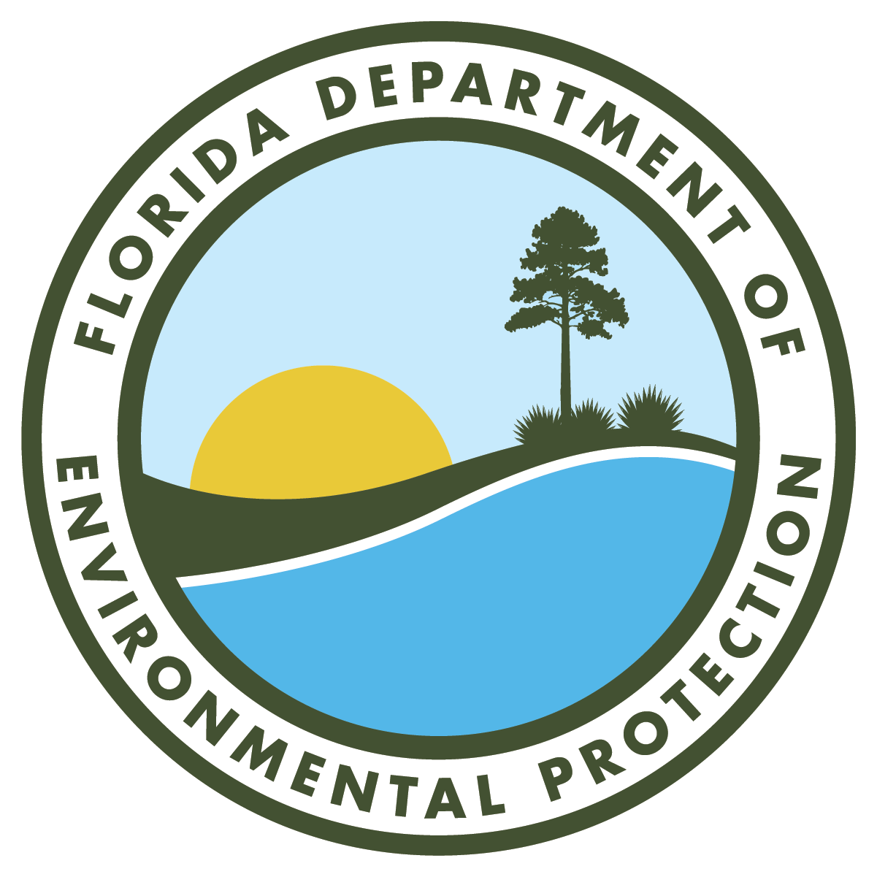
THANK YOU
Kathryn Craver
Regulatory and Communication
Florida Department of Environmental Protection
Contact Information:
Email: Kathryn.Craver@FloridaDEP.gov,

