Slide 1





M.H.O.P.
Mental Health Offender Program

Slide 2
Purpose
A pilot program to reduce the demands on the criminal justice system by helping those with mental illness. The program will provide pretrial release from custody, a customized plan of care to stabilize defendants, and court supervision to ensure compliance.

Slide 3
Background (Community Costs)
For mentally ill persons experiencing homelessness, the average cost to the community is $50,000 per person, per year. This includes jail time, emergency room visits, social services and other costs.*
When a permanent supportive housing solution is implemented, the average cost to the community is 25% to 50% less (between $12,000 and $24,000) when coupled with the necessary wraparound services.
Notes:
STATEMENT OF JUDGE STEVE LEIFMAN Chair, Supreme Court of Florida Task Force on Substance Abuse and Mental Health Issues in the Courts before the Subcommittee on Oversight and Investigations of the Energy and Commerce Committee of the UNITED STATES HOUSE OF REPRESENTATIVES:
Nationwide, jails and prisons have become the largest psychiatric facilities in most states. It is estimated that there are nearly 14 times as many people with mental illnesses in jails and prisons in the United States as there are in all state psychiatric hospitals combined…………Several years ago, the Florida Mental Health Institute at the University of South Florida completed an analysis examining arrest, incarceration, acute care, and inpatient service utilization rates among a group of 97 individuals in Miami-Dade County identified to be frequent recidivists to the criminal justice and acute care systems. Nearly every individual was diagnosed with schizophrenia, and the vast majority of individuals were homeless at the time of arrest….
*Citation for stats on Background slide:“Ending Chronic Homelessness Saves Taxpayers Money” Feb.17, 2017 Retrieved from Endhomelessness.org (National Alliance to End Homelessness)

Slide 4
Background (Increasing Need)
In the U.S., serious mental illness among jail inmates and prisoners is approximately 2 to 5 times higher than the general population.*
Duval County Data (JSO):
  2019: 925 people arrested with a mental health flag and 92 were homeless (10%)
  2020 (through Sept.): 658 people arrested with a mental health flag and 242 were homeless (37%)
Notes:
→ Same population frequently circulates through the Crisis Stabilization Units (CSU) via Baker Acts
Citations from Background, continued slide:
*Seth Prins, “The Prevalence of Mental Illness in US Prisons, A Systemic Review” Retrieved from ncbi.nlm.nih.gov/pmc/articles/July 2015
*“More Mentally Ill Persons Are In Jails and Prisons than Hospitals: A Survey of States” Retrieved from treatmentadvocacycenter.org/documents/final_jails v hospitals study (treatment Advocacy Center, National Sheriffs Association

Slide 5
Program Summary
Target population identified by JSO, State Attorney’s Office, and Sulzbacher based on prior data
Pre-trial diversion program
Criminal Justice system & Sulzbacher Center administer
Restore mentally ill individuals from criminal cycle to stability and personal responsibility
Notes:
(will be representative of all MH flags 37% homeless and 63% housed)
Criteria – history of repeated arrests for non-violent misdemeanors, are severely mentally ill and require intensive wraparound services

Slide 6
BUDGET / EXPENSES:
Personnel: | Request: | Sulzbacher Match
.75 Mental Health Jail Initiative Coordinator (to be housed at Courthouse) New Hire | $50,000 | $0
.4 FTE Psychiatrist @ $136,670 to devote time to working with individuals suffering from mental illness in this program = $54,668. Of this total, $27,334 is requested from this grant and $27,334 will be matched from Sulzbacher's HRSA grant. | $27,334 | $27,334
.5 FTE Psychiatric ARNP @ $100,000 to work with persons suffering from mental illness in this program. New Hire | $50,000 | $0
1 FTE Intensive Case Manager @ $32,000 to provide intensive case management and linkage to services for clients in this program. New Hire | $32,000 | $0
.75 FTE SOAR Processor @ $40,000 to provide linkage to benefits for clients. New Hire | $30,000 | $0
.75 FTE Peer Support Specialist @ $30,000 to provide ongoing support and counseling for clients. New Hire | $22,500 | $0
.25 Gateway Substance Abuse Counselor (contracted by Sulzbacher) | $0 | $20,000
.25 Goodwill Job Counselor (contracted by Sulzbacher | $0 | $15,000
Total Personnel: | $211,834 | $62,334
FRINGE Benefits @ 26% | $21,970 | $0
Total Travel: | $3,225 | $0
Total Equipment: | $4,900 | $0
Total Supplies: | $71 | $0
Other: | Request:
Housing through vouchers or other sources, figured at $800 per month x 9 months x 20 clients = $144,000. | $144,000 | $0
Hotel costs for up to two weeks per client until they are placed in permanent housing, figured at $300 per week x 2 weeks x 20 clients in one year = $12,000. | $12,000 | $0
Food vouchers for program clients until they can be connected to income or Foodstamps. Figured at $100 per client x 20 clients = $2,000. | $2,000 | $0
Pharmaceuticals (will supply all necessary Psychotropic and other meds) approx. $1000 per patient per year | $0 | $20,000-40,000
Total Other: | $158,000 | $20,000 - 40,000
TOTAL EXPENSES: | $400,000 | $82,334 - $102,334

Slide 7
Participating Agencies
Duval County Judges
State Attorney’s Office
Public Defender’s Office
Jacksonville Sheriff’s Office
Sulzbacher Center
Lutheran Services of Florida
Gateway Community Services

Slide 8
Program Scope
Number of Participants: 20-40
Length: 9 month pilot
Requirements – Conformance to Sulzbacher Center rules, compliance with mental health case plan, court supervision, and housing lease (if applicable).
Violations – Reported to Court during supervision.
Services – mental health treatment, free prescriptions, intensive case management; substance abuse treatment and scattered site housing (if needed);
Wraparound services: job placement, SOAR processor for SSI/SSDI, peer specialist, and other supportive services as needed

Slide 9
Target Population
JSO Crime Analysis Unit (CAU)
Number of Arrests
Type of Arrests
CAU Referral
Sends report to the Sulzbacher Center to review and select candidates
The Sulzbacher Center
Sends prospective candidates to State Attorney’s Office for approval
Mental Health Flags
Informs JSO
JSO Pre-Trial Services notifies Sulzbacher Center when candidate is arrested

Slide 10
MHOP Process Overview
Target Population
Eligibility Criteria
Defendant Arrested, Identified, and Screened
Defendant Referred to Judge for Approval and Release
Sulzbacher Staff Transport Defendant
Defendant Stabilized and Assessed by Clinicians
Defendant’s customized plan of care and pretrial diversion proposal is presented
The Sulzbacher Center will supervise Defendant and provide all critical services
Scope of Services
Notes:
Target Population – Identified by JSO, State Attorney’s Office (SAO), and Sulzbacher.
Will be representative of all mental health flags 37% homeless and 63% housed.
Eligibility Criteria
1) History of arrests for non-violent misdemeanors,
2) Severe mentally illness, and
3) Requires intensive wraparound services.
Defendants are arrested, identified in jail and screened by the Sulzbacher Center staff
Defendants are referred to the Judge in First Appearance. If approved, the defendant is released from custody under the supervision of JSO’s Pretrial Services Unit
Sulzbacher staff transport the Defendant to temporary housing for stabilization.
During the first two weeks the Defendant is screened and assessed by Sulzbacher treatment providers and intensive case managers to prepare a plan of care for the Court’s consideration
Defendant’s customized plan of care and pretrial diversion proposal is presented to the defendant, the Court, the SAO, and the Public Defender for consideration and approval. If defendant accepts, he/she is placed into the Pretrial diversion program to complete the program. If defendant declines, his/her case is transferred back to the original division for traditional prosecution.
The Sulzbacher Center will supervise Defendant and provide all critical services such as mental health treatment and intensive case management. Additional support will be provided depending on the needs of the Defendant including Defendant’s customized plan of care and pretrial diversion proposal is presented to the defendant, the Court, the SAO, and the Public Defender for consideration and approval.
Services include critical mental health treatment and intensive case management. Additional support will be provided depending on the needs of the Defendant including housing, substance abuse treatment, employment services, SOAR processing, etc.

Slide 11
Reported Outcomes
Taxpayer Savings: arrests, jail time, CSU and hospitals admissions
Reduction in Homelessness
Decrease in Recidivism
Increase Substance Abuse Treatment and Recovery
Income Attainment via employment and mainstream benefits
Notes:
These outcomes will be measured and reported on.

Slide 12
Collateral Community Benefits
Conservation of JSO resources
Conservation of JFRD resources
Reduction in demands on law enforcement for low level offenses thereby increasing resources for violent crime reduction
Improved criminal justice system collaboration
Restoration for mentally ill defendants
Increased capacity and safety for Pre-trial Detention Facility inmates and officers
Reduction of crime incidents and victimization

Slide 13
C.H.O.P. Study
12 months pre and post entry into program
23 client sample
Arrests ↓ 62% (67 to 26)
  Costs ↓ ($59,228 to $22,984)
Days in Jail ↓ (871 to 182)
  Costs ↓ ($53,131 to $11,102)
Crisis Stabilization Unit Admissions ↓ (28 to 0)
  Costs ↓ ($10,556 to $0)
Total costs dropped from $122,915 to $34,086.

Slide 14
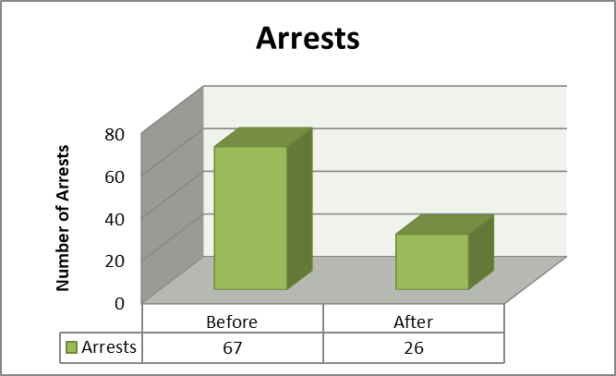
Incidents
62% Decrease

Slide 15
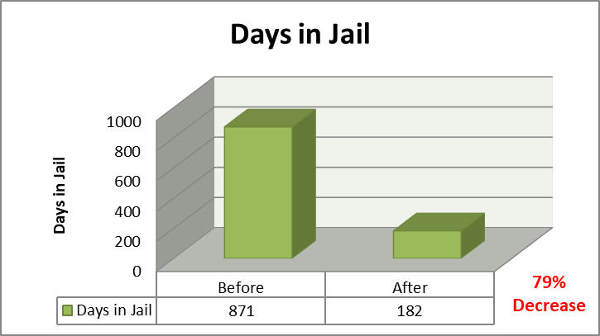
Incidents

Slide 16
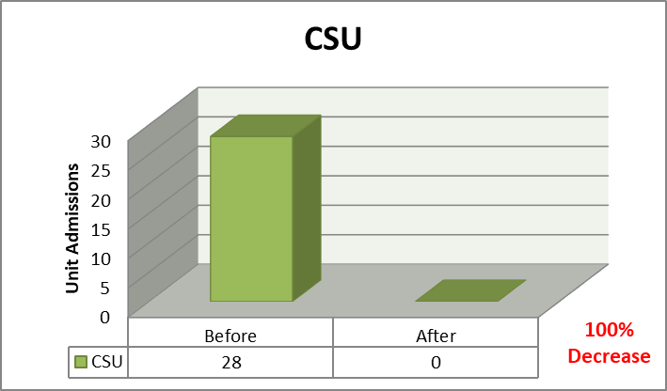
Incidents

Slide 17
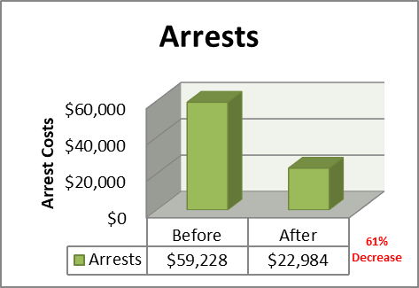
Cost Savings (Arrests)

Slide 18
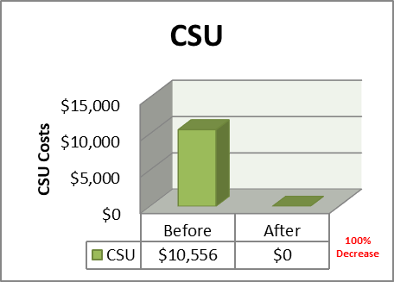
Cost Savings (CSU)

Slide 19
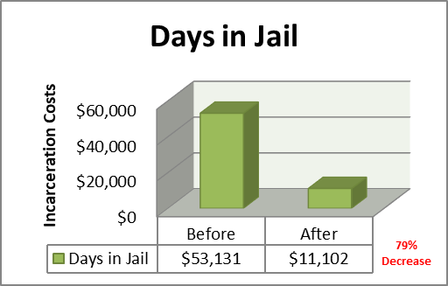
Cost Savings (Days in Jail)

Slide 20
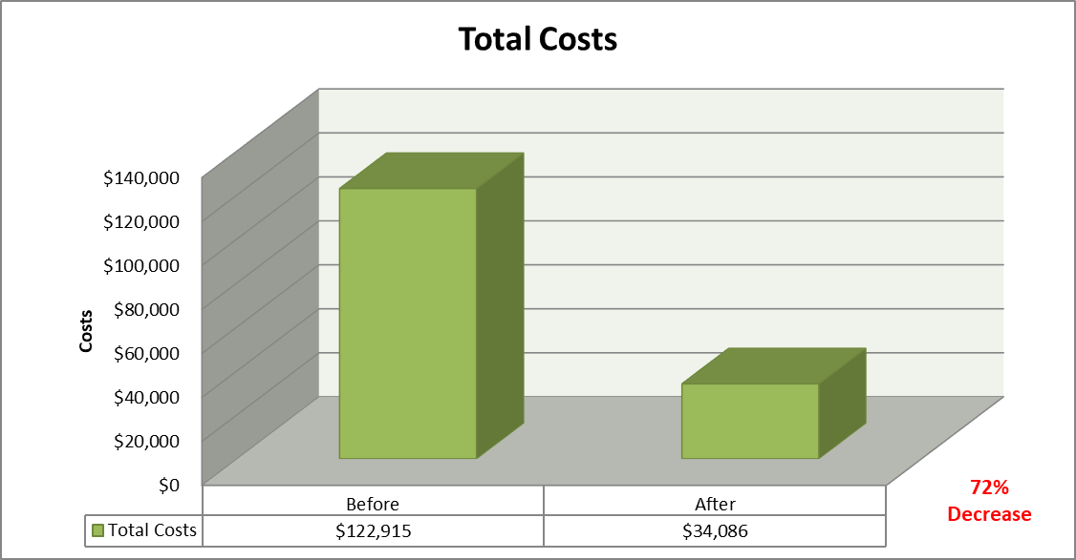
Total Cost Savings

Slide 21

Questions?

