Slide 1


CAMPAIGN OVERVIEW
TEEN VAPING AWARENESS CAMPAIGN
City of Jacksonville, FL
October 2, 2020

Slide 2





RFP & CAMPAIGN OBJECTIVES
“Develop and implement an anti-vaping campaign targeting middle and high school students.”
“[Raise] awareness regarding the dangers of vaping”
“[Help] children, their family members, educators, and communities develop greater awareness of the harmful products and delivery methods, as well as the health and addiction risks.”
Idea should resonate across all ages, however, the campaign sweet spot will be 15 - 16 year olds
----- 11 YEARS -----
----- 18 YEARS -----
----- 15 - 16 YEARS -----
2

Slide 3
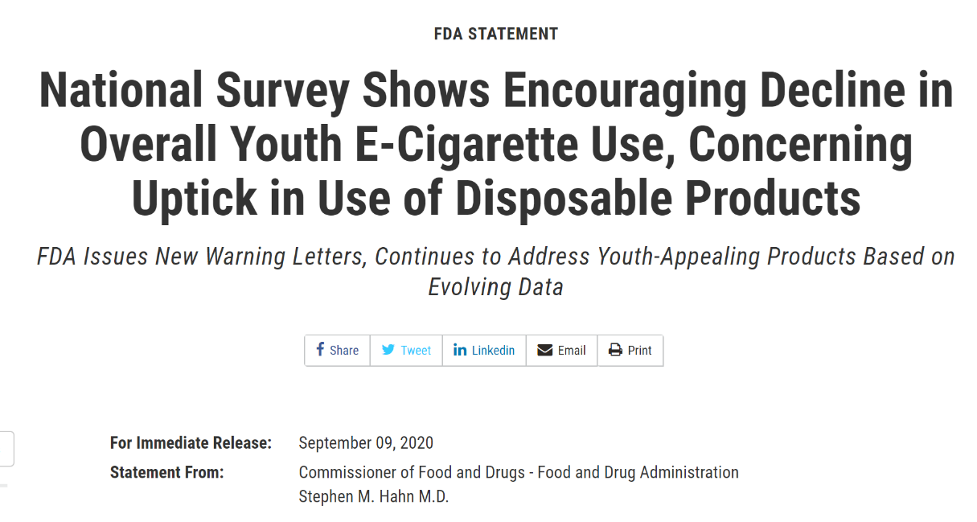
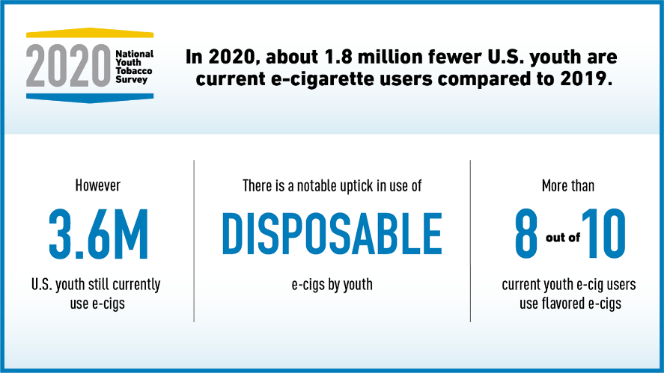
THE CHALLENGE
3

Slide 4
THE LOCAL STORY
Duval County youth (Middle- and High Schools) who have had “an electronic vapor product” in the past 30 days
2014: 6%
2016: 11%
2018: 14%
2020: 13.8%
4

Slide 5
LOCAL TRENDS
Per Duval County Public Schools, for the 2019-2020 school year there were approx. 22,000 students enrolled in middle school and approx. 30,000 high school students.
Using Florida Youth Tobacco Survey figures, that mean approx. 13,000 students have tried vaping and approx. 7,500 students currently vape.
Non-Hispanic Black Students
2016: 9%
2018: 7%
Hispanic Students
2016: 17.5%
2018: 17.5%
Non-Hispanic White
2016: 15%
2018: 19%
Females (use in the past 30 days)
2016: 12%
2018: 13.5%
Males (use in the past 30 days)
2016: 12%
2018: 13%
5

Slide 6
TO REACH YOUTH - AVOID PREACHING AND BLAME
Youth Marketing Research Provides Warnings And Opportunities
The teen and pre-teen market is incredibly valuable to companies across a host of market segments and, as a consequence, is well-studied.
Convey brightness, youth and vitality, and social aspiration
Be authentic. (Today’s youth can detect fakery quickly.)
Respect them for who they are.
Be an ally, not an inauthentic imitation.
Celebrate youthful independence
Tap into teen desire for rebellion
Avoid being dogmatic, which is taken as a threat to freedom
“If the FDA wants to convince kids to stop vaping, it needs to tap into messaging that appeals to kids’ sense of rebellion, not fear of health risks.” Vox.com
6

Slide 7
THE STRATEGY
Strategy is where the product’s truth intersects with the audience’s truth.
Vaping chemicals pose a real threat to young minds and bodies, with long-term negative implications.
I’m old enough to know my own mind and make my own decisions, and I won’t adjust my behavior because someone older orders me to.
Show teens that what they see as a zero-consequence act of minor rebellion is really an act of unintended self-harm
with real-world implications.
7

Slide 8
THE TACTICAL PLAN – IMPLEMENTING STRATEGY
CAMPAIGN ADVERTISING
DIGITAL
STREAMING
MESSAGING
SOCIAL
CAMPAIGN
WEBSITE
SOCIAL
CONTENT
MEDIA RELATIONS + PR
SURVEYS +
POLLS
VIDEO +
SCHOOLS
PRINT
COLLATERAL
MARKETING COMMUNICATIONS
The tactical plan balances timing, budget, behavior and competition to arrive at a mix that can meaningfully raise awareness.
Our ads inspire contemplation and action, and all communications drive to our landing page and microsite to further educate and motivate change.
8

Slide 9

REACHING PRIMARY & SECONDARY AUDIENCES
ADULTS
Launch Event
HIGH-SCHOOL STUDENTS
Digital Ad Buy
SnapChat
MIDDLE-SCHOOL STUDENTS
Social Ad Buy
SnapChat
PR Campaign
Partnership Campaign
Social Ad Buy
Social Ad Buy
YouTube
School Outreach
Handouts
Community Partners
YouTube
School Outreach
Community Partners
Handouts
Digital Ad Buy
9

Slide 10

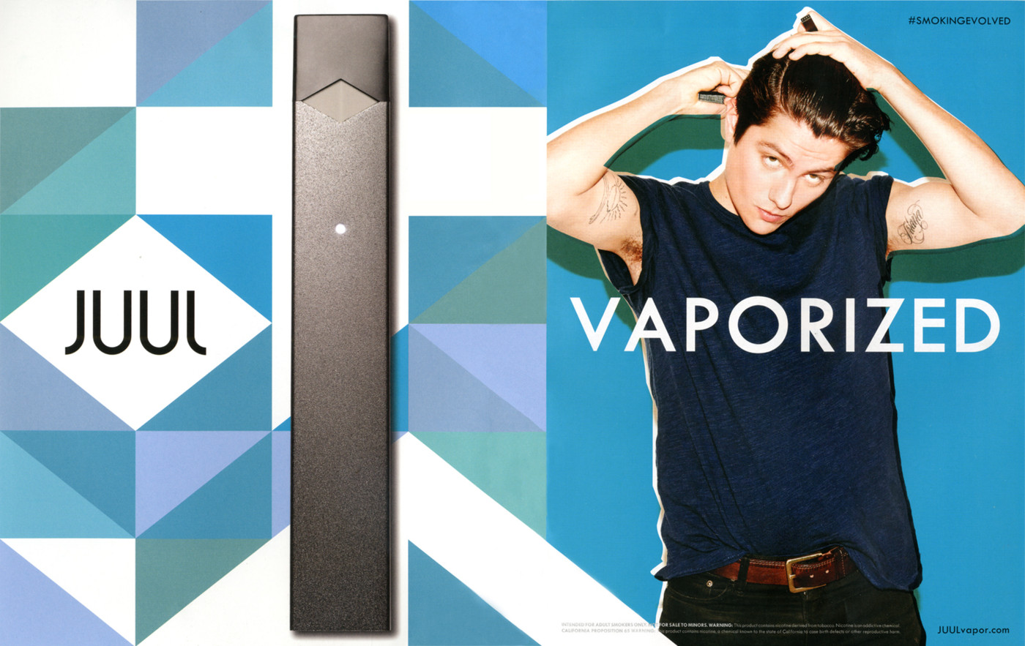
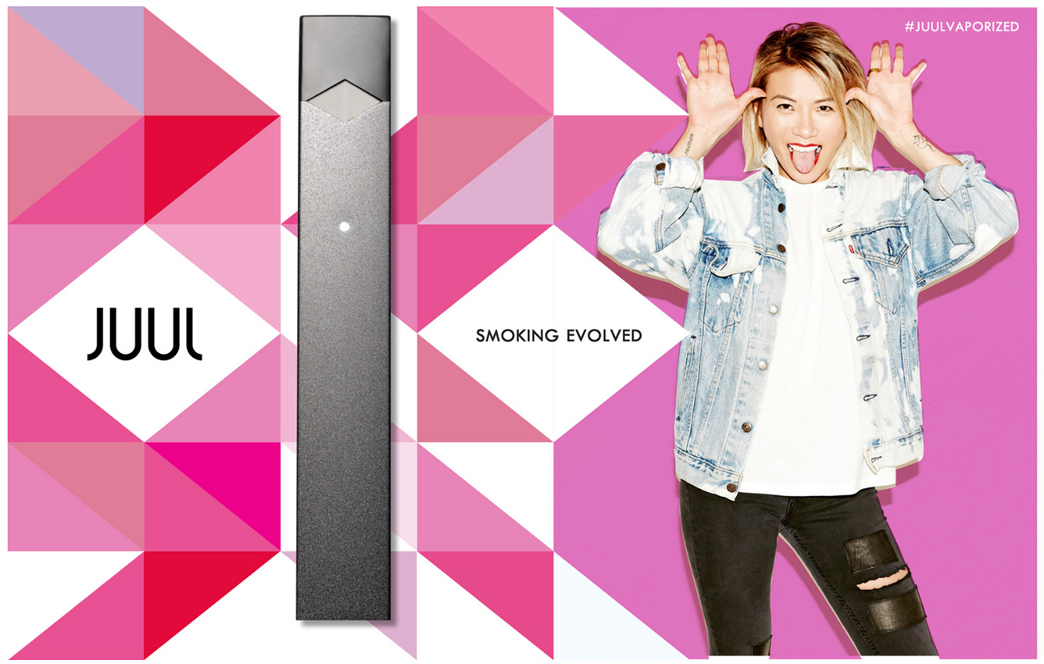
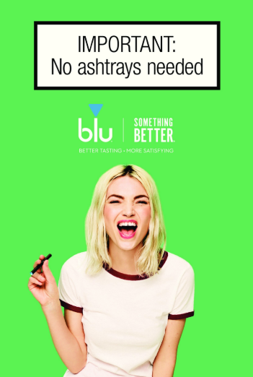
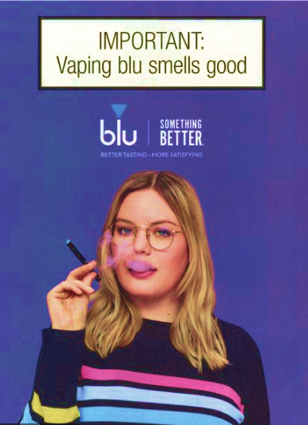

MARKETING: VAPING VS PUBLIC HEALTH
THIS KIND OF APPROACH WORKS WELL
THIS KIND OF APPROACH DOES NOT WORK AS WELL
10

Slide 11
MEASURING OUR RESULTS
Pre-Launch Campaign Survey: Using SurveyMonkey or similar online service to assess attitudes towards vaping and exposure to anti-vaping messaging
Florida Youth Tobacco Survey: Odd year survey – state level data collection only. Useful for comparison
National Youth Tobacco Survey: Useful to identify trends, outliers and to perform basic comparisons
04/2021
08/2021
11/2020
06/2021
09/2021
Mid-Campaign Survey: Same basic survey with additional questions regarding campaign awareness
Post-Campaign Survey: Final online awareness assessments regarding attitudes towards vaping, exposure to anti-vaping messaging and campaign awareness
11

