Slide 1

CITY
PROCUREMENT
IN
Prepared by
Lawsikia J. Hodges
Deputy General Counsel
Government Operations Department

Slide 2


CONTRACTS REQUIRING CITY COUNCIL APPROVAL
            John Sawyer, Chief
            (Economic Development)
            Jon Phillips, Deputy
            (General Litigation)
            Other agreements (e.g., real estate, inter-local agreements)

Slide 3

Most City Procurement Contracts -
No City Council Approval
City Council is generally not involved in the Procurement process – City’s Procurement Division oversees

Slide 4

City Council appropriates $$ in the annual budget
Mayor, through executive departments/boards/commissions, implements and executes the annual budget
City’s Procurement Division assists with budget implementation through various authorized purchasing contracts

Slide 5
So, what does the term “Procurement” mean?
Buying, purchasing, renting, leasing or otherwise acquiring any supplies, services, or construction
Includes solicitation preparation, selection, award of contract and contract administration
Procurement = Process
Examples of procurement purchases (i.e., equipment, supplies, services, construction)

Slide 6

Why do you need to know about City Procurement?
You will get calls from your constituents!
Procurement is a massive operation: over 18,000 purchase orders a year and over 400 formal purchases a year
Office of General Counsel prepares over 1500 City contracts a year

Slide 7

KEY PRINCIPLES OF PROCUREMENT
    Open competition
    Transparency and integrity of the selection process
    Fairness – no unfair competitive advantage
    Best pricing/services for taxpayer dollars

Slide 8

A Few City Procurement
Buzz Words
Purchase Orders
Formal vs. Informal
Using Agency
RFP
Advertisement
JSEB
Minimum Quals
CCNA (i.e., engineering, design-build)
Piggyback

Slide 9
PROCUREMENT CODE
CHAPTER 126, ORDINANCE CODE
All City government units (departments/divisions/offices) subject to Procurement Code requirements
CSPEC, GGAC, and PSEC (Procurement Awards Committees recommends contract awards to Mayor)
Mayor approves contract awards; Procurement Chief approves certain contract awards/purchases
Code provides for certain exemptions

Slide 10
PROCUREMENT PROCESS CYCLE
Identify Need
(Using Agency Procurement)
Solicitation Prep
(Using Agency
Procurement)
Solicitation
(Procurement)
Evaluation/ Award
(Procurement/
Using Agency)
Contracting
(Using Agency)
Do we buy? Do we acquire internally?
Do I have the appropriation?
Do I have the authority?
Contract administration
phase
Procurement method (may require committee approval), specifications, requirements, scope, bid documents creation
Formal
Procurement recommendation
Committee review and approval
Negotiations and contract
Informal
Purchase Order
Advertising, pre-bid, addenda,
opening – up to 30 day advertising
______________________________________________
Silence Period

Slide 11
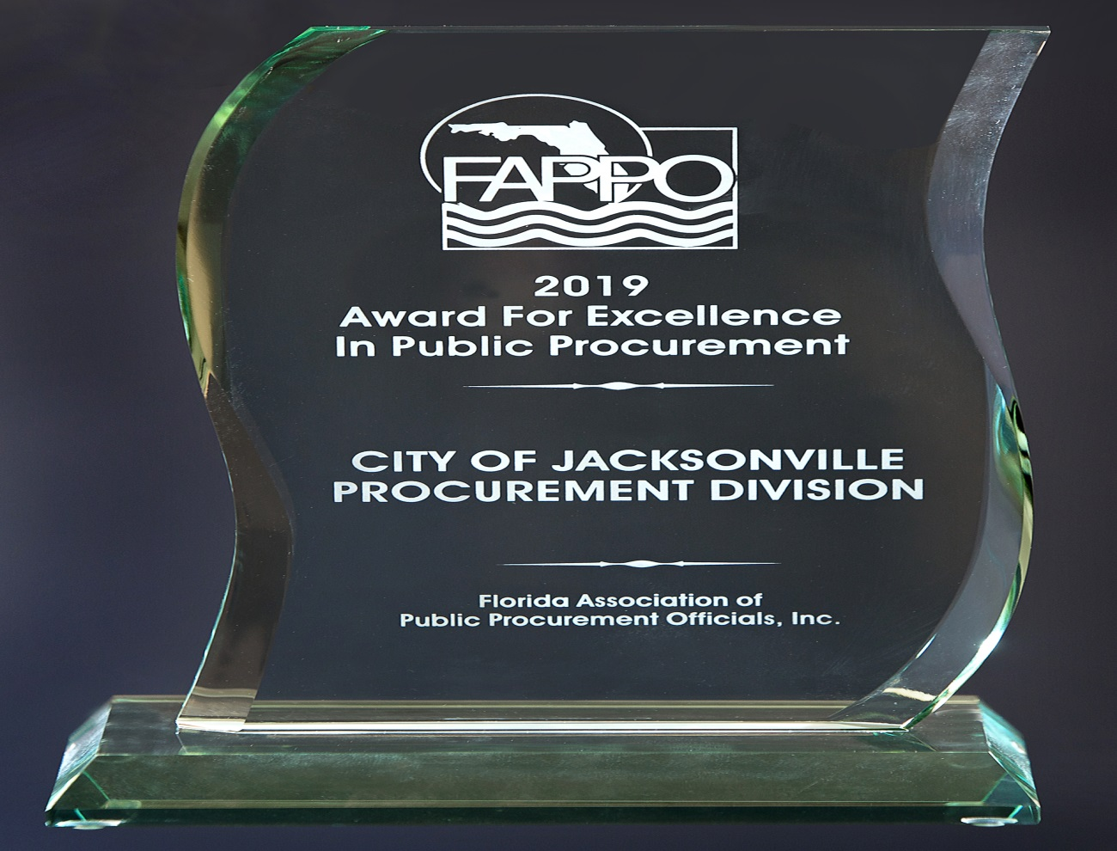
Finance and Administration Department, Procurement Division
GREG PEASE, CHIEF OF PROCUREMENT (904) 255-8801

Slide 12


