Slide 1
City of Jacksonville SPECIAL COMMITTEE ON SAFE AND HEALTHY NEIGHBORHOODS November 9, 2017

Slide 2
District 4 Brookview Neighborhood

Slide 3
Active Code Enforcement Cases
3 Junk Vehicle Cases
2 Nuisance Cases
1 Residential Case
Set for re-inspection later this month

Slide 4
Planned Neighborhood Improvements
Abate the junk vehicle and nuisance cases asap
Sidewalk repairs
Clean ditches, mow and remove dead/dying trees from right of way
Evaluate streets for resurfacing
Coordinate with JEA to ensure all streetlights have been converted to LED and are operable
Coordinate with FDOT to clean up Theresa Drive/295 area
Coordinate with DCSB on improvements around Brookview Elementary

Slide 5
Planned Brookview Elementary Park Improvements
Mow and keep up general maintenance of the park – mowing schedule has been increased from 18 times per year to 24
Repair fence
Add onto community garden
Add gazebo and natural walking trail at community garden

Slide 6
District 8 29th and Chase Neighborhood

Slide 7
Active Code Enforcement Cases
7 Junk Vehicle Cases
63 Nuisance Cases
7 Board Up Cases
1 Nuisance Tree Case
15 Residential Cases
19 Unsafe Cases
3 of the 19 unsafe cases are pending release for demo and 1 is awaiting a change order for asbestos

Slide 8
Planned Neighborhood Improvements
Complete the other 15 demolitions and 7 board ups asap
Abate the junk vehicle and nuisance cases asap
Prioritize homes in this area on the limited repair program list
Sidewalk repairs
Evaluate streets for resurfacing
Clean ditches, mow and remove dead/dying trees from right of way
Coordinate with JEA to ensure all streetlights have been converted to LED and are operable

Slide 9
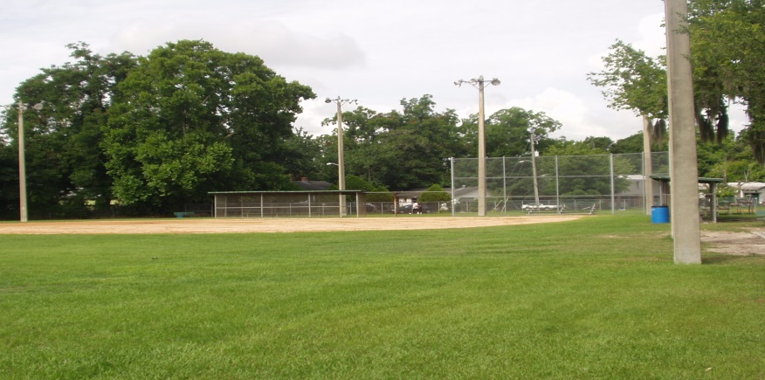
Planned Simonds Johnson Park Improvements
Community center is scheduled to reopen by the end of 2017 – will provide after school and summer spaces programs
Renovate existing basketball courts
Update park lighting to LED
Add outdoor fitness equipment
Resurface existing walking trail

