Slide 1
City Council as CRA Board of Commissioners
August 8, 2016

Slide 2
Council wears 2 hats
CRA Board of
Commissioners
City Council

Slide 3
Community Redevelopment Act of 1969
Chapter 163, Part III of the Florida Statutes
Community Redevelopment
Local governments can follow statutory procedure for declaring areas in need of redevelopment

Slide 4
Creating a Community Redevelopment Agency (“CRA”)
Step 1
Finding of Necessity 163.355, F.S.
Slum and Blight
Specific geographic area
Create CRA Board of Comm. 163.356, F.S.
Can be appointed citizens or City Council
CRA Board = Separate body corporate and politic

Slide 5
Creating a Community Redevelopment Agency (“CRA”)
Step 2
Redevelopment Plan 163.360, F.S.
Capital Projects and Programs
Should be updated/amended every 5 years
Process for amendment is like setting up new

Slide 6
Creating a Community Redevelopment Agency (“CRA”)
Step 2
Redevelopment Plan 163.360, F.S.
Capital projects and Programs
Step 3
Establish Trust Fund 163.387, F.S.
Tax Increment Finance District (“TIF” or “TID”)
Used by CRA Board to finance redevelopment
Only CRA Board (not City Council) may utilize Trust Fund $$ and only for Projects or Programs within the Area

Slide 7
CRA Trust Funds
Tax Increment Finance District
Tax = ad valorem tax for City
Increment = current year – base year
Finance = Trust Fund created per statute and ord.
District = the Community Redevelopment Area

Slide 8
CRA Trust Funds
Tax Increment Finance District
Tax = ad valorem tax for City
Increment = current year – base year
Example: $1M (FY 15) – $800K (base yr) = $200K to TF
Per statute and ordinance, automatically goes to TF when City receives
Increment stays in CRA Area, not General Fund
Finance = Trust Fund created per statute and ord.
District = the Community Redevelopment Area

Slide 9
Jacksonville has 5 CRA’s
Downtown Southbank
Downtown Northbank
JIA
King/Soutel (formerly Soutel/Moncrief)
Renew Arlington

Slide 10
Jacksonville has 5 CRA’s
Downtown Southbank- DIA
Downtown Northbank - DIA
JIA – City Council
King/Soutel - City Council
Renew Arlington - City Council

Slide 11
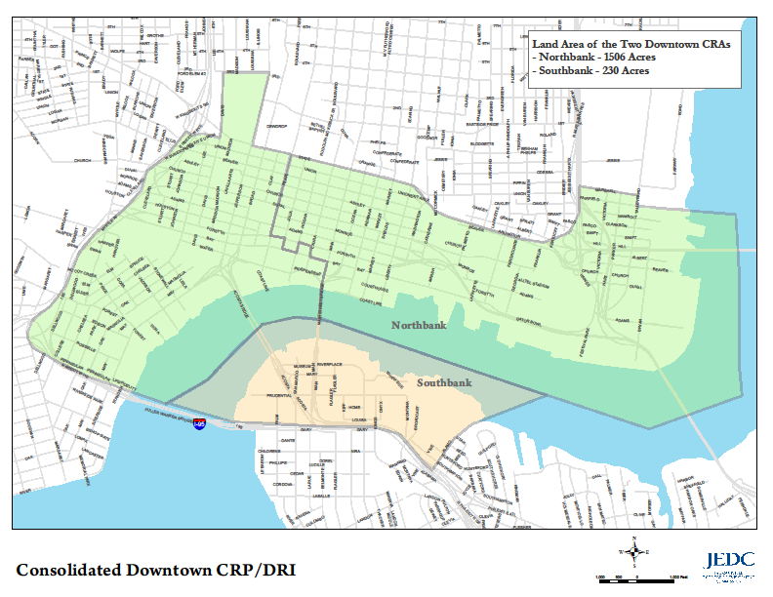
Consolidated Downtown CRA
Created in the 1980’s

Slide 12
JIA CRA Area
Land Area of the JIA
22.25 Sq. Miles
14,245 Acres
Created 1993

Slide 13
King/Soutel Boundary (2,345 acres)
Created 2008

Slide 14
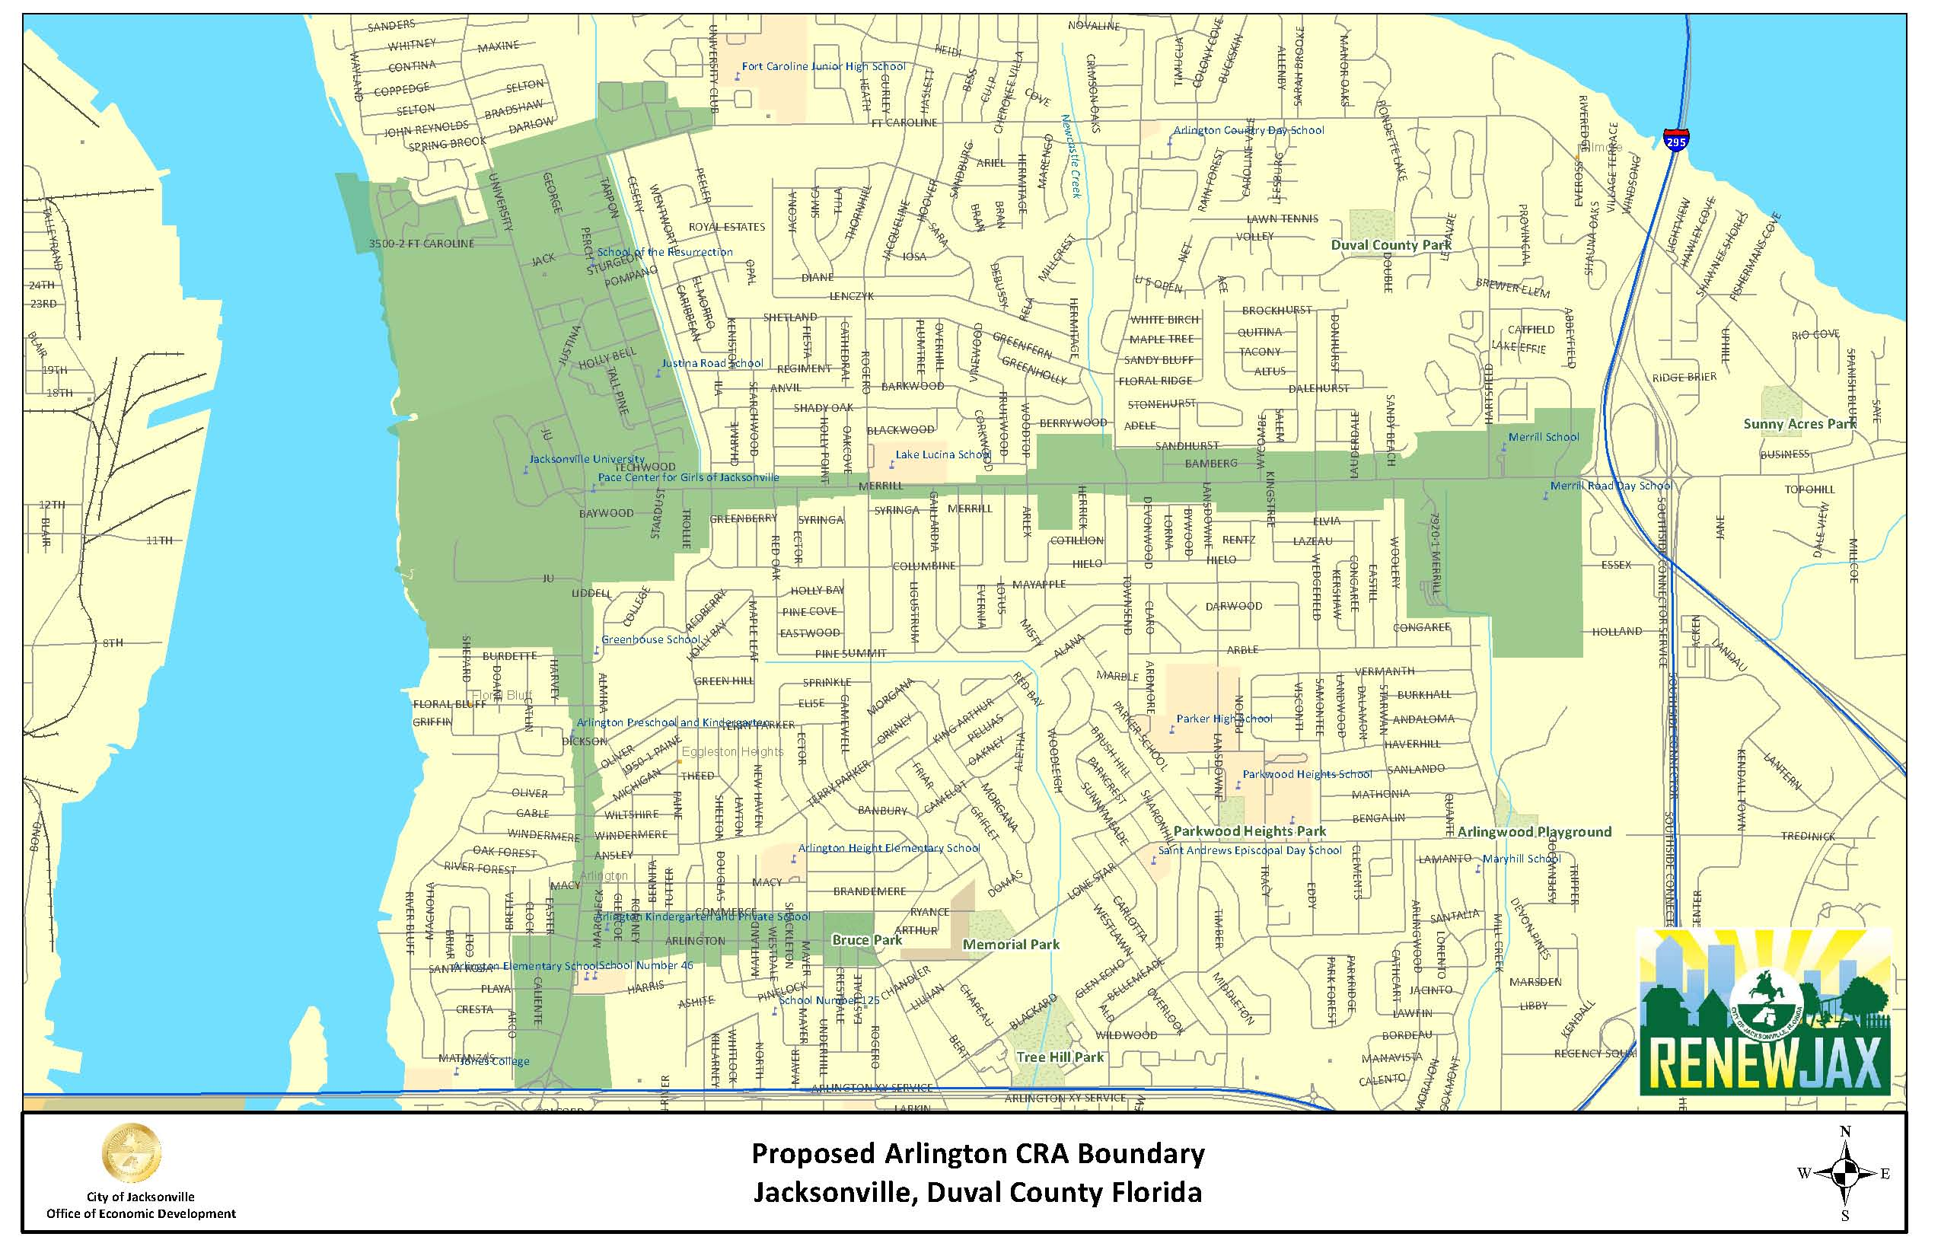
Renew Arlington
Preliminary Boundary Area

Slide 15
Ch. 189, Fla. Statutes
CRA’s are “dependent special districts”
New requirements effective October 1, 2016
Regular public meeting schedule
Meetings, agenda, resolutions, notice, minutes, webpage
Annual budget
Detail similar to City budget
All expenses from TIF must be authorized by the adopted annual budget

Slide 16
City Council is CRA Board
Separate
Notice posted
Agenda and materials posted on Website
Meetings
Resolutions of CRA for decisions (not CC legislation)
Minutes
Minutes posted on Website
Website

Slide 17
Using TIF funds
Only CRA Board (not City Council) may utilize Trust Fund $$ and only for Projects or Programs within the CRA Area
Project or Program must be
Outlined in the CRA Plan
Within the CRA Area
Administrative costs

Slide 18
Implementation of Ch. 189
CRA Boards of Commissioners (City Council) will convene on August 23, 2016 to take up the business of the 3 CRA’s:
JIA CRA
King/Soutel CRA
Renew Arlington CRA

Slide 19
Agenda for 8/23/16 meeting for each CRA
1. Elect Chair and Vice Chair
2. Adopt Bylaws
3. FY 15/16 remainders in each CRA
4. FY 16/17 budget adoption

Slide 20
Agenda for 8/23/16 meeting for each CRA
Elect Chair and Vice Chair
- Not necessarily CP and CVP
2. Adopt Bylaws
3. FY 15/16 remainders in each CRA
4. FY 16/17 budget adoption

Slide 21
Agenda for 8/23/16 meeting for each CRA
1. Elect Chair and Vice Chair
2. Adopt Bylaws
Quorum = majority of Board
Action = majority of Board present
Resolutions for actions
Meeting schedule
3. FY 15/16 remainders in each CRA
4. FY 16/17 budget adoption

Slide 22
Agenda for 8/23/16 meeting for each CRA
1. Elect Chair and Vice Chair
2. Adopt Bylaws
FY 15/16 remainders in each CRA
If/How will the money be spent before end of FY 15/16 for each CRA
2016-441 (King/Soutel Plan Amendment)
4. FY 16/17 budget adoption

Slide 23
Agenda for 8/23/16 meeting for each CRA
1. Elect Chair and Vice Chair
2. Adopt Bylaws
3. FY 15/16 remainders in each CRA
FY 16/17 budget adoption
As detailed as possible
Must follow CRA Plan

Slide 24
Questions?????
Thanks!
Susan Grandin
630-1725
SGrandin@coj.net

