Slide 1
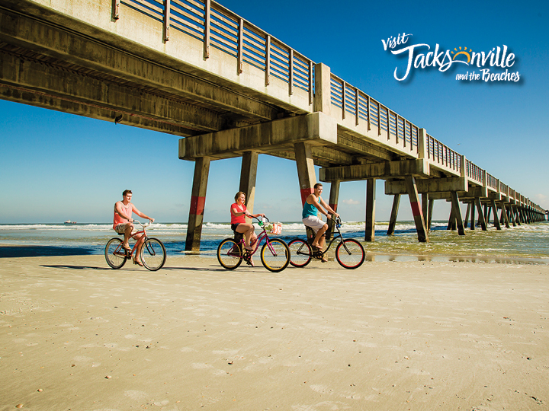
Marketing Update for 2013

Slide 2
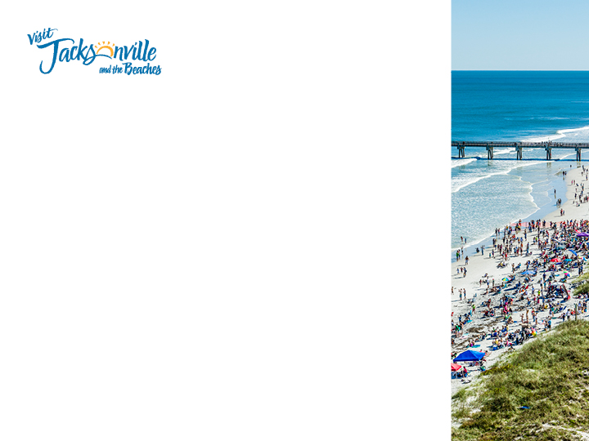
So what did the investment of $496,000 get us?
Digital banner ad impressions: 20,094,479
Video/Commercial Impressions: 3,500,000
8 - 2 page spreads: 207,360 circulation
22 full page ads: 11,374,239 circulation
39 half page ads: 1,926,590 circulation
50 quarter page ads: (majority military publications): 992,080
11 months of digital billboards in North Carolina and
Cocoa Beach
Meaning overall estimated impressions/reach
was 79,604,279

Slide 3
Added Values to every buy possible:
From our total advertising budgets of TDC Grant and Visit Jacksonville budget
For the $496,000 we invested we received $248,507 worth of added value at no cost to us.
$937,000 worth of media impact, which is a 56% Return on Advertising Investment (Average is usually 10-20%)
*See list of added value received

Slide 4
So how has this advertising affected the market?

Slide 5
RevPAR

Slide 6
The revenue growth during this period when the $496,000 advertising ran is an increase in $7,244,462 from the previous year same time period
Much larger growth than previous years

Slide 7
Examples of very successful, measurable advertising buys:
UK Promotion
Cvent Advertising Buy
Military Newspaper Ads

Slide 8
Emergence into the UK:
September 28, Regents Street Block Party which attracted 500,000 attendees.
Visit Jacksonville branded tent with a photo booth. Additionally, there was a promotion to “Win a weeklong holiday in Jacksonville”.
October 26, fan rally in Trafalgar Square attended by over 70,000, over 10,000 Jacksonville beach balls were distributed to Jaguars enthusiasts.
October 27, Tailgate Party inside Wembley Stadium. Anyone with a game ticket could attend the Tailgate party. Thousands of fans visited the tent and again had their photos taken in the photo both. Over 5,000 promo items were distributed.
From these three events, along with the Facebook promotion, there were over 1,500 entries to the “Win a holiday” giveaway!
Notes:
There was a Visit Jacksonville branded tent with a photo booth inside where you could take your picture in front of several beautiful Jacksonville landmarks. Additionally, there was a promotion to “Win a weeklong holiday in Jacksonville”. To enter the contest customers had do so through Visit Jacksonville’s facebook page.

Slide 9
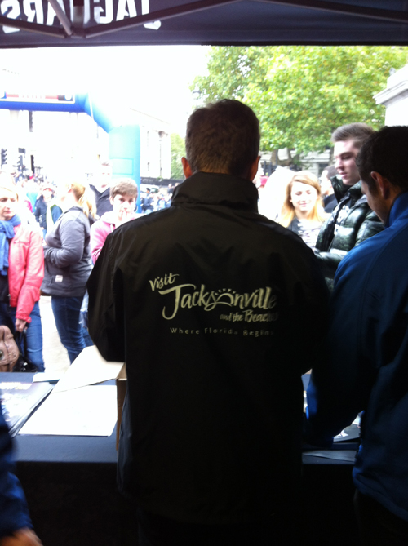
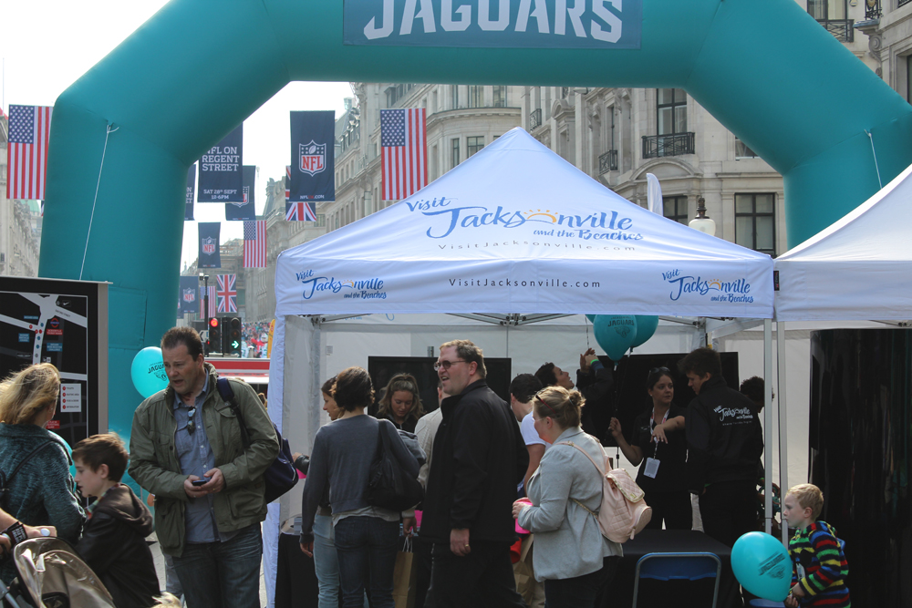
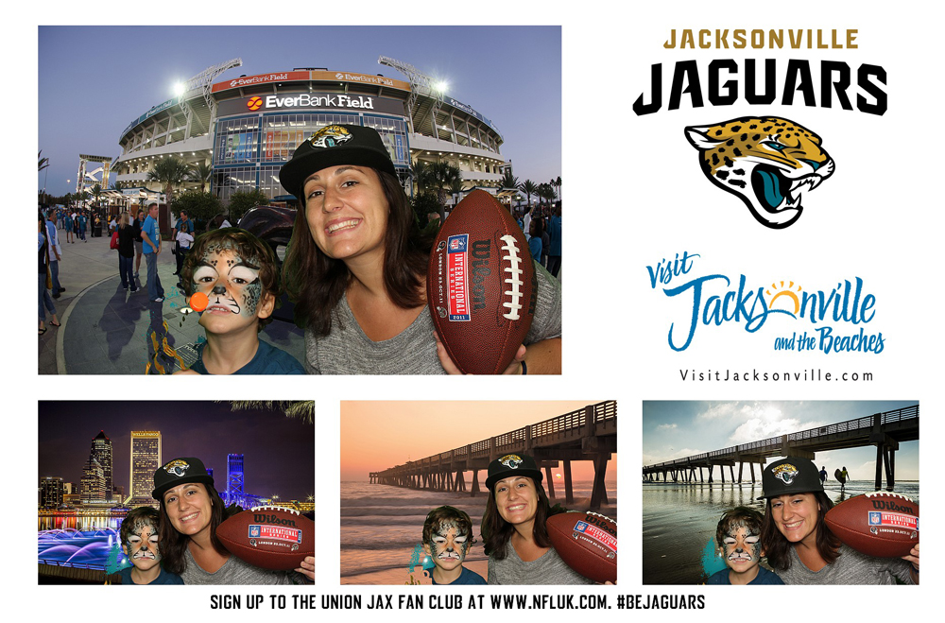

Slide 10
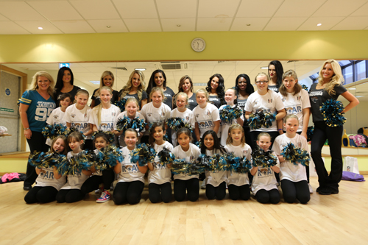
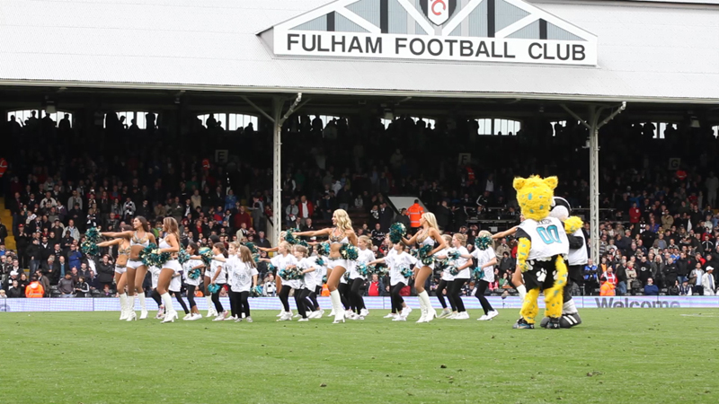
September: Partnered with Fulham FC and the Jaguars on a promotional opportunity.
The Jaguars’ cheerleaders danced at Fulham FC on September 14.
Additionally, there was a win a holiday prize drawing competition and over 2,500 fans entered for a chance to win!

Slide 11
Increased advertising in the United Kingdom:
Editorial and advertisement in Selling the Long Haul Magazine. This magazine is the UK’s leading travel-trade monthly and reaches travel retailers throughout the UK
Advertising package with US Airways which included:
a boarding video,
a 5-minute travel feature
a full-page ad in US Airways Magazine.
During the month of September the Jacksonville 5-minute feature played on all international flights and all flights that had in service video feature options.
British Visitor Handbook It is distributed at Alamo/Dollar Rent-A-Car at Sanford and Orlando airports to British visitors renting a car. These visitors are here for over two weeks and are mainly families visiting with children.

Slide 14
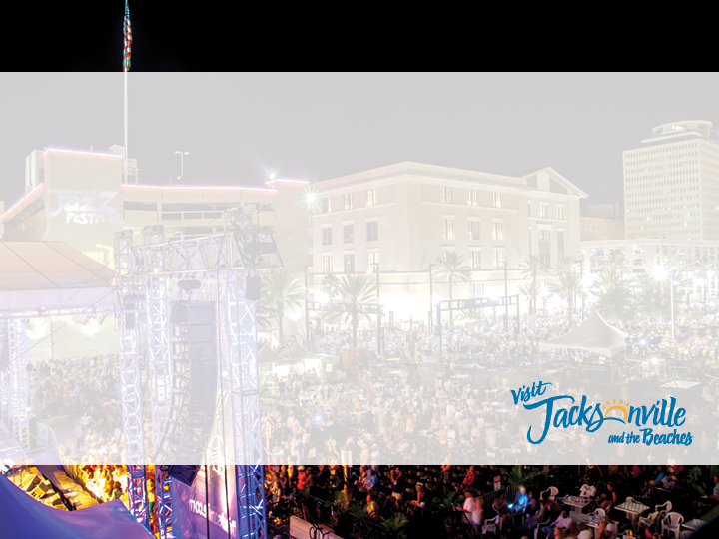
We ran ads in a network of military newspapers and saw an increase in web traffic to our military deals page of 143%!
We ran two ads in Group Tour magazine and banner ads on the website which was viewed 5,117 times with 867 clicking through to our site. There were 51 leads from the print advertising.
From Rejuvenate, Collaborate and Connect Magazines (Collinson Media) we have received over 100 meeting professional leads of planners interested in Jacksonville.

Slide 15
Growth in Targeted Markets
In the Atlanta Market:
We increased traffic to our website from Atlanta by 12% from April-September compared to the previous year
Over the last twelve months we have seen a 16% increase in web traffic from Atlanta
In the Florida market:
From April – September we have seen a 45% increase from traffic from Florida compared to the previous 6 months prior and a 26% increase from the same time the prior year
Increases from individual cities during April-September:
Tallahassee 20% increase
Tampa 278% increase
Boca Raton 600% increase

Slide 16
Consumers are interested:
Over the last year we have added over 9,000 contacts to our leisure database from those who have opted in to learn more about Jax. The database is now over 30,000.
We have grown our Facebook fan base to 47,813.
Twitter Interaction is at an all time high with over
10,784 followers.

Slide 17
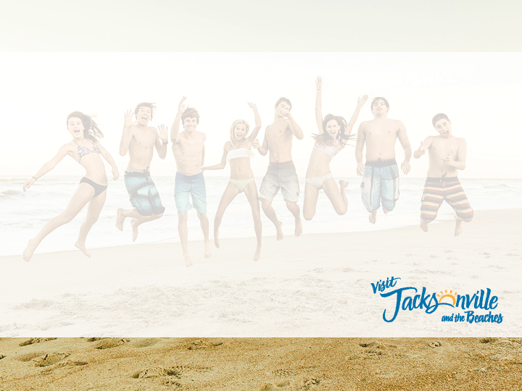
And after accessing it all, we’ve made some changes:
Since we couldn’t measure results we have eliminated all of our billboards for this year and reallocated the dollars to digital advertising we could measure
We have stopped placing small ads in large publications just to be there
We have measured every digital ad campaign and have continued to work with those that performed and moved away from those that have not (VISIT FLORIDA)
And we are in the process of changing the look and refreshing our website so returning consumers will have something new and exciting to interact with!

