Slide 1
Emerging and Proven Waste Conversion Technologies for the 21st Century
City of Jacksonville
Solid Waste Workshop
November 29, 2012
Paul Hauck, P.E.
CDM Smith
1715 N. Westshore Boulevard
Suite 875
Tampa, Florida 33607
(813) 281-2900
hauckpl@cdmsmith.com

Slide 2
Today’s Presentation
CDM Smith solid waste experience
Current solid waste system
Benefits and Limitations of Waste Conversion Technologies
Waste Conversion Technology Examples
The Long Term – 15 to 20 years in the future
COJ Solid Waste Strategy

Slide 3
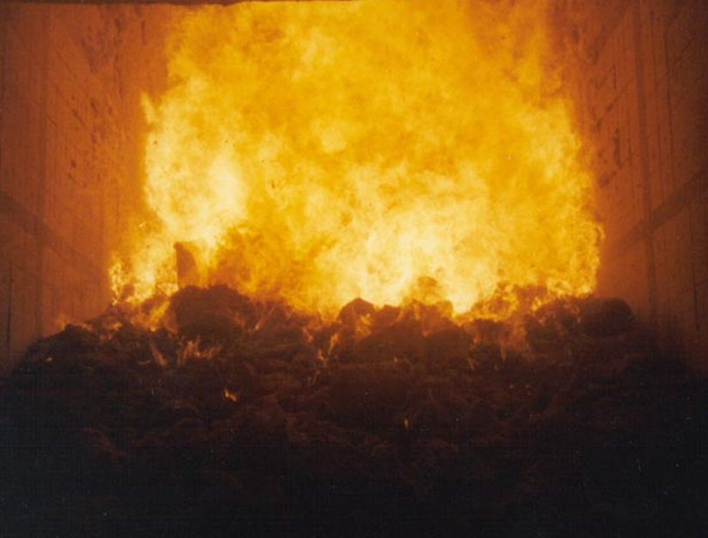
Solid Waste Services
Waste-to-Energy
Transfer stations
Material recovery facilities
Landfills
Rate/financial studies
Recycling

Slide 4
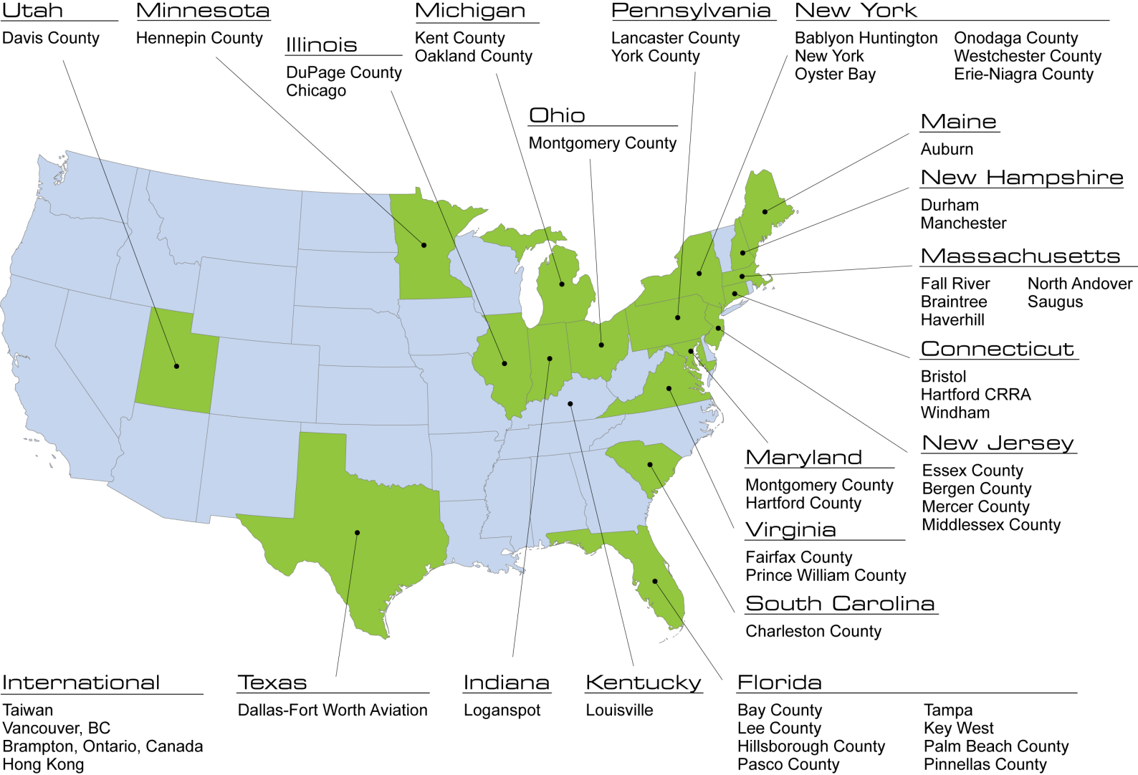
CDM Smith Waste-to-Energy Experience
Introduction

Slide 5
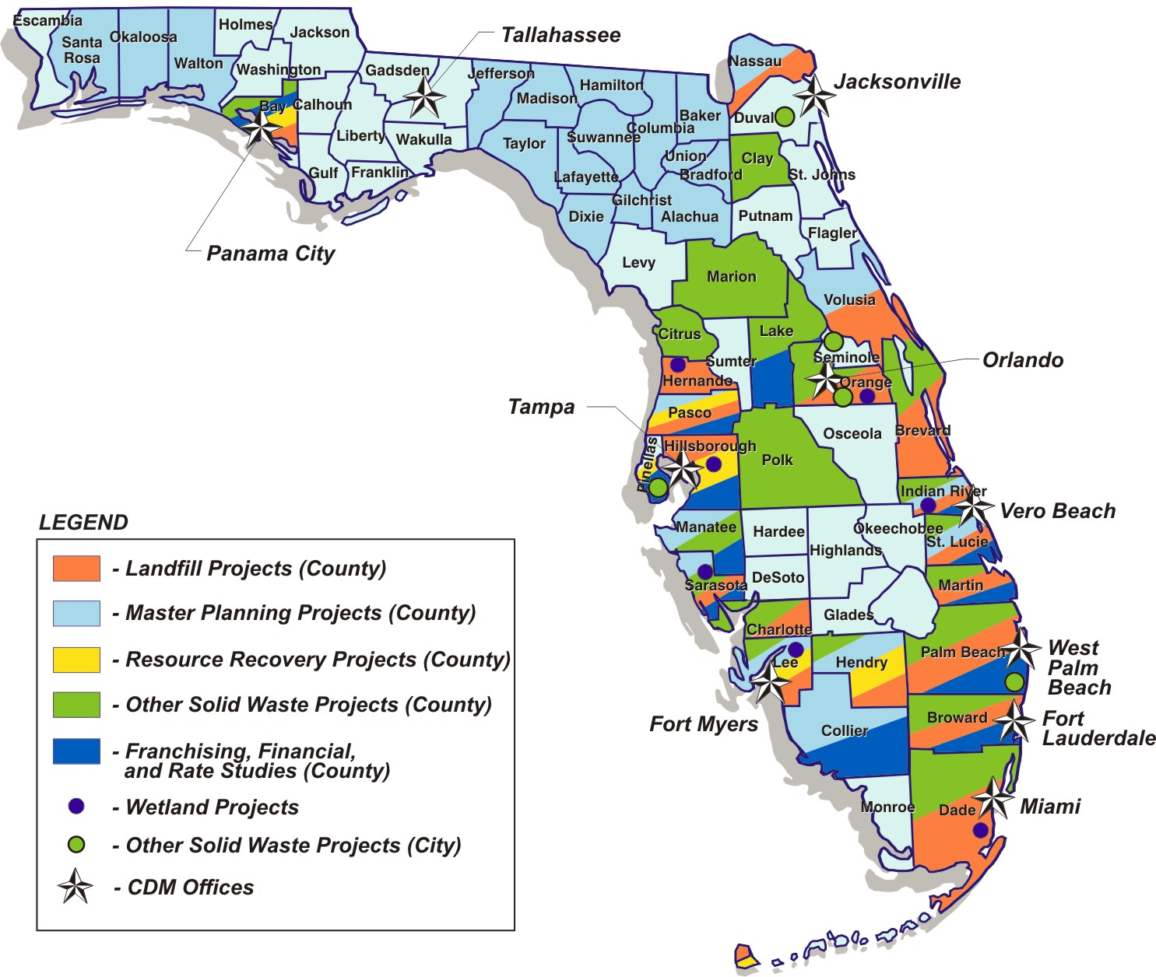
CDM Smith Florida Solid Waste Experience
Introduction

Slide 6
Today’s Presentation
CDM Smith solid waste experience
Current solid waste system
Benefits and Limitations of Waste Conversion Technologies
Waste Conversion Technology Examples
The Long Term – 15 to 20 years in the future
COJ Solid Waste Strategy

Slide 7




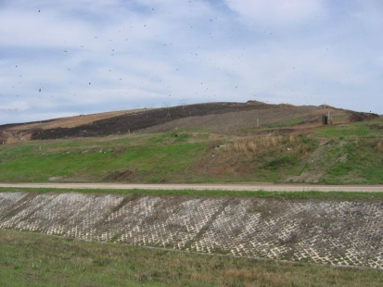
City of Jacksonville
Current Disposal Summary
Third Party Methane Collection & Energy Generation
Landfill Operator
Leachate Collection & Disposal
48%
Yard Waste Processing Facility
Materials Recovery Facility
Notes:
Transition from transport to disposal. Add MRF and yard recycling to flowchart.
Class I – TRL (Class I, Class III, and Commercial MSW )
- operation
- COJ collects tipping fee (COJ staff)
- WM/Operator places waste on the fill (WM paid as operator)
- methane gas pulled off of the hill (third party agreement PPP)
- leachate collection goes to JEA
Class III – goes to TRL
C&D disposal facilities – TRL, Ottis Rd, Jones Rd, Old Kings Rd

Slide 8
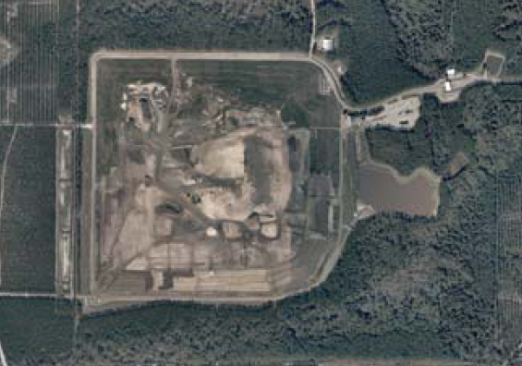
Duval County Landfill Current Status
Approximately
22% of airspace remaining
Phase 1-5 build-out anticipated January 2018
  Population growth
  No hurricane debris
  Settlement/density
To meet Phase 1-5 build-out, construction of Phase 6 completed by July 2016
  + 6 month selective placement of waste
  + 1 year general contingency

Slide 9
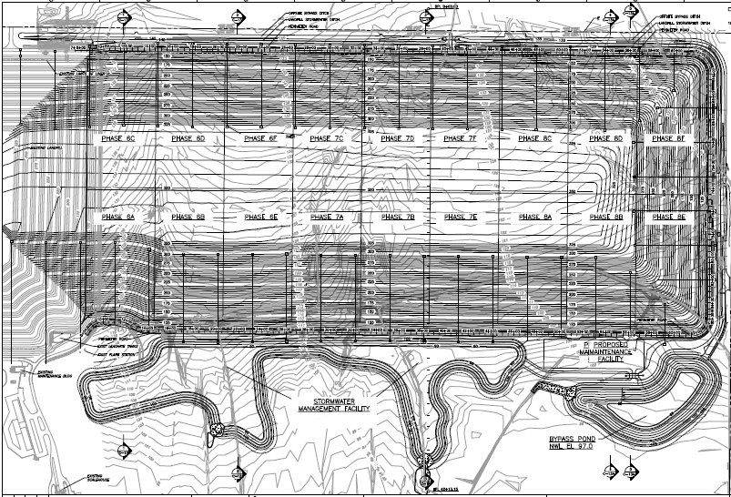

Slide 10
Today’s Presentation
CDM Smith solid waste experience
Current solid waste system
Benefits and Limitations of Waste Conversion Technologies
Waste Conversion Technology Examples
The Long Term – 15 to 20 years in the future
COJ Solid Waste Strategy

Slide 11
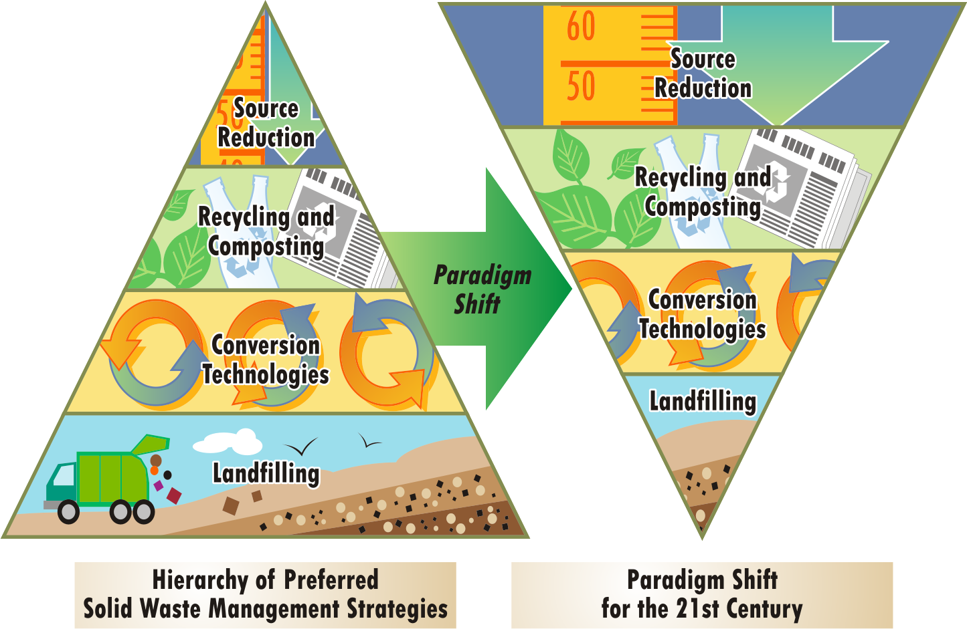
The Future of Waste Management
Emerging Paradigms

Slide 12

Waste Conversion By-Products
Continue to Grow in Economic Value
Conversion Technology | Power |  | Fuels / Chemicals |  |  |  | Amendments/ Aggregates
 | Steam / Heat | Electric | Syn Gas | Bio Methane | Chemical | Fuels | Aggregate | Mulch / Compost
Thermal
Biological / Chemical
Physical
Emerging Paradigms
Notes:
Reduce words , add graphics

Slide 13
Cost and Affordability
Criteria Description | Solid Waste Alternatives
 | Landfill (Phase 6A & 6B) | Massburn WTE | Waste to Biofuels | Thermal Gasification WTE
Market Readiness | Now | Now | 5-10 years | 10-15 years
Capital Cost
Year 2013 | $43M | $400M | $500M | $300 M- $500 M
Operational Cost--Unit Cost/ton
Potential Revenue is Not Included in O&M Cost for the Various Options | $18.10/ton | $35/ton | $45-$50/ton | $30/ton-$45/ton

Slide 14
Today’s Presentation
CDM Smith solid waste experience
Current solid waste system
Benefits and Limitations of Waste Conversion Technologies
Waste Conversion Technology Examples
The Long Term – 15 to 20 years in the future
COJ Solid Waste Strategy

Slide 15
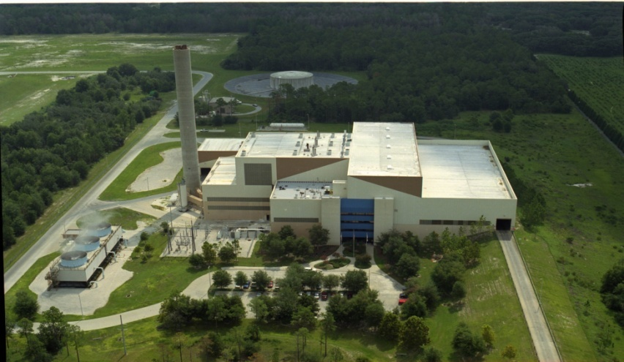
Modern Waste-to-Energy (WTE)
WTE disposes of 13% of the nation’s waste (U.S. EPA)
  86 operating facilities
  36 million people served
  27 states
  Generation capacity in
  excess of 2,700 MW
  16 million MWhrs of
  renewable power generated annually
  259 million tons per year currently disposed of in landfills represents an additional 142,450,000 MWhrs annually (equivalent to 16,261 MW of capacity)
Proven Waste Conversion Technologies
Notes:
Note: Last bullet may not be as applicable to TRL, need to discuss how to present this one

Slide 16
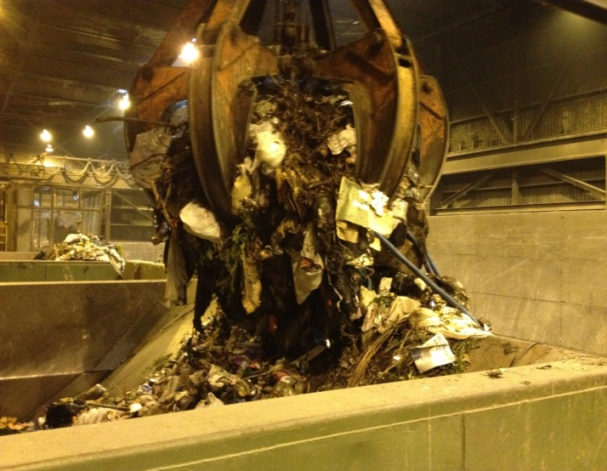
Dominant WTE Technology in U.S.
…Advanced Massburn Combustion
Technology Types
  ~ 74% are massburn facilities
  ~ 14% are refuse-derived fuel (RDF) facilities
  ~ 9% are modular
Energy Production
  73% produce only electricity
  20% produce steam and electricity
  7% produce steam only
Massburn requires no pre-processing of MSW
Proven Waste Conversion Technologies

Slide 17
WTE Ownership and Operation in the U.S.
Ownership
  52% Privately Owned
  48% Publically Owned
Operation and Management
  84% Privately Operated
  16% Publically Operated
Proven Waste Conversion Technologies

Slide 18
STATE
of
TECHNOLOGY
EMERGING (Higher Risk)
PROVEN (Lower Risk)
PILOT SCALE | DEMONSTRATION | MARKET ENTRY | MARKET PENETRATION | MARKET MATURITY
Biomass Direct Combustion
Co-firing
(utility boilers)
Fluidized Bed
Stoker
Biomass Gasification & Pyrolysis
Small Gasifier/
IC Engine
Gasification – Boilers, Kilns
Pyrolysis and Depolymerization
Waste-to- Energy
Massburn WTE & RDF Combustion²
Other Conversion Processes ¹
Co- Digestion
Anaerobic Digestion/ Ethanol
Includes RDF gasification, plasma gasification, and pyrolysis
RDF = Refuse-derived fuel
Emerging Waste Conversion Technologies

Slide 19
Today’s Presentation
CDM Smith solid waste experience
Current solid waste system
Benefits and Limitations of Waste Conversion Technologies
Waste Conversion Technology Examples
  Proven: Massburn, Ethanol
The Long Term – 15 to 20 years in the future
COJ Solid Waste Strategy

Slide 20
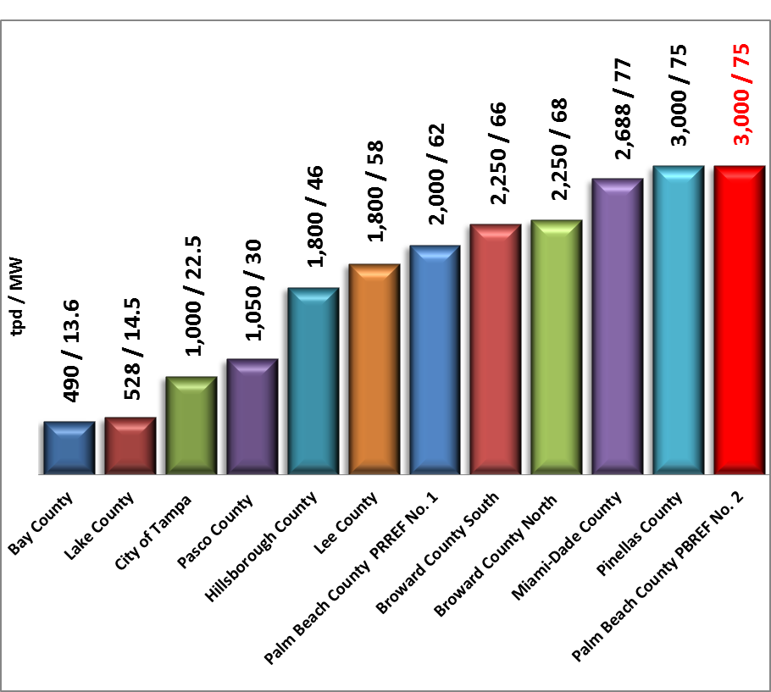
Florida Waste-to-Energy Facilities
12 Facilities – 607 MW of Renewable Electricity
Proven Waste Conversion Technologies

Slide 21
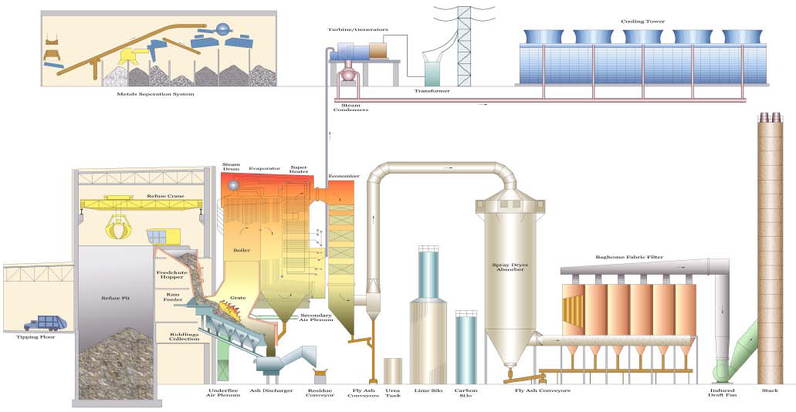
Typical Massburn WTE Crosssectional Diagram
Notes:
Slide 27 or 28, not both

Slide 22
Continuous Reductions of Emissions from
Large and Small Municipal Waste Combustors
Pollutant | 1990 Emissions (TPY) | 2005 Emissions (TPY) | Percent Reduction
CDD/CDF TEQ Basis * | 44 | 15 | 99+%
Mercury | 57 | 2.3 | 96%
Cadmium | 9.6 | 0.4 | 96%
Lead | 170 | 5.5 | 97%
Particulate Matter | 18,600 | 780 | 96%
HCL | 57,400 | 3,200 | 94%
SO₂ | 38,300 | 4,600 | 88%
NOx | 64,900 | 49,500 | 24%
Source: EPA, August 2007
* Dioxin/furan emissions are in units of grams per year toxic equivalent quantity (TEQ), using
1989 NATO toxicity factors; all other pollutant emissions are in units of tons per year
Proven Waste Conversion Technologies

Slide 23
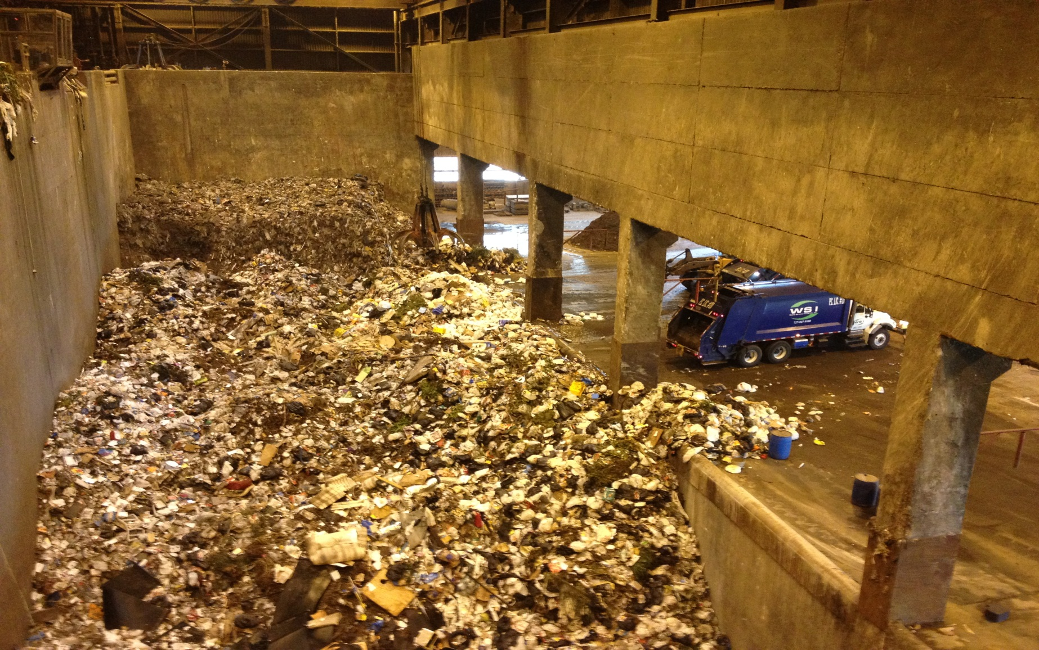
Refuse Storage Pit at Massburn WTE Facility
Modern WTE facilities typically store 5 – 7 days of MSW
Proven Waste Conversion Technologies

Slide 24
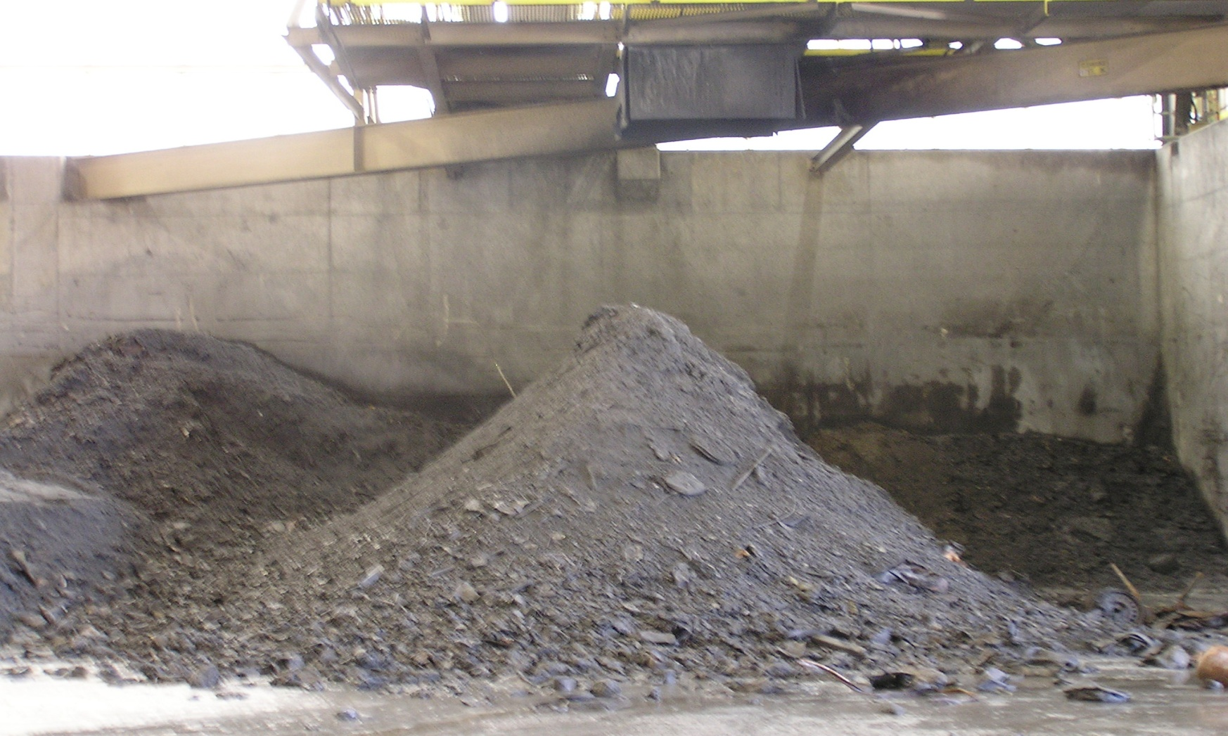
Advantages of Massburn WTE…
Minimal Residuals to the Landfill
Typical WTE Ash Residue
75% weight reduction
90% volume reduction
Proven Waste Conversion Technologies

Slide 25
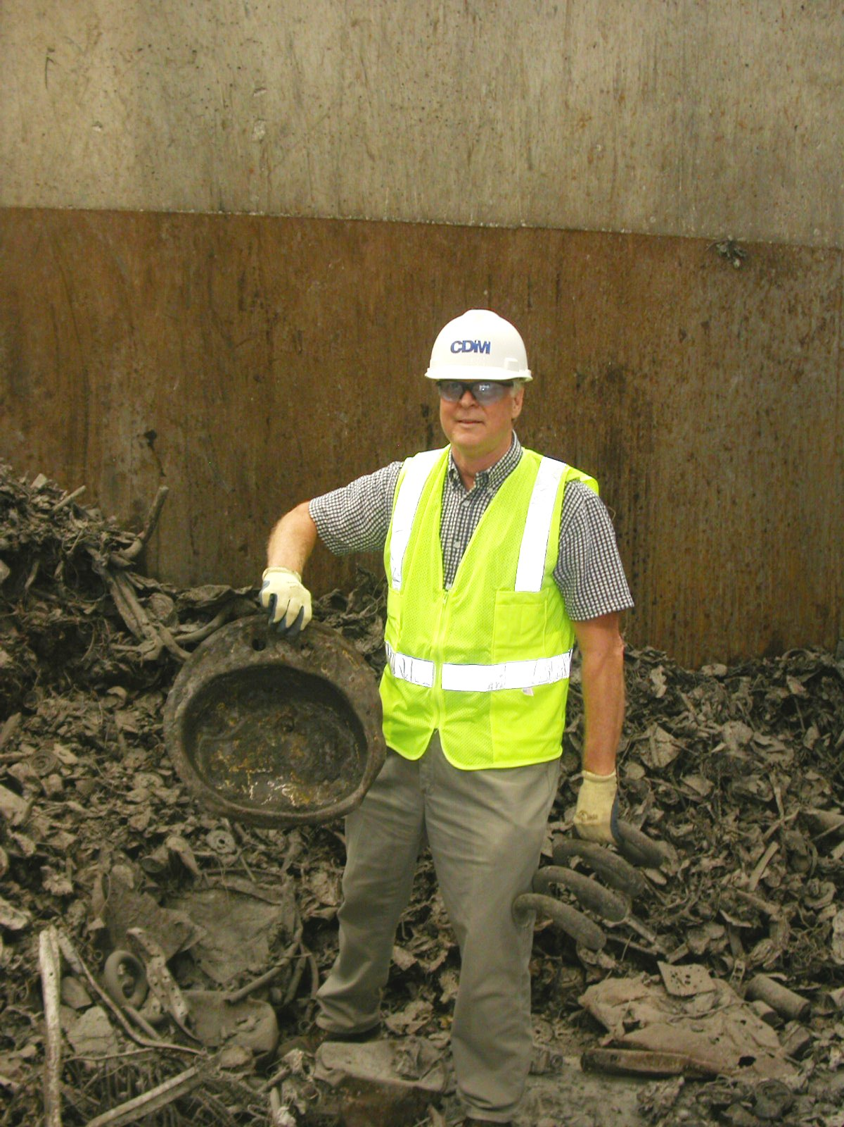
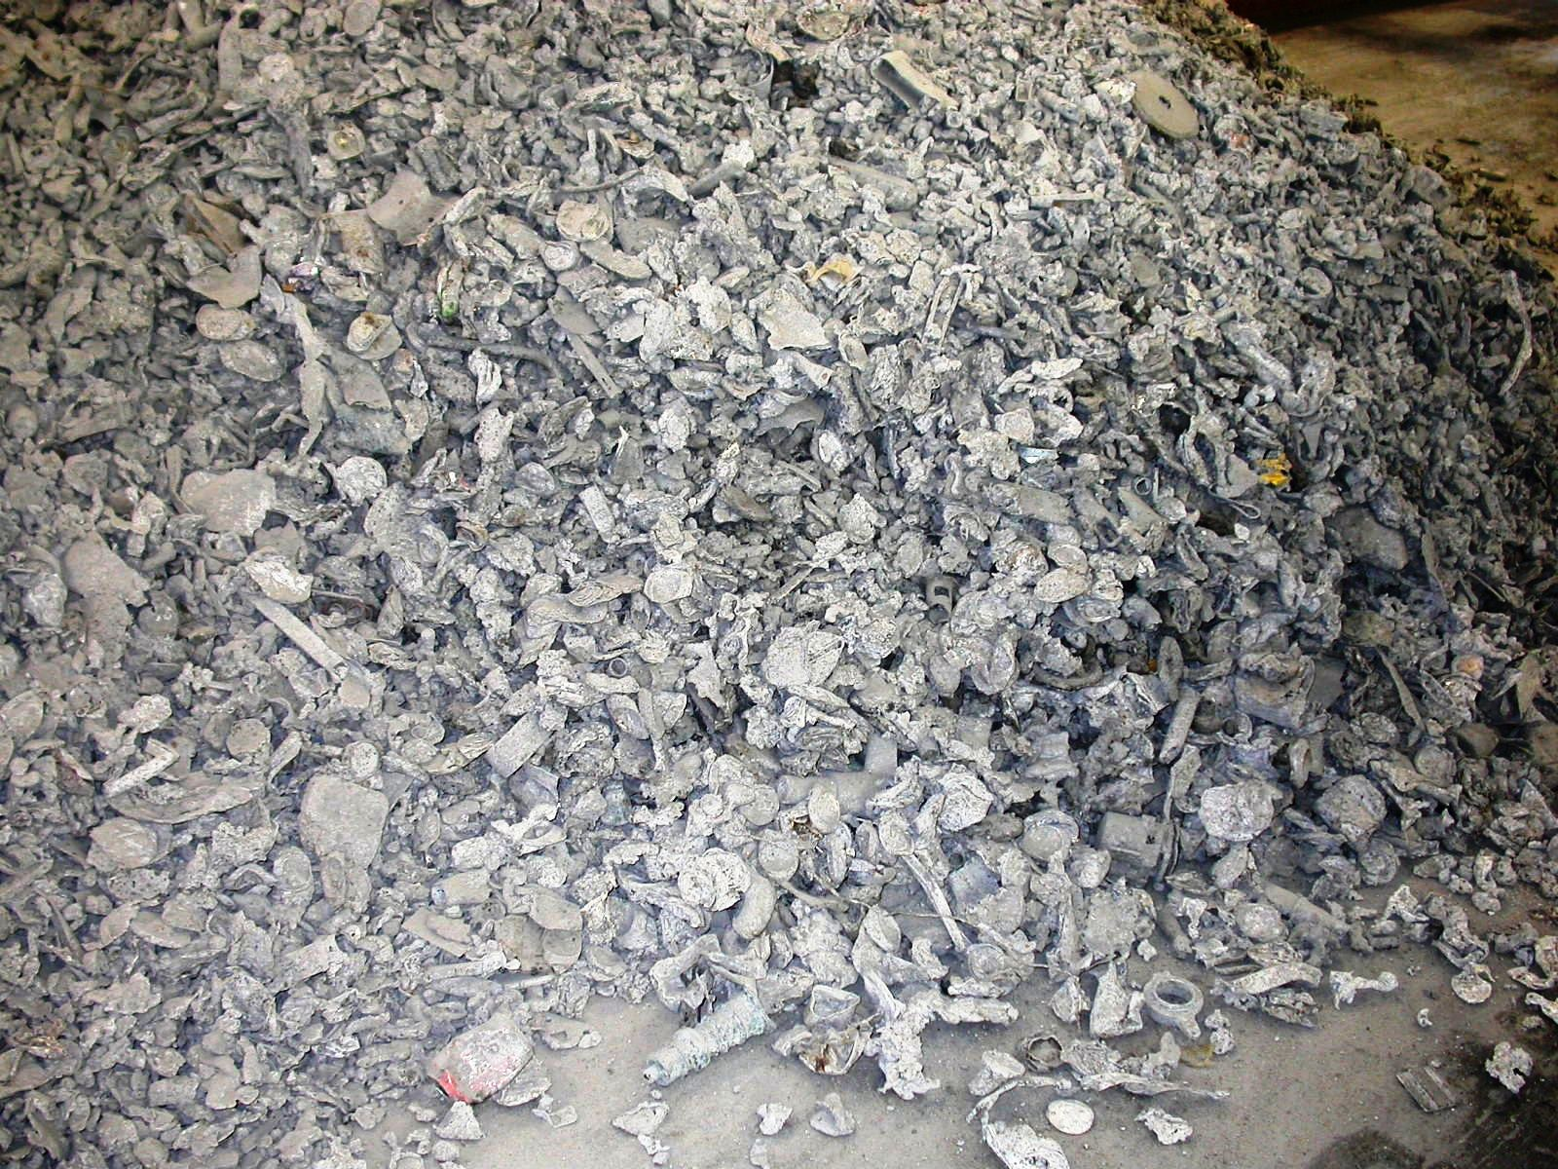
Metals Liberated by the Combustion Process
Recovered and Recycled for Additional Revenues
Ferrous metals everything…including the kitchen sink
Non-ferrous metals (aluminum, brass, bronze, copper, gold, silver, stainless)
Proven Waste Conversion Technologies

Slide 26
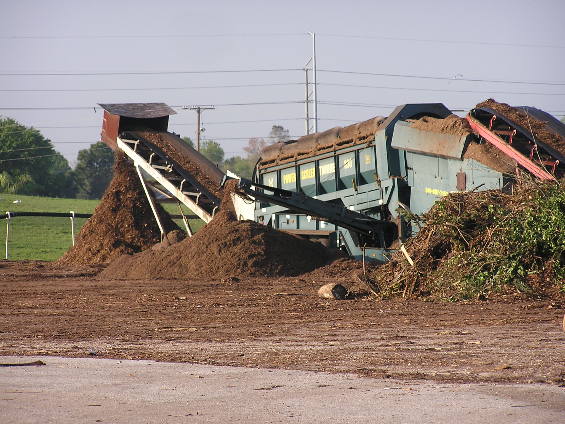
Ethanol Production from Urban Yard and Wood Waste
Future Feedstock for Cellulosic Ethanol: 10 MGY facility will require ~200,000 tons per year
Promising Waste Conversion Technologies
Notes:
How much yard waste does COJ produce? Put in context of 200 kton/yr

Slide 27
STATE
of
TECHNOLOGY
EMERGING (Higher Risk)
PROVEN (Lower Risk)
PILOT SCALE | DEMONSTRATION | MARKET ENTRY | MARKET PENETRATION | MARKET MATURITY
Biomass Direct Combustion
Co-firing
(utility boilers)
Fluidized Bed
Stoker
Biomass Gasification & Pyrolysis
Small Gasifier/
IC Engine
Gasification – Boilers, Kilns
Pyrolysis and Depolymerization
Waste-to- Energy
Other Conversion Processes ¹
Massburn WTE & RDF Combustion²
Co- Digestion
Anaerobic Digestion
Includes RDF gasification, plasma gasification, and pyrolysis
RDF = Refuse-derived fuel
Emerging Waste Conversion Technologies

Slide 28
Today’s Presentation
CDM Smith solid waste experience
Current solid waste system
Benefits and Limitations of Waste Conversion Technologies
Waste Conversion Technology Examples
  In Development: Plasma Arc Gasification, Staged Combustion
The Long Term – 15 to 20 years in the future
COJ Solid Waste Strategy

Slide 29
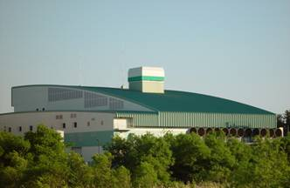
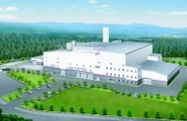
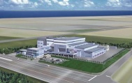
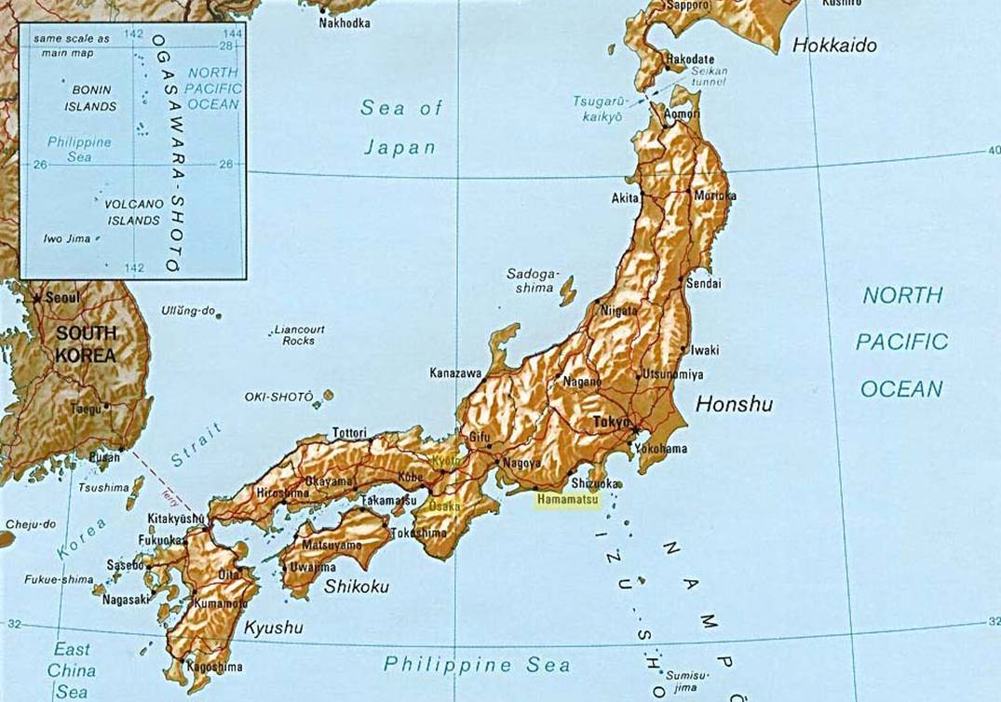
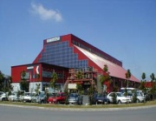
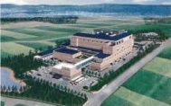
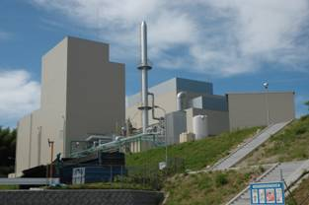
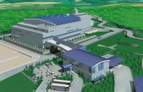
Reference Plasma Arc Projects
Japan
  Yoshi (Hitachi Metals, 166 TPD
  pilot plant 1999 to 2000)
  Utashinai City ( 165 TPD in 2002)
  Mihama / Mikata (28 TPD in 2002)
Canada
  Ottawa (100 TPD demonstration scale in 2008)
England
  Faringdon, Oxfordshire (Advanced Plasma Power -modular test facility)
Experimental Waste Conversion Technologies

Slide 30
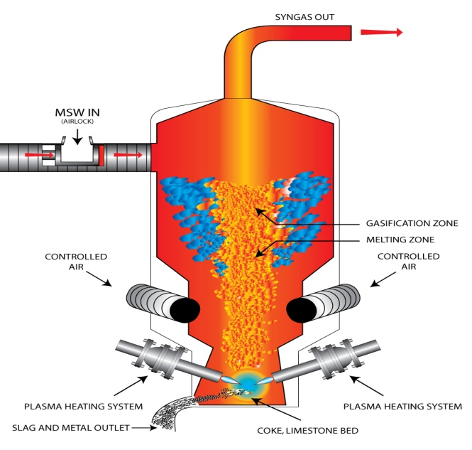
St. Lucie County Plasma Gasification Project
6 year development process, project abandoned in 2011
2012 St. Lucie County selected Covanta for CleerGas Process
2 X 300 TPD for Combined Heat and Power
Promising Waste Conversion Technologies

Slide 31
Current St. Lucie County Covanta Gasification Project
Performance advantages vs. conventional WTE:
  Better control of syngas combustion – lower NOx and CO generation
  Lower air requirement –
  lower flue gas flow, higher boiler
  efficiency, lower particulate,
  smaller equipment
Promising Waste Conversion Technologies

Slide 32
Florida Recent WTE Success Stories
Indian River County Bio-Energy Center
Palm Beach County 3,000-TPD Massburn Facility

Slide 33
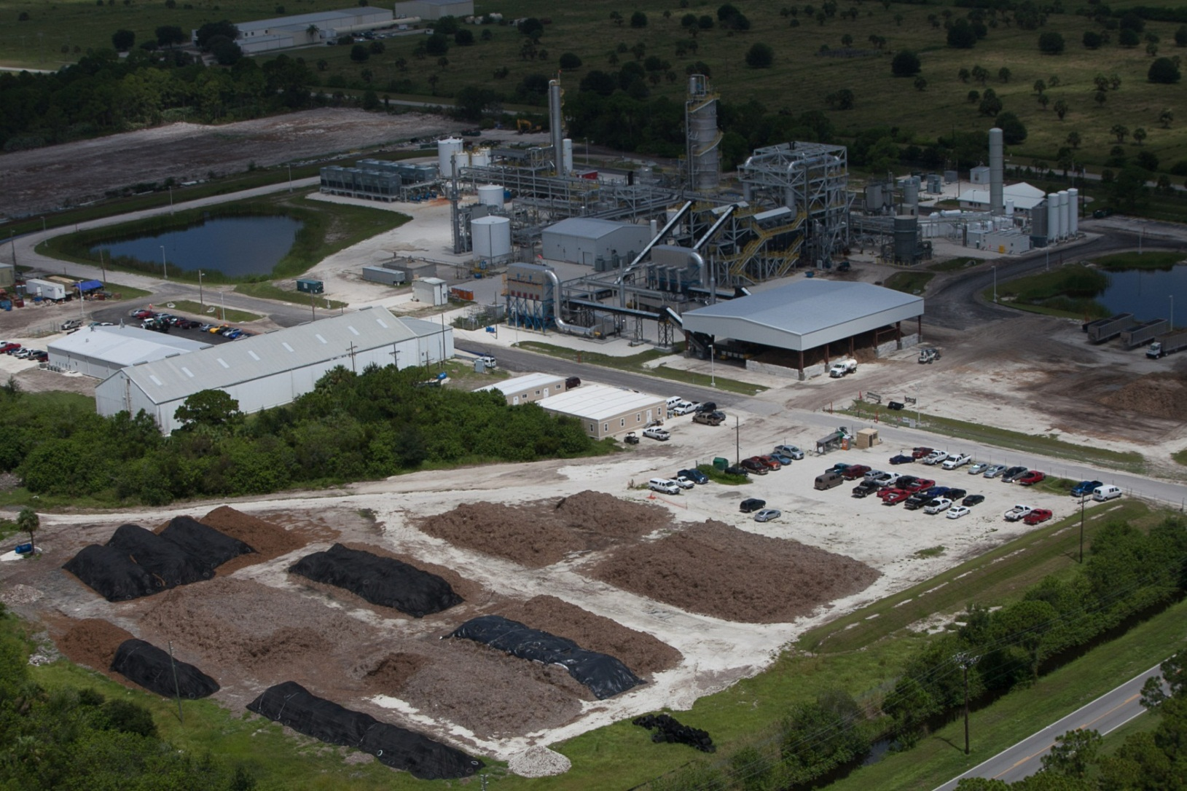
Ineos Bio-Energy Center (2012)
Indian River County Florida
400 direct jobs in construction, engineering and manufacturing
Injected more than $25 million dollars directly into the Florida economy
60 full-time employees
$4 million annually in payroll to the local community
Phase 1: 8MG/yr from 400 tpd biomass
Phase 2: 50MG/yr from MSW/RDF
Promising Waste Conversion Technologies

Slide 34
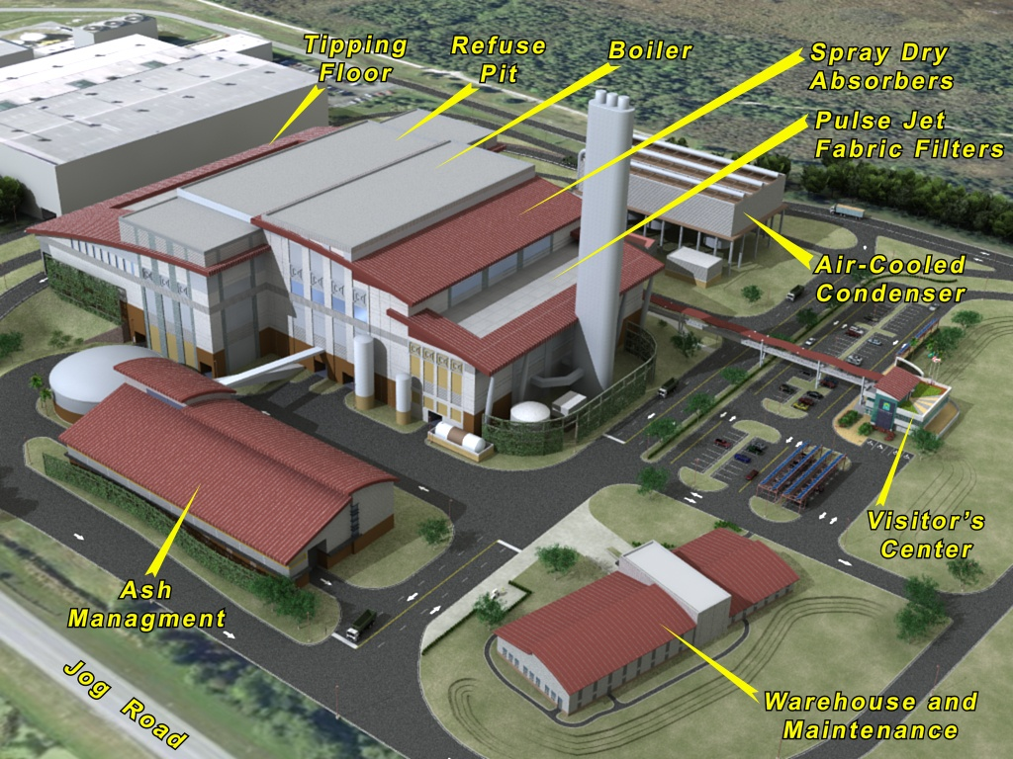
Palm Beach County, Florida (2012)
New 3,000-TPD Massburn WTE Rendering
Incorporating Both Sustainability and Aesthetics
2 MG
Florida Case Studies – Palm Beach County
Notes:
Note the high level of aesthetics for the project, along with the focus on sustainability. The existing 2,000 tpd RDF WTE facility is located in the foreground.

Slide 35
Today’s Presentation
CDM Smith solid waste experience
Current solid waste system
Benefits and Limitations of Waste Conversion Technologies
Waste Conversion Technology Examples
The Long Term – 15 to 20 years in the future
COJ Solid Waste Strategy

Slide 36

My Vision of the Future of WTE and Industry…
Integration of MRFs with WTE facilities
Recycling of ash with other recycled aggregates (crushed concrete, RAP, ceramics, brick, stone, etc.)
Internal use of renewable electricity for powering of water treatment and recycling processes
Biorefinery projects (waste-to-biofuels) including addition of local energy crops
The paradigm of the 21st century shifts from waste management to “Resource Management”
Conclusion
Notes:
Inextricably = Unavoidable; inescapable

Slide 37
Municipal Utility Campus Synergies
Integration of waste-to-energy with
water and wastewater treatment plants
Solid Waste
Excess Electricity to Grid
MRF
WTE
Electricity to
Utility Complex
Sanitary Waste
WWTP
Reclaimed
Water
Reclaimed Water to Grid
Wet Weather
Storage
Potable Water
to Grid
Excess Stormwater
WTP
Wells
Synergistic Opportunities – WTE and Water
Notes:
Sample diagram of a future cascading water recycling process

Slide 38
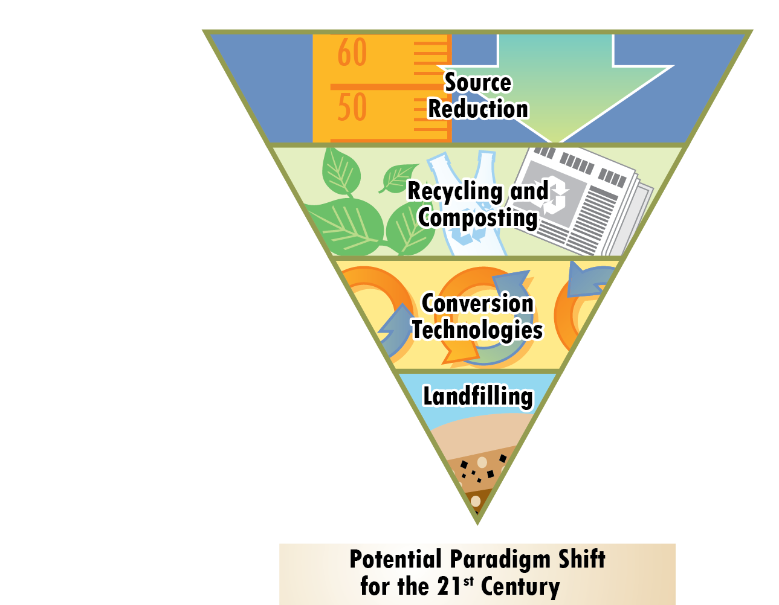
Landfills…Lowest Rung of the ISWM System,
But Prime Sites for Development of Eco-Parks
Reliable supply of feedstock
  MSW, C&D Wastes, Biomass
Proper zoning and buffer
from neighboring developments
Generally have land suitable for development and temporary stockpiling of resources (aggregates, biomass, tires, wood)
LFGTE can also be used for Eco-campus
  Internal use of electricity
  Internal use of biogas for heat (drying of WWTP biosolids)
  Alternate to CNG for powering waste collection fleet
Integrated Solid Waste Management

Slide 39
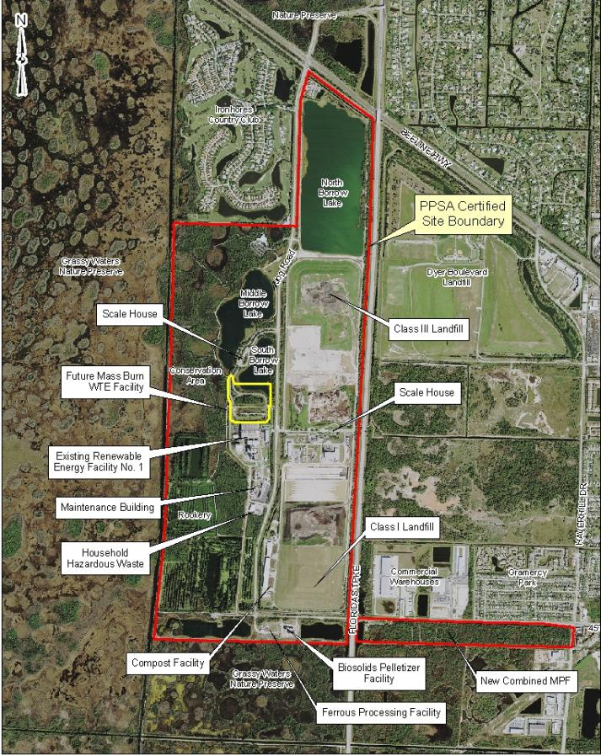
Palm Beach County
Florida ISWM Campus
Florida Case Studies – Palm Beach County
Notes:
The first new WTE facility in the US in the last 16 years has just broken ground in Florida. It will process 3,000 tpd and located on an integrated solid waste management campus, and adjacent to an existing 2,000 tpd RDF WTE facility.

Slide 40
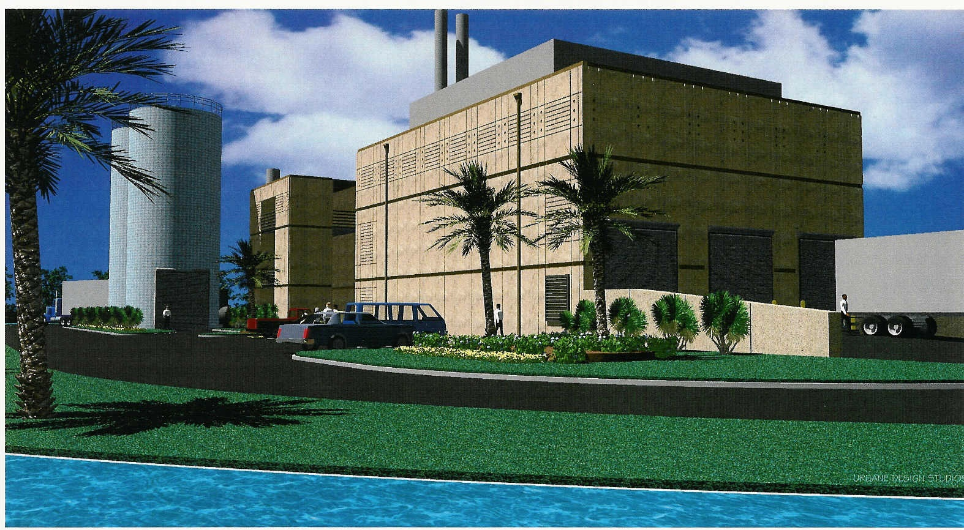
Palm Beach County, Florida
Regional Biosolids Processing Facility
Florida Case Studies – Palm Beach County

Slide 41
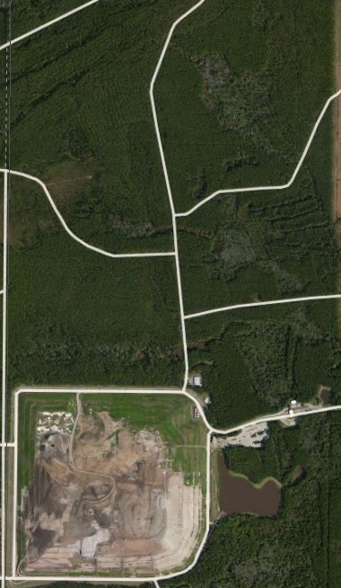
City of Jacksonville
Solid Waste Strategy
Phase 6-8 Landfill Expansion
Permit full landfill expansion
Take advantage of favorable permitting environment
Landfill expansion represents the most impactful land use for permitting purposes

Slide 42
City of Jacksonville
Solid Waste Strategy
Future Technology (WTE)
Landfill
reserved for WTE byproducts
Options are open to modify the permit to accommodate future WTE technology
City evaluated Massburn in 1984 and decided not to pursue it
Other WTE technologies are not ready for commercial scale implementation
Phase 6 Landfill Expansion

Slide 43
Thank You for the Opportunity to Share!
Paul Hauck, P.E.
CDM Smith
1715 N. Westshore Boulevard, Suite 875
Tampa, Florida 33607
(813) 281-2900
hauckpl@cdmsmith.com
We’ll see it, when we believe it!
Conclusion

Slide 44

My Humble Career
BS Mechanical Engineering 1973
Commercial Nuclear Power Industry (17 years)
Waste-to-Energy Industry (23 years)
  Construction
  Research and Marketing
  Consulting (WTE Retrofits, Expansions, O&M)
Public Works Consulting (10 years)
Ethanol Project Development (2 years)
CDM Smith Emerging Waste Conversion Technologies Discipline Leader (5 years)

